Slide 1
NDIS workforce retention
Findings from the NDIS workforce survey
  6.12.2022

Slide 2
BETA Insights
Increase retention of the NDIS workforce by boosting job engagement and decreasing burnout
How we can support workers to stay in the NDIS workforce:
  Current challenge:
  17-25%
  NDIS workforce turnover per annum
  – which means at least 45,900 workers leave the NDIS workforce each year¹.
1. Focus on boosting job engagement and decreasing burnout
2. Support unique needs of sole traders and casual workers
3. Prioritise allied health and disability support workers
Interventions designed to target one or more of the following four areas will have the greatest positive impact on burnout and job engagement:
Managing workload and work hours
Reducing administrative burden and red tape
Improving workplace health and safety practices
Increasing feelings of job value and committed at work
These areas were found to be more important in influencing intentions to stay, compared to pay conditions, career progression or job security.
Sole traders more commonly experienced personally confronting situations, have increased paperwork, higher workloads and lower healthy work practices.
Casual workers felt less committed to their organisation, would prefer to work more hours and are concerned about rostering.
These workers may require a higher level of support or targeted assistance to stay in the sector.
Interventions targeting workers in allied health and disability support roles may have the largest impact on retention.
Allied health professionals had higher levels of paperwork, more experiences of health and safety risk and greater workloads.
Disability support workers more commonly experienced health and safety risks, and were less likely to feel committed to their organisation.
Workers in these roles experience specific challenges that may require additional support.
Why NDIS workers are leaving:
The four main reasons people intend to leave the NDIS workforce:
High workload – 43% of workers feel burned out at least half the time in their job
Concerns about the service quality under the NDIS
High volume of paperwork and NDIS procedures
Negative workplace culture or management issues
1. 0.17 (minimum annual turnover rate) x 270,000 (current number of NDIS workers) = 45,900

Slide 3
Table of contents
Section | Slide number
Executive summary | 3
Project context and design | 5
Experience of the NDIS workforce | 11
Intentions to stay or leave | 12
Job demands | 19
Job resources | 26
Spotlight: Rostering | 31
Spotlight: COVID-19 | 33
Spotlight: NDIS specific challenges | 36
Limitations and next steps | 39
Appendices | 43

Slide 4

Executive summary
BETA conducted a survey to better understand why NDIS workforce turnover rates are high and explore what predicts intentions to leave the NDIS workforce
  BETA surveyed 768 workers in the NDIS workforce from a range of demographic and organizational backgrounds.
  Most respondents (58%) do not plan to leave their current job in the NDIS workforce. However, 21% plan to leave their current job in the next 12 months or sooner, and a further 21% plan to leave in the next 1 – 3 years.
  Of the 42% (314 respondents) who do plan to leave their current job, almost half (48%) intend to leave the NDIS workforce (27% intend to stay and 25% are undecided).
  Some of the main reasons people intend to leave the NDIS workforce included high workload, concerns about the service quality under the NDIS, and the high volume of paperwork or NDIS procedures.
  Statistical modelling found that low levels of burnout and high levels of job engagement are significantly* associated with greater intentions to stay in the NDIS workforce.
  Most respondents had high job engagement, with 65% agreeing they were satisfied with their job and 72% agreeing their job was enjoyable.
  Yet 43% feel burned out at least half the time in their job, including 12% who feel burned out almost always.
  Five barriers (job demands) were significantly associated with higher burnout and/or lower job engagement:
  Facing personally confronting situations at work
  Administrative burden and red tape
  Experiencing health and safety risks
  Having a workload above capacity
  Working more than desired hours
  Job insecurity, experience of discrimination and experience of workplace abuse were not significantly associated with burnout or engagement.
  Three drivers (job resources) were significantly associated with lower burnout and/or higher job engagement:
  Feeling that work was valuable to the community and personally fulfilling
  Having healthy work practices, such as processes in place to take leave
  Feeling committed to their organisation
  A number of other measured resources, such as training satisfaction, opportunities for growth, pay or conditions, relationships with colleagues and supervisors, and working at an organisation with high ethical standards, were not significantly associated with burnout or engagement.
  A spotlight analysis on the impact of COVID-19 found that 52% of respondents felt the pandemic made their work experience worse, but this did not translate into plans to leave the NDIS workforce.
A spotlight analysis found that most respondents were not concerned with rostering practices, such as their hours changing from week to week.
*Statistical significance means that the results are unlikely to be a result of random chance and the p value of a statistical test is small enough to reject the null hypothesis.

Slide 5

Project context and design
What BETA did and why

Slide 6
Project context and scope
The Department of Social Services is interested in understanding the drivers and barriers to retain workers in the NDIS workforce
  Policy background
The NDIS workforce has an annual turnover rate of 17-25%, based on taxation data from 2015-16 – 2017-18. This is notably high compared to the average turnover rate across all sectors (12%) and other similar sectors (e.g., 12% for retail, and 7% for health care and social assistance).
If this turnover rate continues, the NDIS will need 213,000 replacement workers by 2024. In addition, the NDIS workforce will also need to grow by at least an additional 83,000 workers by 2024 to support over 600,000 NDIS participants¹.
  Research scope
BETA partnered with the Markets and Workforce Policy Branch in the Department of Social Services to conduct qualitative and quantitative research on NDIS retention.
The research seeks to understand why worker turnover in the NDIS workforce is high and what predicts intentions to leave the NDIS workforce.
This project explores the experience of workers in the NDIS workforce. The aim is to identify what factors are leading to job engagement or increasing burnout and how this relates to intentions to leave the NDIS workforce.
If behavioural in nature, BETA proposes using the insights from this work to design and test interventions to increase retention and positive experiences in the NDIS workforce.
  Key research questions
  The focus of our research is to answer the following questions:
    Why are workers leaving the NDIS workforce? What influences intentions to leave the workforce, stay in the workforce or retire?
    What are the barriers (job demands) and drivers (job resources) associated with retaining workers in the NDIS workforce?
    What work characteristics are associated with higher intentions to leave the NDIS workforce?
    What intervention/s could be implemented to reduce turnover? How can we support workers to stay in this workforce?
1. Data is based on 2020 Department of Social Services and AlphaBeta analysis of NDIA monthly data.

Slide 7




Research methodology
BETA gathered data from a desktop review, and qualitative and quantitative research
Desktop research
  BETA conducted a literature review to identify common barriers and facilitators affecting worker decisions to remain in the NDIS workforce. The review highlighted key gaps in knowledge including:
  Past research asks about the work environment and intentions to leave, but often the ‘why’ is not clear.
  Little is known about the behavioural and motivational barriers impacting NDIS workforce retention.
  BETA has not found past evidence of a framed field experiment or randomized control trial (RCT) to increase retention in the NDIS workforce.
Interviews
  BETA interviewed NDIS care and support workers who had left the NDIS workforce. The time since leaving the NDIS workforce ranged from ‘currently in the progress of leaving’ to ‘12 months ago’.
  The aim was to establish a foundational understanding of the NDIS and explore why workers were leaving the NDIS workforce. The most common reasons for leaving the NDIS workforce included:
  Complexity of the NDIS system
  Burnout
  Lack of training
  Work instabilities
Survey
  Drawing on the desktop and qualitative research, BETA designed an online survey to dig deeper into the experience of the NDIS workforce.
  The survey had a particular focus on understanding job demands that might contribute to burnout and intentions to leave the NDIS workforce.
  It also focused on understanding job resources that might boost job engagement and intentions to stay in the NDIS workforce.
  See following slides for further details on our survey sample and the results.
Intervention
  Insights from the interviews and survey may be used to design and test intervention/s to better retain current NDIS workers.
  The trial interventions will be scoped after the survey findings have been collated and distributed.
  The intervention design will consider both the perspective of NDIS workers and providers.
Delivered
Delivered
Focus of this report
Next steps

Slide 8
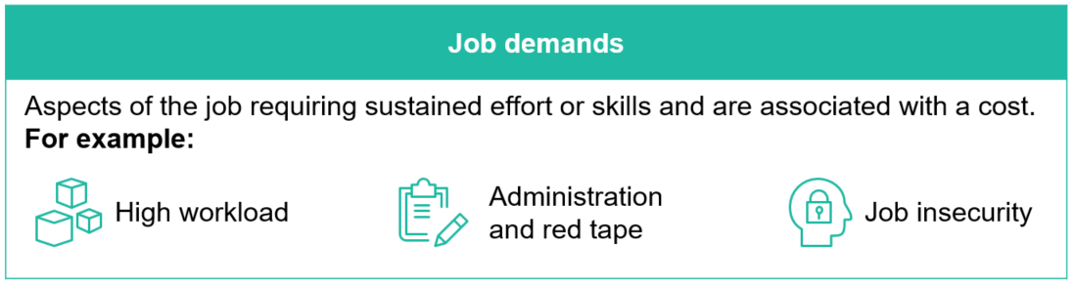


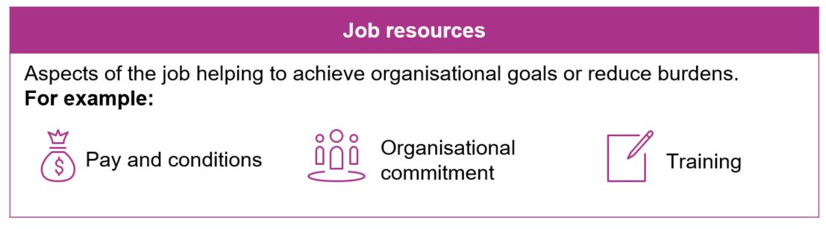

BETA applied an evidence-based model to survey design and analysis
The Job Demands-Resources Model (JD-R model) is well established in organisational psychology¹. It suggests you can predict whether a worker is experiencing burnout or job engagement by understanding the balance between different physical, psychological, social and organisation factors.
These factors can be categorised into two themes:
Job demands are associated with higher levels of burnout and lower job engagement. Job resources protect against burnout and boost job engagement.
In turn, based on the level of burnout or job engagement, this model predicts retention.
That is, when burn out is high and engagement is low people are more likely to intend to leave the NDIS workforce. When burn out is low and engagement is high, people are more likely to intend to stay in the NDIS workforce
Burnout
Intentions to stay or leave the NDIS workforce
Job engagement
Our research:
Determines which job demands and job resources best predict burnout and job engagement in NDIS workers.
Explores if burnout or job engagement is a stronger predictor of intentions to stay or leave the NDIS workforce.
Considers how job demands and job resources are related to intentions to stay or leave the NDIS workforce.
¹ Bakker, A. B., & Demerouti, E. (2007). The job demands‐resources model: State of the art. Journal of managerial psychology.

Slide 9


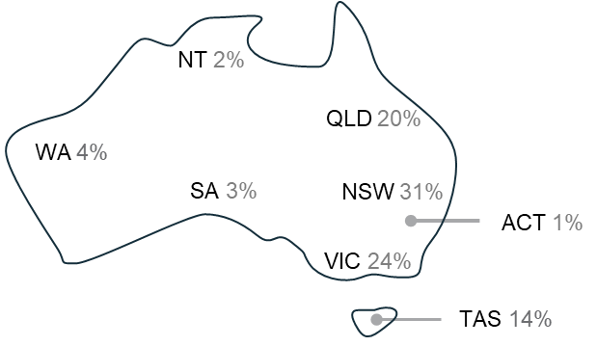





BETA surveyed 768 workers in the NDIS workforce
Survey sample snapshot: Demographics
<30 years | 13%
30-39 years | 21%
40-49 years | 23%
50-59 years | 30%
60+ years | 13%
Year 10 and below | 9%
Year 11/12 | 14%
Trade/Vocational training | 30%
Undergraduate | 25%
Postgraduate | 18%
Female | 73%
Male | 25%
Non-binary | <1%
English | 92%
Other language | 6%
Australia | 78%
Overseas | 19%
Aboriginal and/or Torres Strait Islander | 4%
Not Aboriginal and/or Torres Strait Islander | 93%
Metro | 35%
Regional | 55%
Rural | 7%
Remote/Very Remote | 1%
Note: Excludes prefer not to say therefore, total may not add up to 100%

Slide 10







NDIS workers came from a range of organisational backgrounds
Survey sample snapshot: Work characteristics
Disability support worker | 45%
Allied health professional | 14%
Front line management | 14%
Executive management | 8%
Support coordinator | 6%
Human resources | 3%
Other | 11%
Full time | 46%
Part time | 33%
Fixed Contract | 3%
Casual | 11%
Sole trader | 7%
Employed at one organisation | 87%
Employed at multiple organisations | 6%
Self employed, or sole trader | 7%
Less than 12 months | 9%
1 – 5 years | 39%
6 – 10 years | 18%
11 – 20 years | 18%
More than 20 years | 16%
1 (I work alone) | 3%
2 – 19 | 12%
20 – 49 | 6%
50 – 149 | 11%
150 – 500 | 22%
More than 500 | 30%
Unsure | 16%
Not-for-profit | 64%
Profit | 23%
Public, Government | 3%
Self-employed | 4%
Not sure/Other | 7%
Residential facility/ Specialist disability accommodation | 30%
In-home support | 23%
Community based support | 14%
Support coordination/ Case management | 8%
Day program | 6%
Private practice | 4%
Respite | 2%
Early intervention | 2%
Outreach | 1%
The survey sample does not have a representative portion of casual workers, sole traders or full-time workers.
Please see the limitations section for further details.
*These questions allowed multiple responses. Table displays main response.
Note: Excludes prefer not to say responses therefore, total may not add up to 100%

Slide 11

Experience of the
NDIS workforce
Survey findings exploring factors related to intentions to stay or leave the NDIS workforce

Slide 12

Intentions to stay or leave

Slide 13
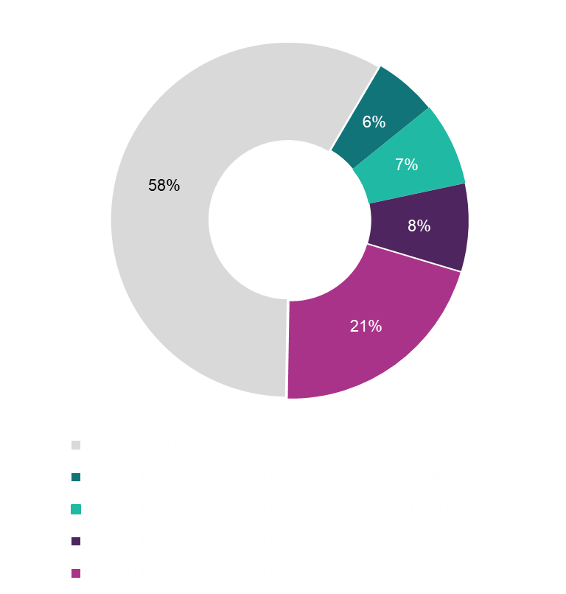
Most NDIS workers do not plan to leave their current job
42% of NDIS workers plan to leave their current job some time within the next 3 years
And the overall experience of working in the NDIS workforce is positive
Of the 42% of respondents who do have plans to leave their current job, half plan to leave some time in the next 12 months (21%) and half plan to leave in the next 1 to 3 years (21%). An annual turnover rate of 21% is consist with past estimates and is high compared to all sectors (12%) and other similar sectors (e.g., 7% for health care and social assistance)¹. However, a desire to change jobs around 3 years since commencing may reflect the general career cycle and tenure of workers, rather than issues with their current job. On average, Australian employee’s change jobs 12 times throughout their life and have an average tenure of 3.3 years.²
Allied health professionals were slightly more likely to have plans to leave their current job some time in the next 12 months (30%) compared to disability support workers (20%), executive management (13%) and front line management roles (21%).
Respondents on part-time or casual contracts were more likely to have plans to leave their current job in the next 12 months (24% and 25% respectively), compared to sole traders (12%) and full-time workers (18%).
71% of respondents reported they had a positive experience working in the NDIS workforce
Allied health professionals and fixed contract workers were the most likely to report a negative experience in the NDIS workforce
^{1.} Department of Social Services, 2021. NDIS National Workforce Plan: 2021-2025; 2. Australian Institute of Business (2018), Changing Jobs – How often is too Often? <https://www.aib.edu.au/blog/career-development/changing-jobs-how-often-is-too-often/>

Slide 14

Of the NDIS workers who do plan to leave their current job, about 1 in 2 intend to leave the NDIS workforce
Only 25% of respondents who plan to leave their current job want to pursue another job in the NDIS workforce straight away
Leave the NDIS workforce | 48%
Pursue a job outside the care and support sector | 22%
Pursue a job in the wider care and support sector | 11%
Retire | 13%
Pursuing further education or temporarily leaving workforce e.g. maternity leave or travel (no intention to return to the sector) | 2%
Respondents who intend to stay in the NDIS workforce were more likely to be currently employed full-time, whereas a greater number of respondents intending to leave the NDIS workforce were casual workers.
More than 1 in 4 (28%) respondents who had been in the NDIS workforce for less than 1 year are planning to leave the NDIS workforce. 2 in 5 (43%) respondents who had been working in the NDIS workforce for more than 20 years are planning to leave the sector, which includes people intending to retire. Half of the respondents aged 60 years and over intend to leave the NDIS workforce.
32% respondents in metro areas had plans to leave the NDIS workforce, compared to 38% of respondents in rural areas.
Stay in the NDIS workforce | 27%
Pursue another job within the disability sector | 25%
Pursuing further education or temporarily leaving workforce e.g. maternity leave or travel (with intention to return to the sector) | 1%
25% of respondents intending to leave their current job indicated that they have not yet decided what they will do after leaving. This could be a key cohort that can be recaptured into the NDIS workforce with the right intervention.
Undecided | 25%
Base n=314
Notes:
Notes in case we are asked about overall numbers: (this sample includes a few people who didn’t answer ‘do you intend to leave your current job’ but did answer ‘what are your plans after you leave your current job’ so be cautious).
Stay in job: 57%
Leave job, leave workforce: 21%
Pursue job in wider care/support sector: 5%
Pursue job outside of care/support sector: 9%
Retire: 5%
Temporarily leaving, no intent to return: 1%
Leave job, stay in workforce: 11%
Pursue another job within disability sector: 10%
Temporarily leaving, intent to return: 1%
Leave job, undecided: 11%

Slide 15
The most common reason workers want to leave the NDIS workforce is high workload
Issues with NDIS service quality and procedures, negative workplace culture and low satisfaction with pay and/or benefits were also endorsed by more than 1 in 3 respondents as potential reasons for leaving the NDIS workforce
Reasons for leaving the NDIS workforce | Select all that apply | Select one
Workload is too high | 42% | 12%
Concerns about the service quality under NDIS | 41% | 13%
Paperwork or NDIS procedures | 41% | 11%
Negative workplace culture or management issues | 32% | 13%
The pay and/or benefits | 31% | 10%
Risk to my health, safety and/or wellbeing | 29% | 4%
Lack of learning or career progression opportunities | 24% | 6%
The rostering and/or work hours | 20% | 3%
Job insecurity | 14% | 3%
Personal reasons e.g. study, family responsibilities | 13% | 5%
Poor induction/ training experience | 8% | 1%
COVID-19 requirements (e.g. vaccination mandate, PPE, quarantine) | 8% | 2%
I saw the disability sector as a temporary career choice | 5% | 2%
Disability work is not what I thought it would be | 4% | -
Other | 17% | 16%
Respondents who plan to leave their job and either wanted to leave the NDIS workforce or were undecided, were asked to select all the main reasons why they would want to leave the NDIS workforce. The most commonly reported reason was high workload (42%), which could be related to the current workforce shortage and high demand for services.
Around 41% of respondents would leave the NDIS workforce due to concerns about the service quality under NDIS and due to the nature of the paperwork or NDIS procedures. Negative workplace culture or management issues were also indicated as a main reason for respondents wanting to leave the NDIS workforce.
As only 5% of respondents indicated that the one main reason for leaving was due to personal reasons, such as family responsibilities, it appears that turnover is more related to issues in the work environment than personal situations.
Respondents also wrote that burn out or stress, challenges with NDIS requirements, a lack of organisational professionalism or a lack of recognition were other reasons for wanting to leave the NDIS workforce.
“Not happy with how I've been treated, after giving my all for eleven years I think I deserve better.”
Note: Total does not add to 100% as respondents may have mentioned multiple themes.
The sample includes workers who want to leave their job and a) plan to leave the NDIS workforce or b) are undecided about leaving the NDIS workforce.
Base: n=191
Notes:
Change working for ‘leave and undecided’

Slide 16
For those who want to stay in the NDIS workforce, the main reason is the nature of care and support work
Respondents mostly commonly reported that the nature of the work (65%) and positive impact it has on people or the community (63%) are key reasons for staying in the NDIS workforce
Reasons for staying in the NDIS workforce | Select all that apply | Select one
Nature of the work (e.g. interesting, enjoyable, challenging) | 65% | 21%
Positive impact on people or the community | 63% | 21%
Utilises my skills and knowledge | 55% | 8%
The relationship I have established with the clients | 53% | 12%
Opportunity to build relationships and interact with people | 42% | 3%
Flexibility of work hours (e.g. weekly rostering) | 36% | 4%
Positive workplace culture | 35% | 3%
Job security | 34% | 9%
Learning or career progression opportunities | 30% | 6%
The pay and/or benefits | 27% | 6%
Relationships with colleagues | 20% | 1%
There is a high demand for disability workers | 19% | 2%
Lack of suitable alternative job prospects | 6% | 2%
Other | 3% | 2%
Established relationships with clients (53%) and the opportunity to build relationships and interact with people (42%) were also highly endorsed reasons to stay in the NDIS workforce.
Respondents also reported a number of reasons related to the organisation they work for. This included flexibility of work hours (36%), positive workplace culture (35%), learning and career progression (30%), pay and benefits (27%) and relationships with colleagues (20%).
Having already developed expertise in the field, career aspirations and wanting positive outcomes for participants were other reasons respondents wrote about.
“I am a specialist in my field and it is important that the community can access me and that I continue to grow my knowledge”
“I want to move up to management if the opportunity arises!!”
Note: Total does not add to 100% as respondents may have mentioned multiple themes
Base: n=512

Slide 17
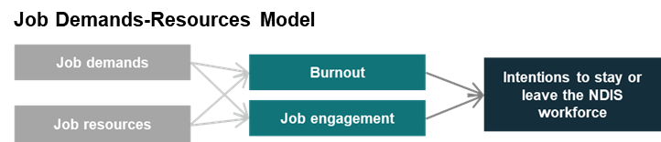





Low levels of burnout and high job engagement are associated with intentions to stay in the NDIS workforce
The modelling showed that job engagement was the strongest predictor of intentions to stay or leave in the NDIS workforce
BETA found that these job experiences were significantly associated with intentions to stay or leave the NDIS workforce:
Job engagement had a positive relationship with intentions, where greater engagement increased the likelihood that someone intends to stay in the NDIS workforce.
Burnout has a significant negative relationship with intentions, where higher levels of job burnout decreased the likelihood that someone will intend to stay in the NDIS workforce.
Note: Intentions: 1 = intention to stay, 0 = intention to leave, retire or undecided

Slide 18
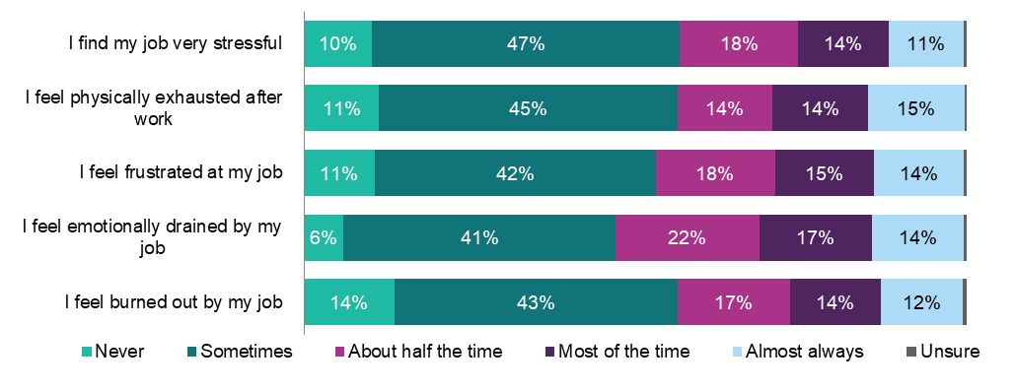
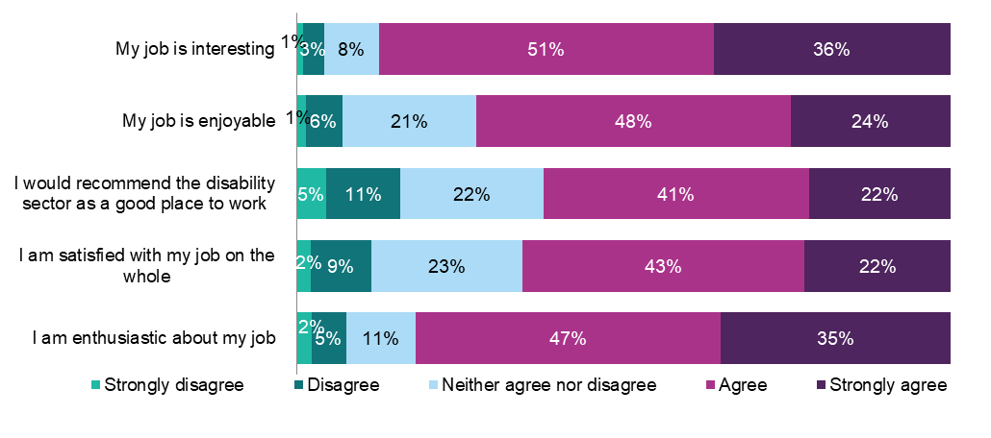
Most NDIS workers feel both burned out and engaged
43% of respondents feel burned out at least half the time, including 12% who feel burned out almost always
About one third of respondents indicated feeling emotionally drained (31%), physically exhausted (29%) and frustrated (29%) in their jobs most of the time or almost always. This highlights the demanding nature of roles in the NDIS workforce.
Allied health professionals reported the highest level of overall burnout and the lowest level of job engagement compared to other roles in the NDIS workforce.
Over 65% of respondents were satisfied with their job
The majority of respondents reported they agreed or strongly agreed that their job was interesting (87%), they were enthusiastic about their job (82%) and their job was enjoyable (72%). People who work alone reported, on average, higher engagement than people who work with two or more people.
Yet 16% of respondents reported they would not recommend the NDIS workforce as a good place to work.
Base: n=742-744
As burnout and job engagement have a moderate correlation, it is possible for NDIS workers to feel both simultaneously, or one but not the other
As high burnout and low job engagement are significantly related to intentions to leave the NDIS workforce, it might be necessary to target both in order to retain workers.
Base: n=746-751

Slide 19

Job demands
Job demands are aspects of the job that require sustained effort or skills and are associated with a cost of some sort.
Here the report identifies 5 job demands associated with increased burnout and diminished job engagement in NDIS workers.
Then we discuss the prevalence of these different demands and how they relate to workers’ intention to stay or leave the NDIS workforce.

Slide 20
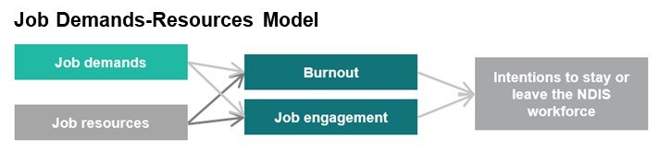












BETA identified which job demands are associated with high burnout and low job engagement
Job demands are aspects of the job that require sustained effort or skills and are associated with a cost of some sort. | BETA applied statistical modelling to understand which job demands are related to burnout and to job engagement.
BETA found these five job demands were associated with increased burnout, decreased job engagement, or both:
BETA did not find a statistically significant relationship between these three job demands and burnout/job engagement:
All coefficients had a p value of 0.001 or less except for Working more than desired hours, which had a p value of 0.037. Although this is still considered significant (p < 0.05), multiple measures were tested in the given study. If the p values were adjusted to be more conservative (to correct for multiple testing), Working more than desired hours could be considered non-significant. As such, the results should be interpreted with caution.

Slide 21

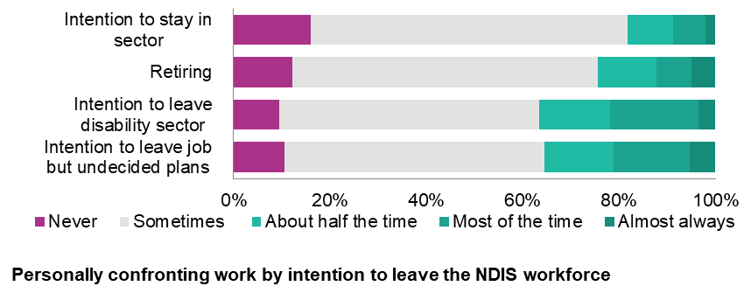

The emotional demands of NDIS work are high
Regularly experiencing personally confronting situations is linked to high levels of burnout
Most respondents (86%) reported they are confronted with things that affect them personally at work, at least some of the time. This includes 12% who reported their work includes personally confronting situations most of the time or almost always.
Out of all the job demands investigated, dealing with personally confronting situations had the strongest association with burnout.
Regular experiences of personally confronting work is related to intentions to leave the NDIS workforce
People who intend to leave the NDIS workforce report being confronted with things that affect them personally more than those that intend to stay.
37% of respondents who had intentions to leave the NDIS workforce reported being confronted with things that affect them personally about half the time or more frequently. This is compared to 18% of those who intend to stay in the NDIS workforce.
Who is impacted?
Casual workers were the least likely to report regularly being confronted with things that affect them personally: 23% reported ‘never’, compared to 14% of full-time workers, and 2% of sole traders.
A quarter (25%) of sole traders reported experiencing personally confronting work most of the time or almost all the time. This is 2.3 times greater than full-time, 2.8 times greater than casual workers, and 1.8 times greater than part-time workers.
Around one in five (19%) respondents working in a for profit organisation reported being confronted with things that affect them personally most of the time or almost all the time, compared to only one in eleven (9%) respondents working in the not for profit sector.
Base: n=716

Slide 22

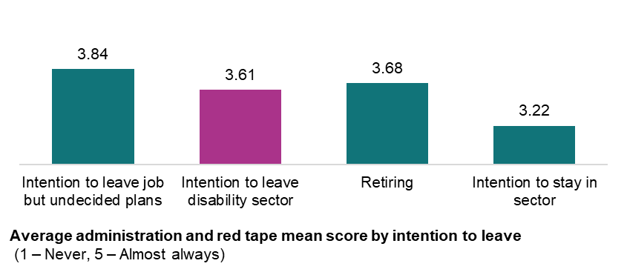
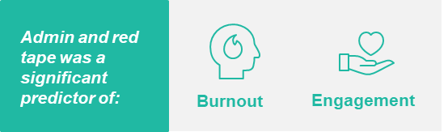
Administrative burden is a common barrier
Many NDIS workers reported having too much paperwork or being blocked by red tape
1 in 2 respondents agreed or strongly agreed that they have too much paperwork. Almost half (46%) of respondents reported that their ability to do a good job is blocked by red tape.
Moreover, 31% of respondents report regularly not getting paid for doing administration or paperwork.
Greater administrative burden relates to higher burnout and lower engagement
People who intend to leave the NDIS workforce reported having higher levels of administration and red tape in their jobs.
Those who had plans to leave their job but are undecided about whether to leave the NDIS workforce reported the highest levels of administration, compared to those with intentions to stay.
Who is impacted?
Three quarters of sole traders reported having too much paperwork (75%), and having their efforts blocked by red tape (77%). This is compared to 20% of casual workers who have too much paperwork and 28% who feel blocked by red tape.
Allied health professionals reported having the highest volume of paperwork (77%), followed by executive management (67%). Disability support workers (39%) and support coordinators (47%) reported the lowest levels of paperwork.
Base: n=704

Slide 23

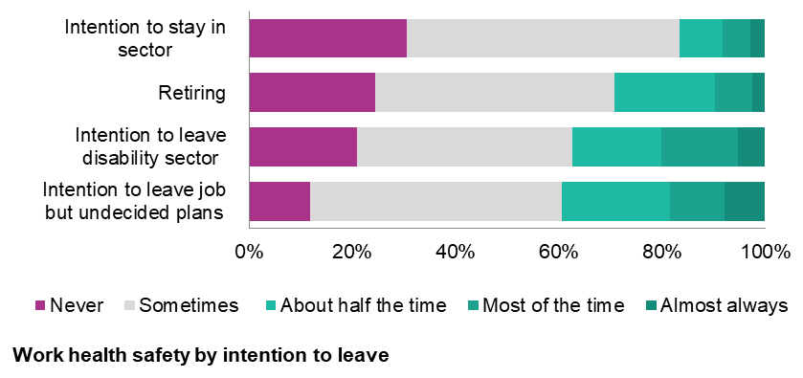

NDIS workers feel their heath and safety is sometimes at risk
More frequent feelings of risk to work health and safety are linked to higher levels of burnout
3 in 4 respondents (73%) reported that their health and safety is at risk working in their job, at least some of the time.
This includes 11% who reported their health and safety is at risk most of the time or almost always.
Risk to work health and safety was related to greater intention to leave the NDIS workforce
More frequent feelings of WHS risk are linked to peoples’ plans to leave the NDIS workforce.
31% of people who ‘never’ think their heath and safety is at risk are intending to stay in the NDIS workforce, compared to 21% in those who intend to leave the NDIS workforce, and 12% planning to leave their job but with undecided plans.
Who is impacted?
A third of full-time NDIS workers reported ‘never’ thinking their health and safety was at risk. This is compared to 25% of casuals, 19% of part-time respondents and 19% of sole-traders.
Allied heath professionals (26%) and disability support workers (27%) were more likely to report their health and safety was at risk half the time or more.
1 in 2 executive management workers reported never experiencing risk to their health and safety.
There did not seem to be a notable difference in work health safety risk between private and not-for profit organisations.
Base: n=717

Slide 24

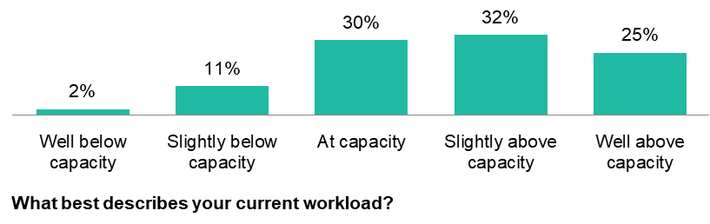
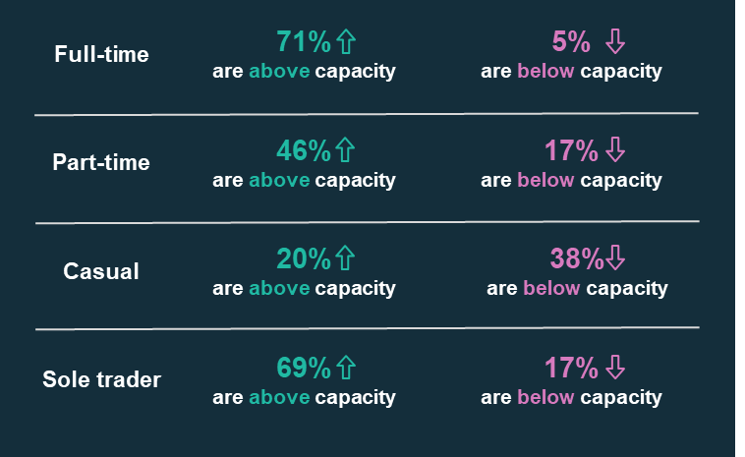

Most respondents had a workload above their capacity
86% of respondents reported their workload was either at capacity or above capacity in their current roles. This is associated with higher likelihood of burnout. Only 14% indicated they did not have enough work or were available for more work.
Those who have plans to leave their current job but are undecided about leaving the NDIS workforce (65%), those retiring (61%), as well as those intending to leave the NDIS workforce (58%) were more likely to report being above capacity. This is compared to those who intend to stay in the NDIS workforce (54%).
Who is impacted?
84% of executive management, 83% frontline management and 71% of allied health professionals reported being above capacity.
This is compared to 53% of support coordinators, and 38% of disability support workers who were above capacity.
There was variation in capacity between employment contracts:
Base: n=729

Slide 25
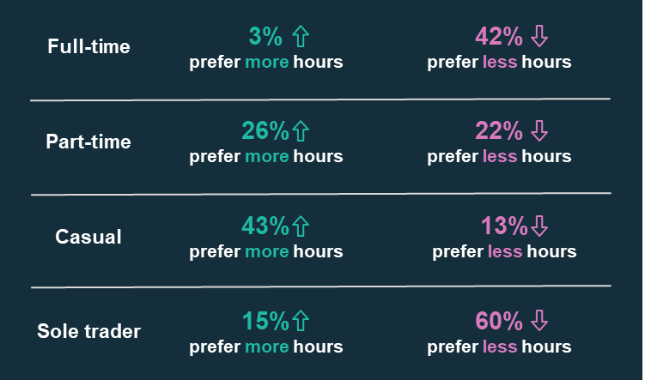
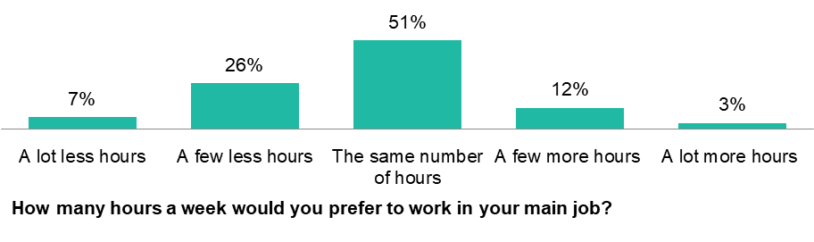
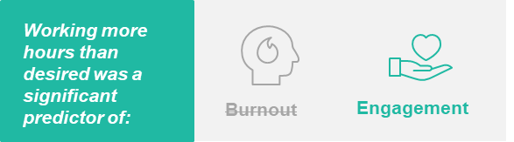
Most respondents are happy with the number of hours they work
Almost 1 in 2 respondents reported working between 36 to 45 paid hours a week (with a median of 37.5 paid hours).
Most NDIS workers want the same number of hours (51%) they currently work.
Working more hours than you desire is associated with lower job engagement. A third (33%) of respondents would like a few less or a lot less hours than they currently work.
A larger proportion of respondents planning to leave their job (44%) or the NDIS workforce (42%) reported wanting to work less hours, compared to those intending to stay in the NDIS workforce (28%).
Who is impacted?
Half of allied health workers, executive management and front line management would prefer to work less hours.
Almost 3 in 10 disability support workers would prefer more hours.
Number of hours preferred differed depending on the employment contract:
Base: n=729

Slide 26

Job resources
Job resources are aspects of the job that help to achieve organisational goals or reduce burdens.
Here the report identifies 3 job resources associated with protecting against burnout and boosting job engagement in NDIS workers.
Then we discuss the prevalence of these different resources and how they relate to workers’ intention to stay or leave the NDIS workforce.

Slide 27
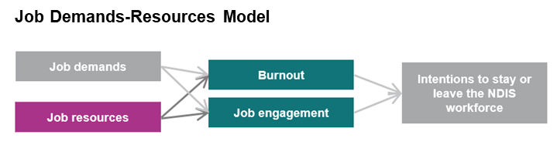
















BETA identified which job resources are associated with low burnout and high job engagement
Job resources are aspects of the job that help to achieve organisational goals or reduce burdens. | BETA applied statistical modelling to understand which job resources are related to burnout and to job engagement
BETA found that these three job resources were significantly associated with lower burnout, higher job engagement, or both:
There were many job resources which did not have a statistically significant relationship with burnout or job engagement:

Slide 28


Not all NDIS workers feel they have healthy work practices
Most NDIS workers are satisfied with their work life balance, but not all share the same experience
Who is impacted?
49% of respondents are satisfied with the work practices in place to help manage mental and physical health.
However, many organisations do not appear to have adequate practices in place to satisfy their workers. A quarter (25%) of respondents disagreed that they were satisfied with the work practices in place to manage mental and physical wellbeing.
51% of respondents reported having a healthy balance between work and personal life, but 28% of respondents indicated that they did not.
Similarly, 55% of respondents agreed that there are processes in place so they can take leave, but 22% disagreed.
Having a combination of healthy work practices (organisational practices to manage mental and physical health, work life balance and processes to take leave) was related to lower levels of burnout and greater job engagement.
Sole traders and those self employed reported lower levels of healthy work practices.
Those working in executive management were the most likely to disagree that they had a healthy work life balance (42%), however, were most likely to agree that they were satisfied with the work practices in place to help manage mental and physical wellbeing (60%).
Disability support workers and support coordinators report having a healthy balance between work and personal life, compared to other roles.
Healthy work practices varied by intentions to leave
Respondents who intend to leave the NDIS workforce reported fewer healthy work practices.
Respondents intending to retire had similar levels of healthy work practices compared to those with intentions to stay
Average healthy work practices score by intention to leave
(1 – Never, 5 – Almost always)
Base: n=684

Slide 29

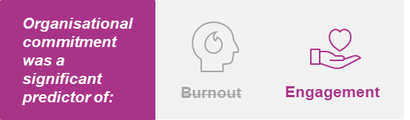
Most NDIS workers feel committed to their organisation
When NDIS workers have strong organisational commitment, intentions to stay are higher
64% of respondents feel committed to their organisation, with only 15% of respondents indicating they disagree.
When asked about the organisations values, 72% of respondents agreed or strongly agreed that the organisations they current work for has values that aligned well with their own values.
This suggests that there is high organisational and personal fit in the current sample, as organisational values and personal values are well matched.
Who is impacted?
Respondents on part-time or casual contracts were the least likely to feel committed to their organisation, or agree that the organisations values align with their own.
Just over half (53%) of disability support workers feel committed to their organisation, compared to 69% of allied health workers or front line management, 84% of executive management and 78% of support coordinators.
60% of disability support workers agree their values align with their organisation. This is compared to 79% of allied health workers, 82% of executive or frontline management, and 85% of support coordinators.
Not surprisingly, respondents who were self-employed were more likely to strongly agree to feeling committed to their organisation, compared to respondents employed in other organisation types.
Organisational commitment is related to intentions to stay in the NDIS workforce
Respondents who intend to leave the NDIS workforce or retire have lower levels of commitment to their organisation compared to those who intend to stay.
Average commitment to organisation score by intention to leave (1 – Strongly disagree, 5 – Strongly agree)
Base: n=676

Slide 30


Job value in the NDIS workforce is very high
And when NDIS workers feel their jobs provide value, they intend to stay in the NDIS workforce
Who is impacted?
Sole traders were more likely to agree that they find the work personally fulfilling, however were less likely to agree that people think highly of disability support workers compared to other employment types. There were no other notable differences across employment types.
Support coordinators were also more likely to agree that people think highly of disability support workers, compared to other roles. Allied health professionals and executive management are more likely to disagree with this statement.
88% agree that working in the NDIS workforce provides a valuable contribution to the community.
81% of respondents agree they find the work personally fulfilling.
80% are proud to work in the NDIS workforce and 83% believe their work makes a difference for people living with disability.
While respondents see the significant value their job in the NDIS workforce adds to society, many respondents do not believe that this is recognised by the greater community.
30% of respondents disagreed with the statement ‘I believe people think highly of disability support workers’. 32% neither agreed or disagreed with the statement.
Out of all the job resources investigated, job value had the strongest association with job engagement.
Greater value placed on the job seems to be related to intentions to stay
Respondents who are planning to stay in the NDIS workforce reported much higher levels of value on their job, compared to those who intend to leave the NDIS workforce
Not surprisingly, respondents intending to leave the NDIS workforce have the lowest levels of value placed on their job, followed by those leaving their job but undecided about leaving the sector.
Average job value score by intention to leave
(1 – Very undervalued, 5 – Very valued)
Base: n=752

Slide 31

Spotlight: Rostering

Slide 32
In general, rostering issues were not a concern, but most people reported working outside their rostered hours
In general, respondents were not concerned with the rostering in their current jobs
Expectations to work outside rostered hours or come into work at short notice varied across employment type
BETA looked at part-time, casual, sole trader, self-employed and independent contractors’ responses, to understand their rostering concerns. The analysis found that most respondents were not concerned with hours changing week to week, not getting enough notice of shift times, or not getting preferred shifts.
1 in 2 (47%) respondents reported that their employers expect them to work outside of rostered hours to meet job demands on a weekly basis. A further 24% indicated that it occurred on a monthly basis.
Similarly, 69% of sole traders and 47% of part-time workers worked outside rostered hours to meet job demands on a weekly basis, compared to 35% of casual workers.
1 in 3 respondents were requested weekly to come into work at short notice, but 1 in 4 reported that this almost never or never happens.
For casual workers, 44% reported requests to come into work at short notice on a weekly basis. In contrast, 30% of part time workers and 33% of sole traders were requested to come into work at short notice on a weekly basis.
Casual workers were more concerned about rostering. 1 in 3 casual worker respondents were moderately or very concerned about their hours changing week to week, compared to 1 in 5 part-time respondents. Similarly, 1 in 3 casual respondents reported not getting enough notice of shift changes compared to 1 in 6 part-time respondents.
Base: n=397, excludes full-time workers
Note: Excludes full-time workers

Slide 33

Spotlight: COVID-19

Slide 34

NDIS workers feel the pandemic negatively impacted their work
52% of respondents reported the COVID-19 pandemic made their work experience worse
Reasons why COVID-19 made their work experience worse
The majority of respondents who reported the pandemic negatively impacted their work indicated that it created more stress (81%), made it more difficult to provide support to NDIS participants (67%), it increased their workload (66%) and complying with COVID-19 requirements was inconvenient (59%).
Other negative impacts commented by respondents include fears about being exposed to COVID-19, dealing with NDIS participants who were also experiencing negative impacts, and changes to NDIS procedures.
31% felt COVID-19 made no difference to their work experience
Base: Respondents who had a worse work experience due to COVID-19, n=351
Reasons why COVID-19 made their work experience better
16% of respondents reported the COVID-19 pandemic made their work experience better
Of those who reported a better work experience, almost half indicated that it was due to strengthened relationships (46%). This could include relationships with colleagues, NDIS participants or the greater community. 41% of respondents reported that COVID-19 made their work experience better by increasing their workload, suggesting previous underutilisation.
Other reasons why the pandemic made work better for survey respondents was due to the ability to work remotely, reduced travel commitments and other flexible working arrangements.
Base: Respondents who had a better work experience due to COVID-19, n=111
Note: Total does not add to 100% as respondents may have mentioned multiple themes

Slide 35
COVID-19 caused a range of concerns, but it did not translate into intentions to leave
Respondents were mostly concerned about transmitting COVID-19 to NDIS participants or colleagues
Due to COVID-19, many restrictions and guidelines were implemented including lockdowns, travel restrictions and health requirements. This resulted in many challenges for individuals, particularly those in the care and support sectors. 41% of respondents reported being moderately or very concerned about losing all or part of their income due to COVID-19.
24% of respondents were very concerned about contracting COVID-19 during work, however 40% of respondents were very concerned about transmitting COVID-19 to NDIS participants or colleagues.
The broader health and care sector have also been subject to stricter health measures at work, such as PPE and vaccination compared to many other sectors. While many were not concerned about complying to these regulations, 40% were either moderately or very concerned. Being pressured by employers to work against health advice was not a common experience.
The pandemic has not impacted on intentions to stay or leave the NDIS workforce
Base: n=676-677
For the majority of respondents (85%), COVID-19 has not impacted their intentions to stay or leave the NDIS workforce. Only 8% of respondents that were planning to stay in the NDIS workforce, reported they will now leave or retire. But 2% also reported they were intending to leave or retire, but will now stay in the NDIS workforce.
Some respondents mentioned they are undecided about whether they will stay or not, with a few commenting that if more vaccinations or boosters are required, they might leave the NDIS workforce.
Base: n=669

Slide 36

Spotlight: NDIS specific challenges

Slide 37
The open ended response provides further insight into the challenges of working in the NDIS workforce
Survey respondents were given the opportunity to comment on any additional challenges of working in the NDIS workforce
The most commonly reported challenges related to the NDIS systems and funding, such as the complex nature of the program, administrative requirements and lack of funding (see next slide for details).
Staff shortages were a key challenge in the NDIS workforce. Respondents reflected on issues with recruiting workers with the appropriate skills and qualifications. This includes concerns with management staff not having a background in support services or understanding issues related to the NDIS workforce, causing problems within the organisation.
Another common challenge was the high workload resulting in inefficiencies in their role. This included administrative requirements and regulatory burden of the work, where processes were not streamlined.
Some respondents had issues around pay. This included not getting an adequate hourly wage, not being reimbursed for travel time and feeling like responsibility outweighed financial incentives. In addition, some respondents also believe there is a lack of recognition from government around the value that disability support workers provide to the community. They reflected nurses and other frontline workers during COVID-19 received a bonus for their work, which was not extended to the NDIS workforce.
“Management with no disability experience. Being rostered on with clients with needs that I haven't trained in. Working with clients without proper training resulting in an injury with long term impacts.”
“In general the work force is under paid with high expectations and responsibilities from stakeholders.”
Base: n=314
Note: Total does not add to 100% as respondents may have mentioned multiple themes

Slide 38



Challenges around NDIS systems and funding was the most commonly mentioned issue
Responses about NDIS systems and funding can be grouped into three main themes
Respondents commonly mentioned the challenges of navigating the NDIS system. This included managing policy and pricing changes, restrictive practice and limitations of the guidelines, lack of transparency in the process and long approval times. This can make it challenging for workers to support NDIS participants and manage their expectations.
Respondents reported that the NDIS does not provide enough funding and has reducing funding, resulting in participants needs not being fully met. Respondents commented that worker salaries and compliance costs are increasing but NDIS funding is not.
Changes to price guides with limited communication and support has resulted in frustrations with workers.
The complicated NDIS environment has reportedly resulted in worse outcomes for participants due to the regulatory requirements, limited funding and changing guidelines. Some respondents perceive that since the introduction of the NDIS, the NDIS workforce has become billing focused rather than people focused.
Respondents commented that NDIS participants have been cut off from funding or are not able to receive support due to long response times.
“Constantly changing regulations and information makes it really hard to support people, and it gets frustrating for everyone not knowing whether they will be able to access the supports they need when required because the NDIS changes the parameters again.”
“The insecurity of [them] constantly changing the price guide and rules is by far the most stressful part of my role.”
“Too many times I’ve seen people slip [sic] through the cracks because of red tape bureaucracy and paper pushers waiting to the last minute. Causing severe [sic] mental health declines and attempts at life.”
“The NDIS do not provide enough funds to support participants to achieve their goals - particularly in psychology. They disregard the impact of disability on someone's mental health.”
“Extremely frustrated with the current NDIS communication system.”
“I feel the NDIS has changed the level of support and speed of getting provider services to clients. I feel there are more road blocks in providing quality, timely support to clients.”

Slide 39

Limitations and next steps

Slide 40
Limitations
BETA designed our survey to understand the factors leading to workers leaving the NDIS workforce. Like any research, our studies have limitations that should be considered when assessing the results.
A follow-up survey will be launched in 2023 to measure how many respondents left the NDIS workforce since the initial survey.
This will allow us to measure if intention to leave was a good predictor of behaviour.
Around 3 in 5 respondents indicated they would like to participate in the follow-up survey.
Survey sample
Number of predictors
Intention vs Action
Reliability of self reports
The survey sample was recruited through Boosting the Local Care Workforce (BLCW) existing channels with NDIS providers.
In 2020, the NDIS workforce consisted of 270,000 workers¹. In total, the survey collected 768 responses. While this is a large, diverse sample, it is not truly representative of the NDIS workforce. In particular, it only includes people who are online and willing to participate.
The sample also had a low percentage of casual workers (11%) and sole traders (7%), and a high percentage of full time workers (33%) compared to the percentage of casual workers (34%)², sole traders (28%)³ and fulltime workers (13%)⁴ in the NDIS workforce. This may limit generalizability.
As our model included a lot of job demand and job resource predictors, there were a large number of model parameters.
Although the parameter to sample size ratio was acceptable, it is possible the model was unable to detect smaller effects.
In order to increase our confidence in the significance testing, we used a backwards estimation method to arrive at the final model. This method can introduce statistical bias, such as inflated coefficients.
Future research could collect a larger sample so backwards elimination is not necessary.
The survey mostly assessed intentions. It is widely recognized that intentions alone do not necessarily lead to action – this is known as the ‘intention-action’ gap.
Nonetheless, intentions are a necessary precursor to action so the analysis typically assume that an increase in intentions will lead to some (smaller) increase in action.
In addition, the survey asked respondents to reflect on their experiences and attitudes about working in the NDIS workforce to better inform the drivers to intention.
At several points in our surveys, respondents were asked about their experience of working in the NDIS workforce. While these 'self-reports' are often a useful guide, sometimes they may be misleading.
For example, when people are in a reflective state (as with a survey experiment) they often prefer more information and detail. In a busy, real-world setting, greater levels of details sometimes lead to inaction.
1. DSS Workforce Policy: Workforce statistics as of 16 Nov 2022. 2. Department of Social Services, 2021. NDIS National Workforce Plan: 2021-2015; 3. Market Analytics Team DSS – from Qtr 1 FY 2021-22. 4. NDS, 2021, State of Disability Support Sector Report 2021,
.

Slide 41





Next steps: Intervention
Based on the qualitative and quantitative findings, BETA will design an intervention in partnership with DSS to address retention issues in the NDIS workforce.
BETA will present a preliminary intervention design at the NDIS Workforce Industry Reference Group, to gain insights from NDIS providers.
BETA will design, launch and analyse the follow-up survey findings.
Once BETA and DSS agree on an intervention, BETA will progress an ethics application and design intervention materials.
BETA will implement and evaluate the intervention and publish a report on the findings.
December 2022

Slide 43
Appendices
Full sample responses to all survey questions

Slide 44
Survey Demographics
Role (Select all that apply)*
Disability support worker | 48%
Support coordinator | 9%
Human resources | 4%
Front line management | 16%
Executive management | 10%
Allied health professional/assistant | 16%
Other | 12%
Time in current job
Less than 1 month | 1%
1 - 5 months | 8%
6 - 11 months | 9%
1 - 5 years | 53%
6 - 10 years | 16%
11 - 20 years | 9%
More than 20 years | 4%
Disability
Yes | 12%
No | 85%
Prefer not to answer | 3%
Carer
Yes | 58%
No | 40%
Prefer not to answer | 2%
Base: n=669
Question: Do you have a disability?
Base: n=669
Question: Do you have any caring responsibilities outside of work? (e.g., for children, person with disability, or elderly parents)
Base: n=767
Question: What is your role in the disability sector?
Base n=764
Question: How long have you worked at your current place of employment?
Setting (Select all that apply)*
Residential facility/ Specialists Disability Accommodation/ Supported Independent Living facilities | 41%
In-home support | 44%
Day programs | 22%
Community based support | 38%
Support coordination/ Case management | 14%
Outreach | 5%
Respite | 13%
Early intervention | 10%
Private practice/ Outpatients clinics | 8%
Hospitals | 3%
Other | 13%
Average hours per week
No. of hours | Paid | Unpaid
0 | - | 49%
1-5 | 1% | 24%
6-10 | 3% | 15%
11-15 | 2% | 5%
16-25 | 14% | 4%
26-35 | 24% | 1%
36-45 | 49% | 1%
46-65 | 2% | 1%
66 + | 4% | 0%
Household income
Under $30,000 | 2%
$30,000 to under $60,000 | 17%
$60,001 to under $90,000 | 23%
$90,001 to under $120,000 | 16%
$120,001 to under $150,000 | 13%
More than $150,000 | 16%
Prefer not to answer | 13%
Qualifications*
No | 31%
Certificate III and/or IV | 41%
Advanced diploma or diploma | 18%
Undergraduate bachelor’s degree | 7%
Graduate diploma or Graduate certificate | 5%
Masters Degree | 5%
Doctoral Degree | 1%
Other (please specify) | 4%
Prefer not to answer | 2%
Base: n=669
Question: What is the total annual income of your household, before tax?
Base: n=765
Question: In what setting/s do you perform your role?
Base: n=665
Question: Do you have any specific qualifications in disability?
Base n=753
Question: In a typical week, how many paid and unpaid hours do you work in the disability sector?
*Total does not add up to 100% as question allowed multiple responses

Slide 45
Experience and Burnout in the NDIS
Overall experience
Burnout
Base: n=752
Question: In general, what is your experience of working in the disability sector?
Base: n=742-744
Question: Based on your experience in your current job, how often do you feel each of the following?

Slide 46
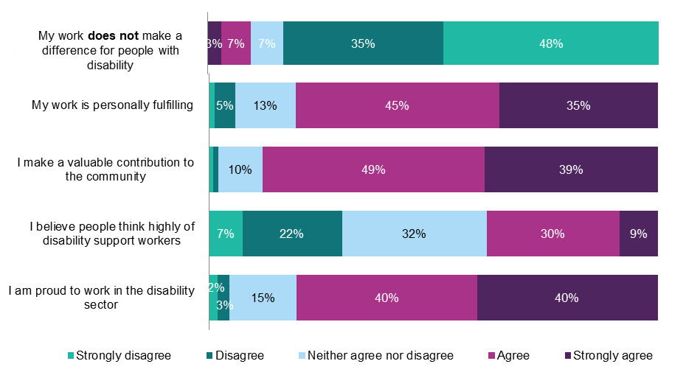
Job Engagement and Value in the NDIS
Job engagement
Job Value
Base: n=746-751
Question: Based on your experience in your current job, please respond to the following statements:
Base: n=751-752
Question: Based on your experience in your current job, please respond to the following statements:

Slide 47
Job Demands in the NDIS
Rostering experiences
Current workload
Base: n=729
Question: What best describes your current workload?
Hours desired
Base: n=733-734
Question: Over the last 6 months, how often have you…
Base: n=729
Question: How many hours per week would you prefer to work in your main job?

Slide 48
Job Demands in the NDIS
Job expectations
Administration and Red Tape
Base: n=720
Question: Based on your experience in your current job, please respond to the following statements…
Base: n=733-735
Question: Over the last 6 months, how often have you…

Slide 49
Job Demands in the NDIS
Discrimination and abuse/bullying
Workplace Health and Safety
Base: n=717
Question: Have you experienced discrimination in your current job? Have you experienced any abuse or bullying in your current job?
Base: n=717
Question: Do you think your health and safety is at risk working in your job?
Personally confronting situations at work
Base: n=716
Question: In your job, are you confronted with things that affect you personally?

Slide 50
Job Resources in the NDIS
Relationship with colleagues
Job control
Base: n=701-702
Question: To what extent do you agree or disagree with the following statements…
Relationship with supervisor
Base: n=697-698
Question: To what extent do you agree or disagree with the following statements…
Base: n=702
Question: To what extent do you agree or disagree with the following statements…

Slide 51
Job Resources in the NDIS
On boarding
Training Satisfaction
Base: n=708
Question: Thinking back to when you first started your current job, please respond to the following statements…
Base: n=705-707
Question: Based on your experience in your current job, please respond to the following statements:
Organisations ethical standards
Training Opportunities
Base: n=720-721
Question: Based on your experience in your current job, please respond to the following statements…
Base: n=705-707
Question: Since starting your current job, how often have you undergone the following types of training?

Slide 52
Job Resources in the NDIS
Healthy work practices
Inclusive culture
Base: n=684-685
Question: Thinking about your current job, to what extent do you agree or disagree with the following
Base: n=684-685
Question: Based on your experience in your current job, please respond to the following statements…
Job security
Base: n=683
Question: Based on your experience in your current job, please respond to the following statements…

Slide 53
Job Resources in the NDIS
Organisational commitment
Pay conditions
Base: n=684
Question: Thinking about your current job, to what extent do you agree or disagree with the following
Growth and recognition
Base: n=684-685
Question: How satisfied or dissatisfied are you with your:
Base: n=685
Question: Thinking about your current job, to what extent do you agree or disagree with the following

Slide 54
COVID-19 and the NDIS workforce
Impact of COVID-19
COVID-19 concerns of NDIS workers
Base: n=683
Question: Overall, do you think the COVID-19 pandemic affected your experience of working in the disability sector?
Impact of COVID-19 on NDIS workers plans to work in the workforce
Base: n=669
Question: Has the pandemic changed your plans to work in the disability sector?
Base: n=676-677
Question: During the pandemic, how concerned have you been about the following at work…

