Slide 1
Improving energy bills: final report
A report prepared for the Australian Energy Regulator
  October 2021

Slide 2
Executive Summary (i)
      Context and research design
      BETA partnered with the Australian Energy Regulator (AER) to apply behavioural insights to the design of energy bills. We conducted a literature review to identify key research questions, which we examined through two online samples involving over 14,000 Australians, including a survey and 6 randomised controlled trials (RCTs, or online survey experiments).
      This Final Report incorporates the content from the Interim Report we published in September and also includes: survey results, additional RCT results, and qualitative research. In addition, we’ve synthesised our recent research with the findings from our literature review. For further details of the substantive additions to this Final Report, see Section H.
      The Final Report is accompanied by:
      A technical appendix detailing our research methods, survey questions, intervention designs, and a description of the results from secondary outcome measures, subgroup analyses and sensitivity analysis.
      Data files containing tabulations of survey responses, and the statistical analysis underpinning the results in this report.
      Unit record data from this research, which is available through the Australian Data Archive.
      A literature review, which has been updated since it was first published in September.
These publications are all available at: https://behaviouraleconomics.pmc.gov.au/projects/improving-energy-bills
      Survey overview
      We conducted a survey to better understand how people receive and use their bills.
      Most respondents receive their bills quarterly and by email, and most pay by BPAY or direct debit.
      Only 9% of respondents had switched retailers in the past year however a further 24% said they had considered doing so.
      Other survey results are presented at appropriate points in the report.
      Bill content
      The top ways that consumers use their energy bill are: finding out how much to pay, finding out how much energy they have used, and checking how their bill was calculated.
      However, survey respondents, especially those in financial hardship, also use the bill for a range of other purposes such as complaints, faults, seeking financial help, or to find interpreter services.
      There is a general consensus that a bill should, at a minimum, include: the amount due, due date, billing period, discounts, how to pay, a detailed charges table, and key contact details. Most of this content should go on the first page.
      A bill with only this ‘minimum content’ would fail to meet the needs of many consumers. Additional content could include: past energy usage, benchmark comparisons, solar exports, a plan summary, help to switch to a cheaper plan, or definitions of technical terms.
      To inform how these additional elements should be prioritised, we tested whether including all the additional elements would become overwhelming. We also tested the efficacy of each of these elements individually.

Slide 3
Executive Summary (ii)
      Bill simplification: Length and layout
      We investigated bill simplification because our literature review concluded that consumers can find bills complex and confusing. We identified design principles that could aid bill simplification. In addition, we tested 4 well-designed bills that varied in specific aspects of the bill’s length or layout.
      Design principles: We distilled 4 key design principles for energy bills from the literature: use simple language, make the bill attractive, make the key information salient, and order the information logically.
      Bill length: Compared to a short bill, we did not find evidence that a well-designed longer bill reduced comprehension. Reducing the amount of content may not be that important for addressing information overload. This is just one element of simplification: other elements are reflected in the design principles.
      Off-bill content: We also designed a bill where some information was moved off-bill and made available via a link to a ‘Home Energy Report’. This friction made respondents much less likely to find the information, even when asked to look for it.
      Bill comprehension: Understanding how the bill was calculated
      Detailed charges table: We tested different formats for the detailed charges table showing the breakdown of costs. None of the alternative designs performed better than the current ‘invoice-style’ table.
      Plan summaries: Simple plan summaries helped consumers to better understand their plan (but did not improve the likelihood they would choose a better deal).
      Definitions box: Including a box with plain English definitions for technical terms had no positive impact on comprehension.
      Bill comprehension: Switching and market engagement
      There are many costs and barriers to switching. Bills alone won’t solve this problem but they have a role to play. Information on bills may make it easier to compare plans, reduce transaction costs of switching, or counter inertia.
      Best offer: In two separate trials, adding a ‘best retailer offer’ to bill prototypes increased respondents’ intentions to switch plans. This was based on responses to an open question seeking suggestions for how to save money.
      Reference price: We tested the impact of comparing bill plans to a reference price, which generally represents the highest price on offer in the market. Respondents who saw that a plan that was equal to the reference price were more likely to say they would shop around for a better plan, as compared to respondents who saw a plan below the reference price.
      Bill comprehension: Energy usage and solar exports
      Benchmarks: Benchmarks are likely to benefit some consumers, especially if well designed. We found benchmarks helped consumers understand how their usage compared to similar households, and made them more likely to think about ways to save energy. The evidence was less clear, however, when the benchmark featured on a comprehensive bill.
      Past energy usage: There is general support for including historical usage charts on bills. We did not find one chart design that was superior to others.
      Solar exports: Solar exports information may help consumers shift their usage times to save money and reduce pressure on the grid. 89% of respondents who have solar panels agreed they would value having this information on their bill. We did not find one chart design that was superior to others.
      Limitations
      Like any research, ours has limitations. We’ve highlighted these in the report.

Slide 4
Contents
A. | Context and research design
B. | Survey overview
C. | Bill content
D. | Bill simplification: length and layout
E. | Bill comprehension: how the bill is calculated
F. | Bill comprehension: switching and market engagement
G. | Bill comprehension: energy usage and solar exports
H. | Limitations

Slide 5
Policy context and BETA’s role
The policy context
In March 2021, the Australian Energy Market Commission (AEMC) released its final rule determination requiring the Australian Energy Regulator (AER) to publish a Better Bills Guideline for retailers determining bill content and billing requirements (AEMC 2021).
The rule determination states that the bill objective is to provide billing information that enables small customers to easily understand:
Payment amounts, dates and methods;
How their bill is calculated and whether it conforms to their customer retail contract;
Their energy consumption and production, and related costs and revenue to assist with:
      Using energy efficiently;
      Comparing their customer retail contract with other energy offers available to them;
      Considering options for energy supply other than through the distribution system;
How to dispute or raise a query in relation to their bill;
How to access interpreter services and seek financial assistance; and
How to report a fault or emergency
How we helped
BETA partnered with the Australian Energy Regulator (AER) to undertake research to inform the Better Bills Guideline. BETA’s contribution builds on its earlier research on energy bills (BETA 2018) and includes:
A literature review, covering relevant academic research and stakeholder submissions to the AEMC rule determination process
Further research – in the form of a survey and 6 survey experiments – that attempted to address some of the research gaps identified in the literature review.
The AER also commissioned focus groups with two specific cohorts. The focus groups with people from culturally and linguistically diverse backgrounds (CALD) was facilitated by the Ethnic Communities Council of NSW (AER 2021 p2). Hall & Partners (2021) conducted focus groups with older, non-digital consumers aged 65 or more.
The literature review, survey, survey experiments, and focus groups are all inputs feeding into the AER’s process for developing the Better Bills Guideline. They will be considered alongside the views of stakeholders and experts provided through the Better Bills Guideline consultation process.

Slide 6


We undertook a review of existing literature
The literature review identified several well-supported findings:
BETA began this project by undertaking a literature review on three bill content areas:
Energy bills include complex content that can make them difficult to understand and cause confusion for consumers.
1
Complex bill content and structures are confusing for consumers in the energy market. Stakeholder have different views about what causes this confusion, but there are matters where evidence in the literature is clear on the changes that can improve energy bills. Replacing text with graphs, using conversational language, reducing the amount of information, and providing important information on the first page are proven ways to improve bill comprehension. Further research should test whether standard presentation of key plan characteristics and plain language definitions of technical terms improve understanding.
Providing consumers with feedback on their energy usage is an effective way to engage and educate them on their energy efficiency. However, issues with the format and delivery of usage feedback in Australia means that many consumers have problems understanding this information. Existing research does not clarify the ideal format and mode of delivery for this and the information could be improved to help consumers whilst reducing costs for businesses.
Making bills easier to compare is a crucial step in encouraging switching, but more active promotion of switching services in bills themselves also motivates inert consumers. Standardisation of key terms between retailers will help consumers make better decisions when comparing plans. However, switching providers is often difficult. Encouraging ‘within provider’ switching (i.e. to a cheaper plan offered by one’s current retailer) may be an easier and more effective method for helping consumers. So-called ‘Best offer’ notices and other calls to action on bills need further investigation to identify how they can be used to aid consumer switching.
Bill simplification, based on evidenced-based behavioural principles, can reduce the cognitive load that bills place on consumers, making them easier to understand and effectively use.
2
3
Drawing on the available literature, stakeholder submissions and broader evidence from behavioural science, we identified four key principles for the design of energy bills:
Language: Use simple, conversational language
Presentation: Make the bill visually attractive
Salience: Make the key information salient
Structure: Order the information carefully and logically.
Caveat: The literature review sought to cover most of the key research relevant to identifying gaps in relation to energy bill contents and billing requirements but it was not a full systematic review and so does not claim to be comprehensive.

Slide 7




We identified gaps in the literature
The gaps in the literature that we identified included:
These gaps shaped our three research questions:
Simple definitions of technical terms, e.g, kilowatt-hours, tariffs, should be tested to improve comprehension of bills.
The presentation of calls to action (for switching behaviour) should be tested to improve understanding of consumers while minimising distrust.
A standardised summary of plan characteristics placed on the front page should be tested for its potential to improve comprehension of a plan.
Different displays of total usage in historical usage graphs should be tested to improve comprehension of bills.
The impact of taking non-essential information off bills and/or delivering it through alternative means (such as a link from the bill to a website) should be tested to determine whether it would improve comprehension.
The efficacy and format of peer comparison (benchmarking) energy usage graphs should be tested to improve comprehension for consumers and reduce costs for businesses receiving complaints.
Communication of solar power in bills should be tested to help consumers more accurately evaluate the value of their solar system and optimise their consumption.
Bill content: What is the priority content for inclusion on the bill?
This covers how consumers engage with their energy bills (what elements they read, and what they use their bills for) and the impact of some new types of bill content.
Bill simplification: How do we reduce information overload in bills?
This covers bill length and layout, as well as inclusion of plain English definitions of technical terms.
Bill comprehension: How do we maximise comprehension of bill content?
Comprehension covers a number of features:
How the bill is calculated
Switching and market engagement
Energy use and solar exports

Slide 8
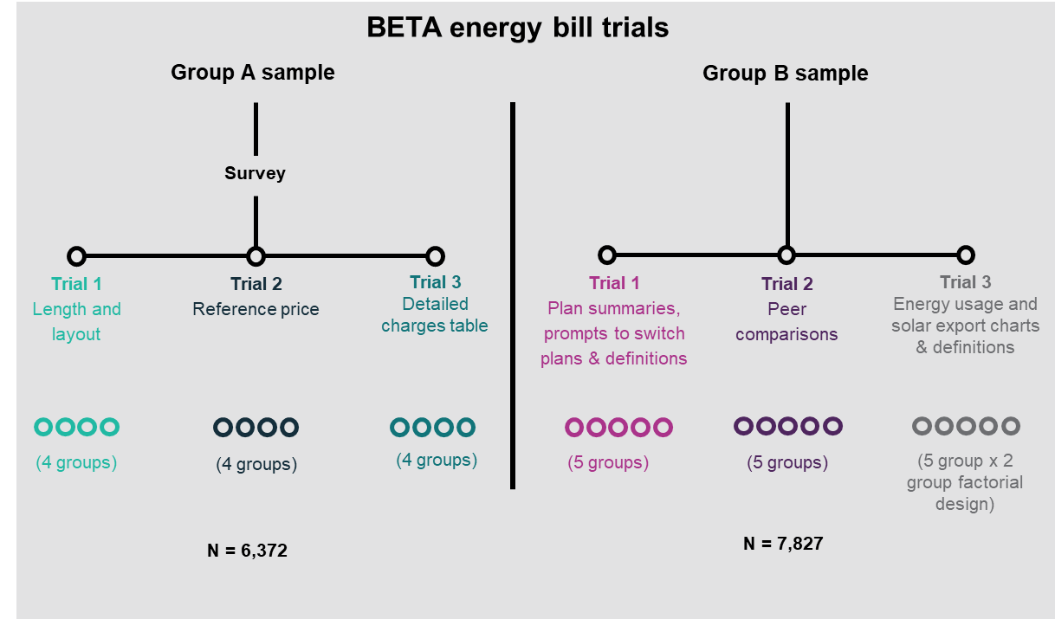
We conducted research with over 14,000 Australian consumers
We collected 2 online sample populations targeting energy consumers living in the regions covered by the National Energy Customer Framework (NECF – QLD, NSW, SA, TAS and the ACT). We oversampled respondents from SA, TAS and the ACT. The sample characteristics are illustrated on the next slide.
There were 6 randomised controlled trials (RCTs) embedded in the 2 samples. For each RCT, respondents were shown one bill design, followed by a series of questions designed to measure their comprehension (based on up to 9 questions) or intentions.
Respondents were randomly assigned to see different bill designs independently for each trial.
The first sample population of 6,372 respondents (Group A) included a survey and 3 trials. In each trial, we tested 4 bills or bill elements (hence each bill was shown to more than 1,500 respondents). The ordering of the 3 RCTs was the same for all respondents but the ordering of the survey and the 3 RCTs was randomised.
The second sample of 7,827 respondents (Group B) included 3 more trials, with 5 bills or bill elements in each trial (again showing the bill to more than 1,500 respondents). The ordering of each RCT was randomised.
In each of our RCTs (or ‘survey experiments’), we attempted to mimic a real-life situation. Nonetheless, respondents’ reactions in an online survey setting may be different from how energy consumers react in real life.
Caveat: like any research, ours has limitations and we’ve highlighted these as relevant in the report. See also Section H: Limitations.

Slide 9
The AER commissioned focus groups to understand specific audiences
Targeted focus groups were conducted to better understand the needs of older consumers, and consumers from culturally and linguistically diverse backgrounds.
Culturally and linguistically diverse (CALD) consumers
The Ethnic Communities Council of NSW facilitated focus groups (in language) with people from culturally and linguistically diverse backgrounds. Participants were selected on the basis of:
speaking a language other than English at home, with specific language groups chosen according to their population size and lack of community support
lower levels of English
a strong desire for in-language engagement.
6 focus groups were run, and were conducted face-to-face, online and hybrid (face-to-face and online).
The language groups considered were Arabic, Korean, Cantonese, Mandarin, Urdu and Vietnamese.
To overcome language barriers, each group was facilitated by two in-language educators from the Ethnic Communities Council of NSW.
Consumers aged 65 and over who don’t typically engage with their bill online
Hall & Partners conducted focus groups with older consumers aged 65 or more. All participants were selected on the following screening criteria:
Aged 65+ years
Opted to receive a hard copy of their bill via postal mail
Preferred to resolve any issues with their bill via phone call with their provider
Had not downloaded an app from their electricity provider.
3 focus groups were conducted face to face and were split according to locations: Canberra, Hobart, Adelaide. Additional sessions in Brisbane and Sydney were cancelled due to COVID-19 restrictions.
Reports on the focus group findings can be found here: https://www.aer.gov.au/retail-markets/guidelines-reviews/better-bills-guideline/consultation

Slide 10
Contents
A. | Context and research design
B. | Survey overview
C. | Bill content
D. | Bill simplification: length and layout
E. | Bill comprehension: how the bill is calculated
F. | Bill comprehension: switching and market engagement
G. | Bill comprehension: energy usage and solar exports
H. | Limitations

Slide 11
Survey design and overview
Understanding how people receive and use their bills
Survey data quality
Demographic characteristics
We conducted a survey to better understand how people receive and use their bills. Some survey results are presented in this section while the remainder are included at relevant points throughout the report.
The survey started with some basic questions including:
How often respondents receive their electricity bills
How they receive their bill
How they pay their bill
We also asked questions about:
What parts of the bill they use
Whether they refer to the bill to compare plans
Whether they refer to the bill to improve their energy efficiency
Take-up of home technologies that impact energy consumption, such as solar panels, batteries and smart meters.
Members of online survey panels regularly participate in surveys in return for small incentive payments. A common issue with such panels is that some respondents will not have provided genuine responses.
For the survey analysis, we removed ‘speeders’ (i.e. respondents whose survey duration was implausibly short) and ‘incompletes’ (i.e. respondents who didn’t complete the survey and trials). This left a sample size of 4,818 for the cleaned dataset (compared to 6,372 for the full dataset).
Unlike the survey, the results for the randomised controlled trials (RCTs) are robust to non-genuine responses and so we used the full dataset for that analysis. We confirmed this by conducting a sensitivity analysis on the cleaned datasets. (The RCT ‘results’ refer to differences between each group in the trial.)
For further details, see the discussion of limitations in Section H .
We collected large and diverse samples through an online survey panel however they were not truly representative of the NECF population. In particular, they only include people who are willing to regularly participate on online surveys. The Technical Appendix (Section 2) provides details of the samples’ demographic characteristics and compares them with the relevant population.
For Group A (cleaned), the key difference was that only 4% reported that the main language spoken in the household was not English, no doubt because the survey was only conducted in English. As noted earlier, to address this gap, focus groups were held with Australians from various non-English speaking backgrounds.
The Group A sample was also skewed in the following ways: more women; more from smaller jurisdictions (SA, ACT and TAS) and fewer from NSW; more renters and fewer mortgagees; and more with post-secondary education and fewer with Year 10 or below. Finally, the sample tended to be younger than the NECF population.

Slide 12
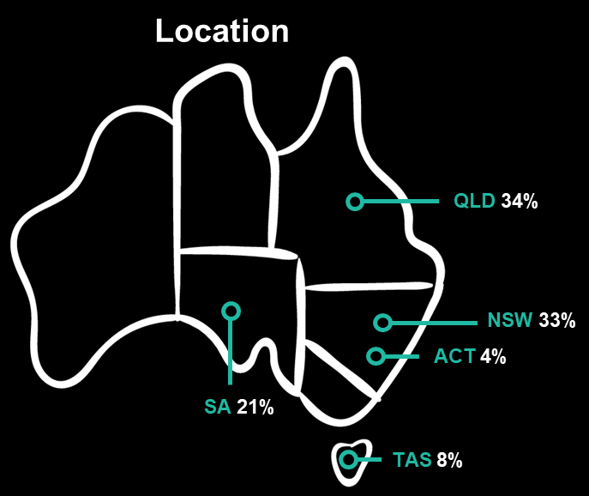
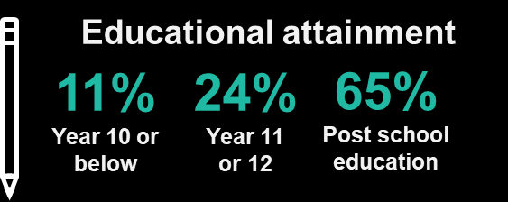
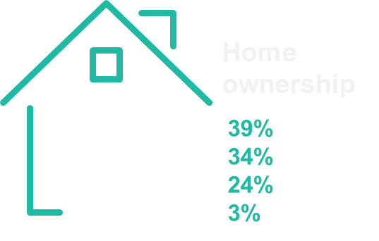
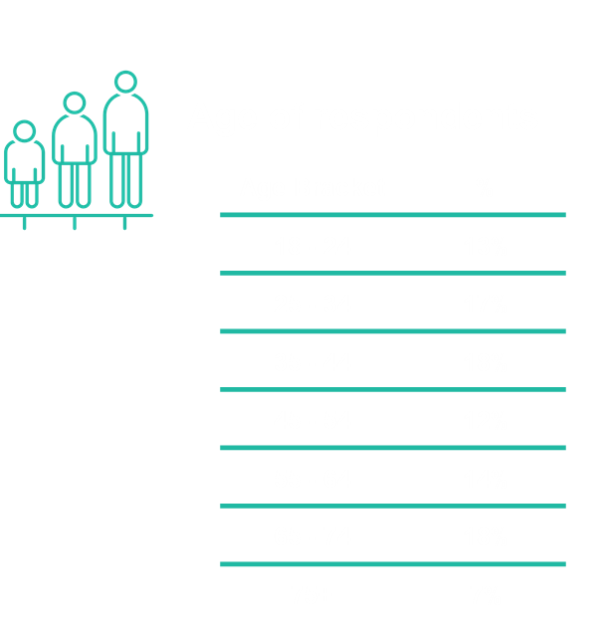
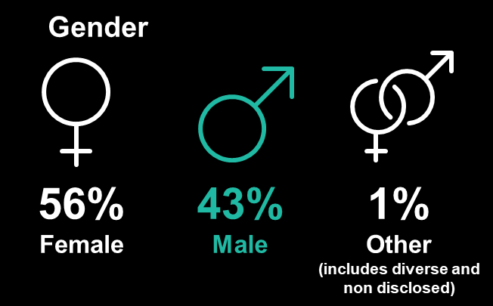

The survey reflected groups in varied circumstances in different parts of Australia*
* Group A, n=4,818. Group B showed similar diversity. See Technical Appendix (Section 2) for further details.

Slide 13
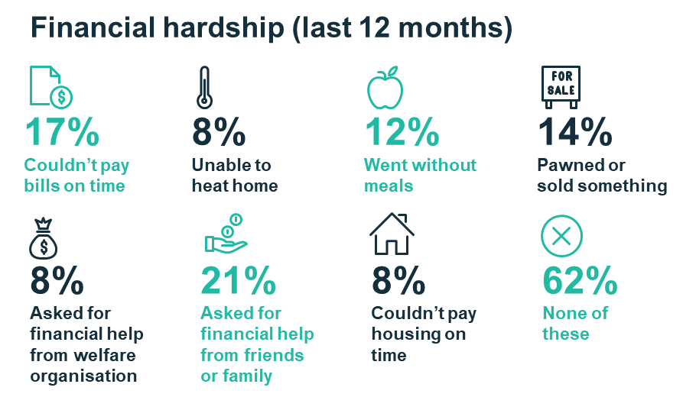
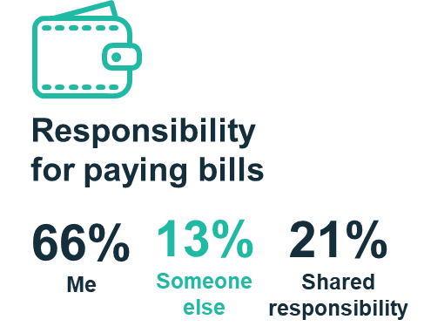
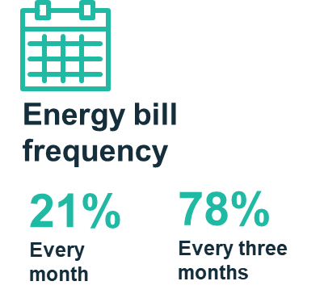
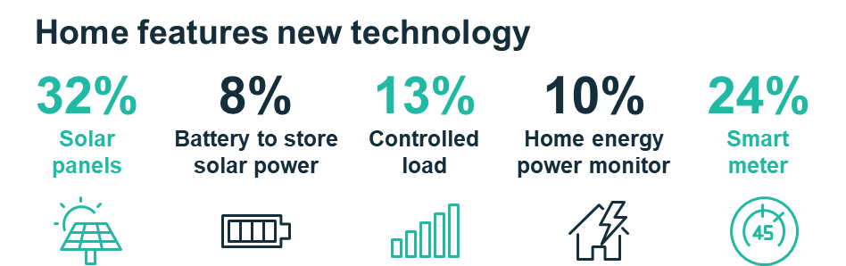
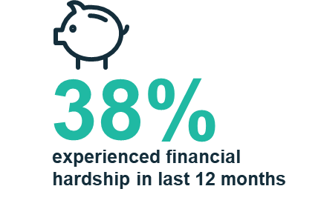
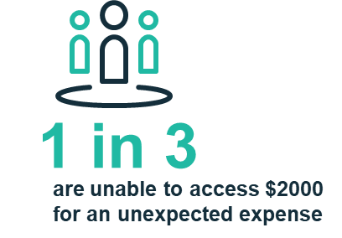
The survey reflected groups in varied circumstances
* Group A, n=4,818.

Slide 14

People use a range of methods for receiving and paying for energy bills
36%
get paper bills
While many consumers receive bills via email and engage with their retailer online, more than one-third still rely on a paper bill in the mail.
How bills are received: Respondents mostly receive their bills via an email (64%) or letter (36%). Others do so via an app (12%) or on a retailer website (4%), noting that some people use multiple formats.
Email bills: Of those receiving an email bill, 52% usually view it on a computer while 40% usually do so on a smartphone. Many retailers have already introduced simplified email bills with the regulated bill attached as a pdf file. A large majority (86%) of people receiving an email bill said they opened the pdf attachment, rather than just looking at the email.*
Online engagement: 66% of respondents use a website, an app or both to get information from their energy retailer. Most commonly they do this to view or pay bills, but they also use the website or app to check energy usage, edit their details, or to get information on their current plan.
Payment: Respondents pay their bills through various means. The most common were: BPAY (40%), direct debit (26%), through the retailer’s app or website (9%), or at the post office (8%). Less common payment options included: EFT (6%), cheque (2%), or Centrepay (2%).
66%
use the retailer app or website
26%
pay bills using direct debit
*Note: This contrasts with our results for an email-style bill – described in Section D – where only 15% clicked on a link to view additional information. However, our email-style bill was much more detailed than typical email bills, which often just include the amount due but not payment details. This may explain the difference in the open/click-through rates.
Survey questions: Q4.2 How do you currently receive your energy bills? (Please select all that apply.) | Q4.3 How do you usually view your energy e-bill? | Q4.4 Do you usually open the attached bill (the PDF) or just check the total amount in the email?| Q4.7 How do you usually pay your energy bills? | Q4.13 Do you get information from your energy company in an app or a website? | Q4.14 How do you use the app or website? (Select all that apply)

Slide 15
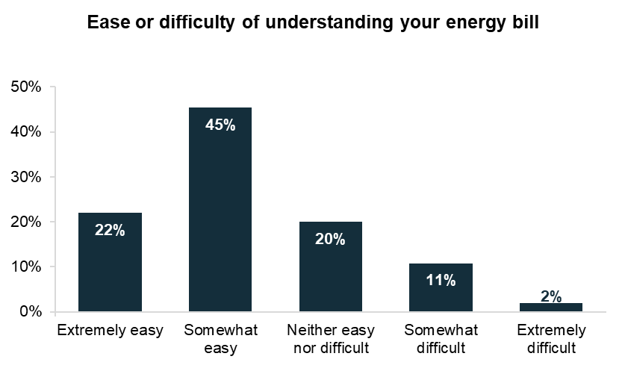
Some cohorts are more likely to say they find bills difficult to understand
People who have experienced financial hardship were more likely to rate bills as difficult to understand
Most respondents (67%) said they found bills easy to understand but some (13%) found them somewhat or extremely difficult.*
People who have experienced financial hardship in the last 12 months were more likely to rate bills as somewhat or extremely difficult to understand (17% compared to 10%).
Age and experience contribute to confidence understanding energy bills
Ease of understanding was correlated with age. A higher proportion of older respondents reported finding bills easy to understand than younger cohorts.
The focus groups with those aged 65+ revealed that this cohort generally have a sense of how much they expect their bills to be each quarter. Participants reported an understanding of the rise and fall of energy bills with the seasons and they budget appropriately.
People who identified themselves as being responsible for paying the bills in their household were much more likely to rate bills as extremely easy (27%) compared to those who identified someone else in the household as being the responsible for bills (9%).
By contrast, finding bills easy or difficult to understand did not vary greatly by education level.
Note: Q3.2 How easy do you find it to understand your energy bills?;
Self-reported assessments of comprehension should be treated with caution.
*Note: self-reported assessments of comprehension should be treated with caution, especially as this was a general question about ease of understanding a bill. The existing literature and stakeholder submissions suggest that many consumers find at least some specific bill elements difficult to understand.

Slide 16
Contents
A. | Context and research design
B. | Survey overview
C. | Bill content
D. | Bill simplification: length and layout
E. | Bill comprehension: how the bill is calculated
F. | Bill comprehension: switching and market engagement
G. | Bill comprehension: energy usage and solar exports
H. | Limitations

Slide 17
Bill content: Overview and key findings
What content should a bill include?
The academic literature and stakeholders both recognise that consumers use bills for various purposes, and that different consumers have different needs. We confirmed this in our survey research.
The challenge is to address two conflicting aims:
the bill should provide enough information to address different needs, and enough detail that the information can be easily understood, but
the bill should avoid including so much information or detail that it becomes overwhelming.
Top uses for energy bills
We found consumers’ top uses for energy bills are: finding out how much to pay, finding out how much energy they have used, and checking how their bill was calculated.
Survey respondents, especially those in financial hardship, also use the bill for: complaints, faults, seeking financial help, or to find interpreter services.
Based on these survey results and our literature review, we concluded a bill should, at a minimum, include the following content:
The amount due and the due date
The billing period and any discounts
How to pay
A detailed charges table that explains how the bill was calculated
‘Need help?’ contact details
We also concluded that most of this content should go on the first page.
Additional uses for energy bills
Consumers also use bills for a range of other purposes.
In particular, survey respondents also said they refer to their bill when comparing energy plans or seeking to improve their energy efficiency.
A bill with only the ‘minimum content’ would fail to meet the needs of such consumers. Possible additional bill elements could therefore include:
past energy usage
benchmark comparisons with similar households
past solar exports
a plan summary with details of, for example, peak and off-peak times and rates
help to switch to a cheaper plan
definitions of technical terms
How we investigated priority bill content
The purpose of our research was to provide further evidence on which of these additional elements should be prioritised.
We tested whether including all the additional elements in a well-designed ‘comprehensive bill’ would become overwhelming, when compared to a well-designed ‘basic bill’ (which only included the ‘minimum content’).
We did not find respondents’ comprehension suffered from including additional content in a well designed bill. See Section D for details.
We tested each of these elements individually to determine their impact on comprehension or intentions to change behaviour. Drawing on these results, alongside the existing literature and qualitative research, we made an assessment about the strength of evidence supporting the prioritisation of each of these elements. See
Sections E-G for details.

Slide 18
What the literature and stakeholders say about bill content
Bills are mainly used to make payment, and to check energy usage and how the bill was calculated
The most important content should go on the first page
There were divergent views about how much additional content to include
Consumers primarily use bills to make payments on time, check their energy consumption, and check they are being charged correctly (see, e.g., EU 2018 p127; our survey reached the very similar conclusions in the Australian context – see next slide).
There is broad agreement that the most important content should go on the first page (see, e.g. BEWorks 2016 p21; BETA 2018 p20; Energy Project 2020). From our review of the literature and stakeholder submissions, we concluded that the front page should contain the following essential elements:
The amount due and the billing period
The due date
Any discounts that have been applied.
The front page could also include information on how to pay, or to help consumers compare plans (e.g. a ‘best offer’ – see Section F for details).
Stakeholders expressed divergent views – in their submissions to the Australian Energy Market Commission (AEMC) in 2020 – about what additional content bills should contain. Several retailers pointed to their own consumer research findings, in which their customers expressed a preference for shorter bills. And there was a general concern that too much content would generate undue complexity (notwithstanding that some complexity is inherent to complex energy plans).
See Section 3 of the Literature Review for further details.

Slide 19
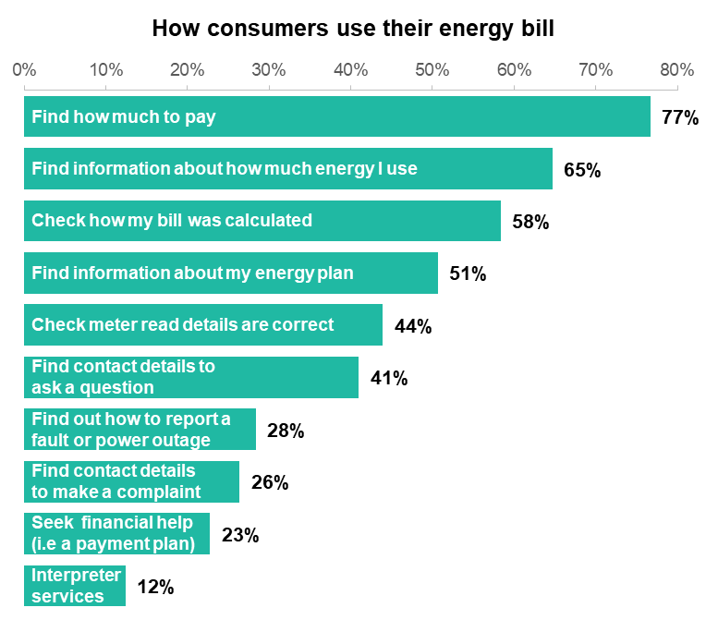
Survey respondents use bills to find out how much to pay, and for a variety of other purposes
Bills are mainly used to make payment, and to check energy usage and how the bill was calculated
Consistent with previous research, the survey respondents’ top uses for energy bills were:
Finding out how much to pay (this may be optional for the 26% of respondents who are direct debit consumers)
Finding out how much energy they have used
Checking how their bill was calculated
However, bills are also used for many other purposes, as shown in the chart.
The most-read bill elements correspond closely to the most common ways bills are used. Almost all respondents (88-89%) said they always or mostly read the amount owing and the due date. And a large majority also said they read elements relating to: their electricity usage (in the current period, and in the past year), discounts, and the detailed list of charges.
People experiencing financial hardship are more likely to use the bill for financial help, financial advice, or complaints
Respondents experiencing financial hardship were more much more likely to use their bill to seek financial help. They were also more likely to use it to: find contact details to make a complaint, ask a question, or find interpreter services. This group is also likely to refer to their bill when getting financial advice, or looking at ways to improve energy efficiency.
N=4,818. Q4.8 Have you ever used your energy bill for the following reasons? (Response options: Yes, used my bill for this; Used other source for this; Have not needed to do this)
Caveat: Some figures in this chart, especially smaller ones, should be treated with caution due to data quality issues. However, we regard the ranking of different uses as robust. See Section H for further details.

Slide 20
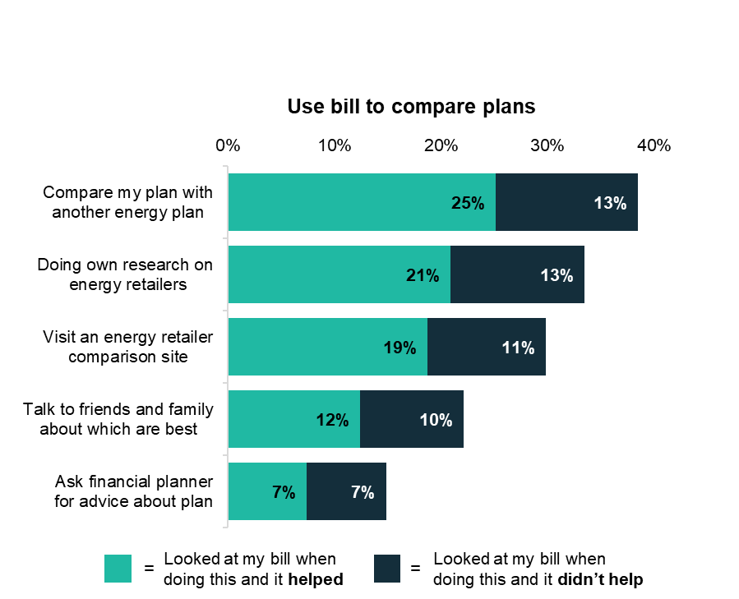
Bills are used when comparing plans
Switching retailers is uncommon
Less than half of respondents (43%) said they had switched retailers at some point in the past and only 9% had done so in the past year. A further 24% saying they had considered doing so, and 3% said they tried to switch but it got too hard.
Respondents use bills to compare plans
A substantial minority of respondents refer to their bills when they are comparing plans. For example:
38% look at their bill when comparing their plan with another energy plan
30-34% look at their bill when doing their own research on retailers or visiting an energy retailer comparison site
However, many of those who refer to their bills for these tasks say they didn’t find bills helpful (refer to the grey bars in the chart).
Consumers use a range of strategies to select an energy plan
The most common approaches for selecting an energy plan were to choose: the cheapest plan (27%), a plan that suits how much energy you use (15%), the largest discounts (11%), or a retailer you have heard of or used previously (10%).
N=4,818. Q4.11 Have you ever looked at your energy bill for more information when doing any of the following things? (Response options: Have never done this, Did this without looking at my bill, Looked at my bill when doing this but it didn't help, Looked at my bill when doing this and it helped, Not sure / can't recall)

Slide 21
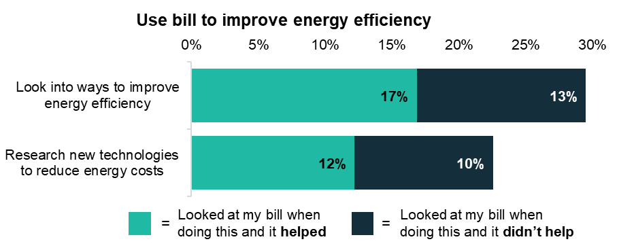
Bills are also used to improve energy efficiency
Most said it was very important to use less energy
72% of respondents said it was ‘very’ or ‘extremely’ important to them to use less energy, and almost all (94%) said it was at least moderately important.
When asked ‘If you made a decision to use less energy, what would be the main reason?’, 77% said ‘to lower the cost of the bill’, and 23% said ‘better for the environment’. The most likely to prioritise cost were people: in financial hardship, in rental accommodation, or aged over 65.
Q3.8 How important is it to you to use less energy?
Respondents use bills to improve their energy efficiency
A substantial minority said they look at their bill for more information when seeking to improve energy efficiency or reduce energy costs:
30% looked at their bill when investigating ways to improve energy efficiency
22% looked at their bill when researching new technologies to reduce energy costs.
N=4,818. Q4.11 Have you ever looked at your energy bill for more information when doing any of the following things? (Response options: Have never done this, Did this without looking at my bill, Looked at my bill when doing this but it didn't help, Looked at my bill when doing this and it helped, Not sure / can't recall)

Slide 22
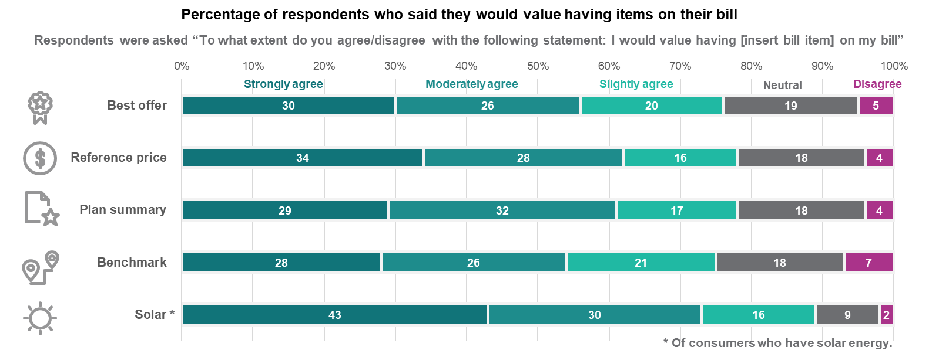
We asked consumers whether they would value new or existing elements of their bills
We tested several types of new and existing bill content designed to meet the Australian Energy Market Commission’s (AEMC) billing objectives. After giving respondents an opportunity to engage with the bill content (through a randomised controlled trial), we asked a follow-up question to find out whether they agreed that they would value this information on their own energy bill. The graphics below show that a large majority of respondents strongly, moderately or slightly agreed that they would value this information.
Caveat: stated preferences do not always match actual preferences.

Slide 23
Contents
A. | Context and research design
B. | Survey overview
C. | Bill content
D. | Bill simplification: length and layout
E. | Bill comprehension: how the bill is calculated
F. | Bill comprehension: switching and market engagement
G. | Bill comprehension: energy usage and solar exports
H. | Limitations

Slide 24
Bill simplification: Overview and key findings
Overview
Consumers want bills that are clear and simple to understand. This section explores the research on how this can be achieved.
We identified key design principles for energy bills, drawing on the existing literature (including our own previous research).
Using these design principles, we developed 4 prototype bills. While the 4 bills had many design features in common, they varied in specific aspects of the bill’s length or layout.
A ‘comprehensive’ 2-page bill with much additional content (e.g. plan summary, best offer, benchmarks, etc)
A ‘structured comprehensive’ bill with the same content but more structured and spread over 3 pages
An ‘email-style’ bill with the same content except some was ‘off-bill’, accessible via a link
A ‘basic’ 2-page bill with just the minimum content
Design principles for energy bills
The existing literature reinforces the importance of bill design and layout for consumer comprehension and engagement. It also provides numerous techniques for how to achieve good design, including: using boxes and bold sparingly to highlight key information, structuring information carefully, and using conversational language.
We distilled these suggestions and insights into 4 key design principles for energy bills.
Language: Use simple, conversational language.
Presentation: Make the bill visually attractive.
Salience: Make the key information salient
Structure: Order the information carefully and logically.
We confirmed these principles in qualitative research from focus groups and our survey. Consumers indicated that they want bills to be easy to understand. Specific suggestions for simplification included: reduce clutter, make critical information stand out, increase the font size, use less jargon, and provide clearer explanations.
Testing bill length and layout
We tested the impact of the bill prototypes on comprehension. This helped us answer 3 questions in relation to bill length and layout.
First, would too much additional content be overwhelming? We tested this by comparing comprehension levels for respondents who saw Bills 1 & 2 vs. those who saw Bill 4. We did not find evidence of a difference in comprehension. This implies that, in a well-designed bill, additional content may not be overwhelming.
Second, would better structure and more white space improve comprehension (Bill 1 vs. Bill 2)? Again, we did not find evidence of a difference.
Finally, we also looked at whether it would help to move some information off-bill (Bill 1&2 vs. Bill 3). In this case, we found moving information off-bill had a negative impact on comprehension because many respondents did not click on the link.
We asked respondents what they liked and disliked about the bill they saw. They generally commented favourably on the bills’ designs but, for all 4 bills, there were mixed views on specific features (see slides on ‘What people liked or disliked’ for further details).

Slide 25

What the literature says about bill simplification
The bill layout matters for consumer comprehension and engagement.
An online experiment with over 10,000 participants across 10 countries tested the impact of a ‘best practice’ bill, which clearly and coherently laid out important information (European Commission 2018, pp136-144). This bill outperformed a stylised ‘current market practice’ bill on a several measures of comprehension and easing of understanding.
The bill’s formatting and presentation is also important.
Presentation matters for gaining and holding the reader’s attention. This could include:
Using boxes and bold sparingly to highlight key information
Making the bill visually attractive
Ordering information carefully
Using a combination of text, diagrams and tables.
Complex language and terminology reduces consumer comprehension.
Consumers struggle with complex language, detailed data, and with technical terms such as ‘supply charge’, ‘kilowatt-hour (kWh)’, or ‘solar exports’. Techniques to address this include:
Using graphs to present data
Using conversational language (such as ‘What do I owe?’ and ‘When should I pay by?’)
Removing jargon or defining technical terms
Aiming for a year 7/8 reading level
Make it easy
Presenting information in a simple and salient way – highlighting the key information, using simple and conversational language, and utilising white space – helps consumers better attend to and understand information presented.
Note: For more detail, refer to Section 3 of the Literature Review.

Slide 26




We identified 4 principles for well-designed energy bills
Key design principles applied to energy bills
We drew on the literature review, our previous research, and key behavioural insights principles to design prototype bills.
Our previous research (BETA, 2018) included:
a review of the literature,
focus groups in which participants compared three existing electricity bills, answered semi-structured questions, and designed their ideal bill,
user testing, including eye tracking of a range of designs and checking comprehension, and
testing a subset of the designs through a survey experiment.
We also applied BETA’s ‘WISER framework’ for improving government forms to the updated bill designs (BETA, 2020) .
Language
Use conversational language and plain English, aiming for a year 7-8 reading level. Remove jargon or technical terms where possible.
Presentation
Make the bill visually attractive. Use a combination of text, diagrams and tables.
Salience
Include key information on the front page. Only include one graphic for the ‘amount due’. Use boxes and bold sparingly to highlight key information.
We tried to design simple bills, but energy plans aren’t always simple
It is much easier to design a simple bill when the underlying plan is straightforward. It was out of scope to test a bill for every type of plan (e.g. bundled plans, controlled load rates, seasonal changes in rates, etc), but we did try to test a bill that needed to communicate several layers of complexity. We opted for a ‘time of use’ plan with a usage discount and solar feed-in tariffs.
Structure
Group the bill contents into common themes (e.g. how to pay, understand your bill, understand your plan). Order information carefully and draw out key facts.

Slide 27




We tested the length and layout of four well-designed bills
We designed four bills which varied in length, layout and the number of additional elements on the bill.
The ‘simple bill’ from our previous research (BETA, 2018) was the starting point for all 4 bills developed for this trial. To design a ‘comprehensive bill’, we reviewed many bills in the market, and drew on key ideas from our literature review and from stakeholder submissions. The ‘basic bill’ was stripped back to minimum essential information.
In all the bills tested, we set out to make the information as clear and as easy to understand as possible, based on principles established in the existing literature. Thus, we tested well-designed prototypes, not genuine bills.
Each bill element was kept constant across designs so we could isolate the impact of specific changes to bill length or layout. In subsequent trials, we tested the impact of including individual elements (such as a plan summary) or we tested variations in the design of that element (such as the past usage chart).
Respondents were randomly assigned to view 1 of the 4 prototype bills – described on the right. They were able to refer to the bill to answer a series of 9 comprehension questions that tested their understanding of: how much and how to pay; where to find important details, and how their bill was calculated.
1
2
Comprehensive bill (2 pages)
Similar to many existing bills over two, densely packed pages.
Structured comprehensive bill
(3 pages)
Same content but with headings, more white space, and a “home energy report” on the third page (this drew together all the information about energy consumption, solar exports and benchmarks).
3
4
Email-style bill
Main bill contains same content as first two pages of Bill 2 in long email format. The additional information in the “home energy report” is available via a clickable link.
Basic bill (2 pages)
Only contains information necessary to enable payment, a table showing how the bill was calculated and key contact details (omits plan summary, definitions, best offer and home energy report).

Slide 28
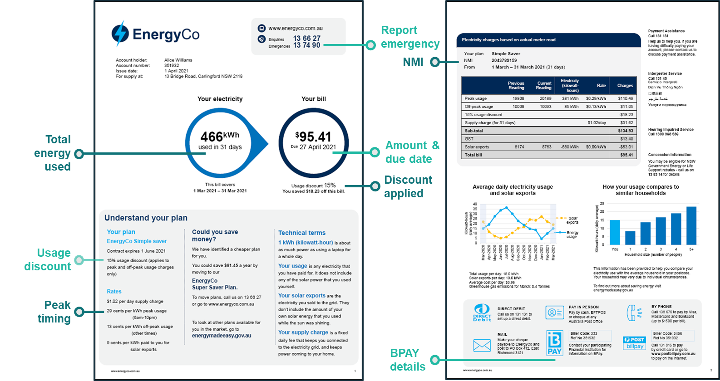
Bill 1: Comprehensive bill (control group)

Slide 29
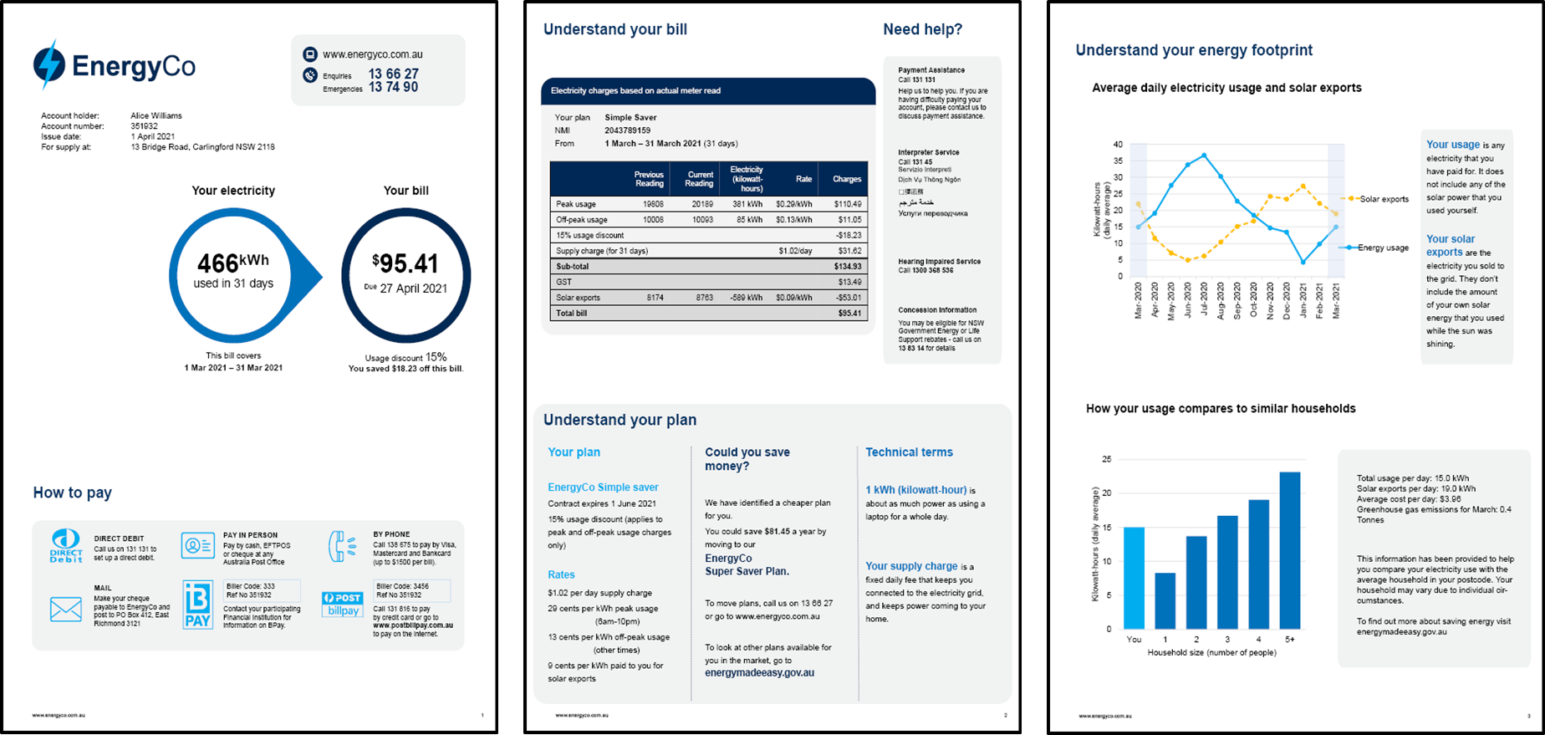
Bill 2: Structured comprehensive bill (3 pages)

Slide 30
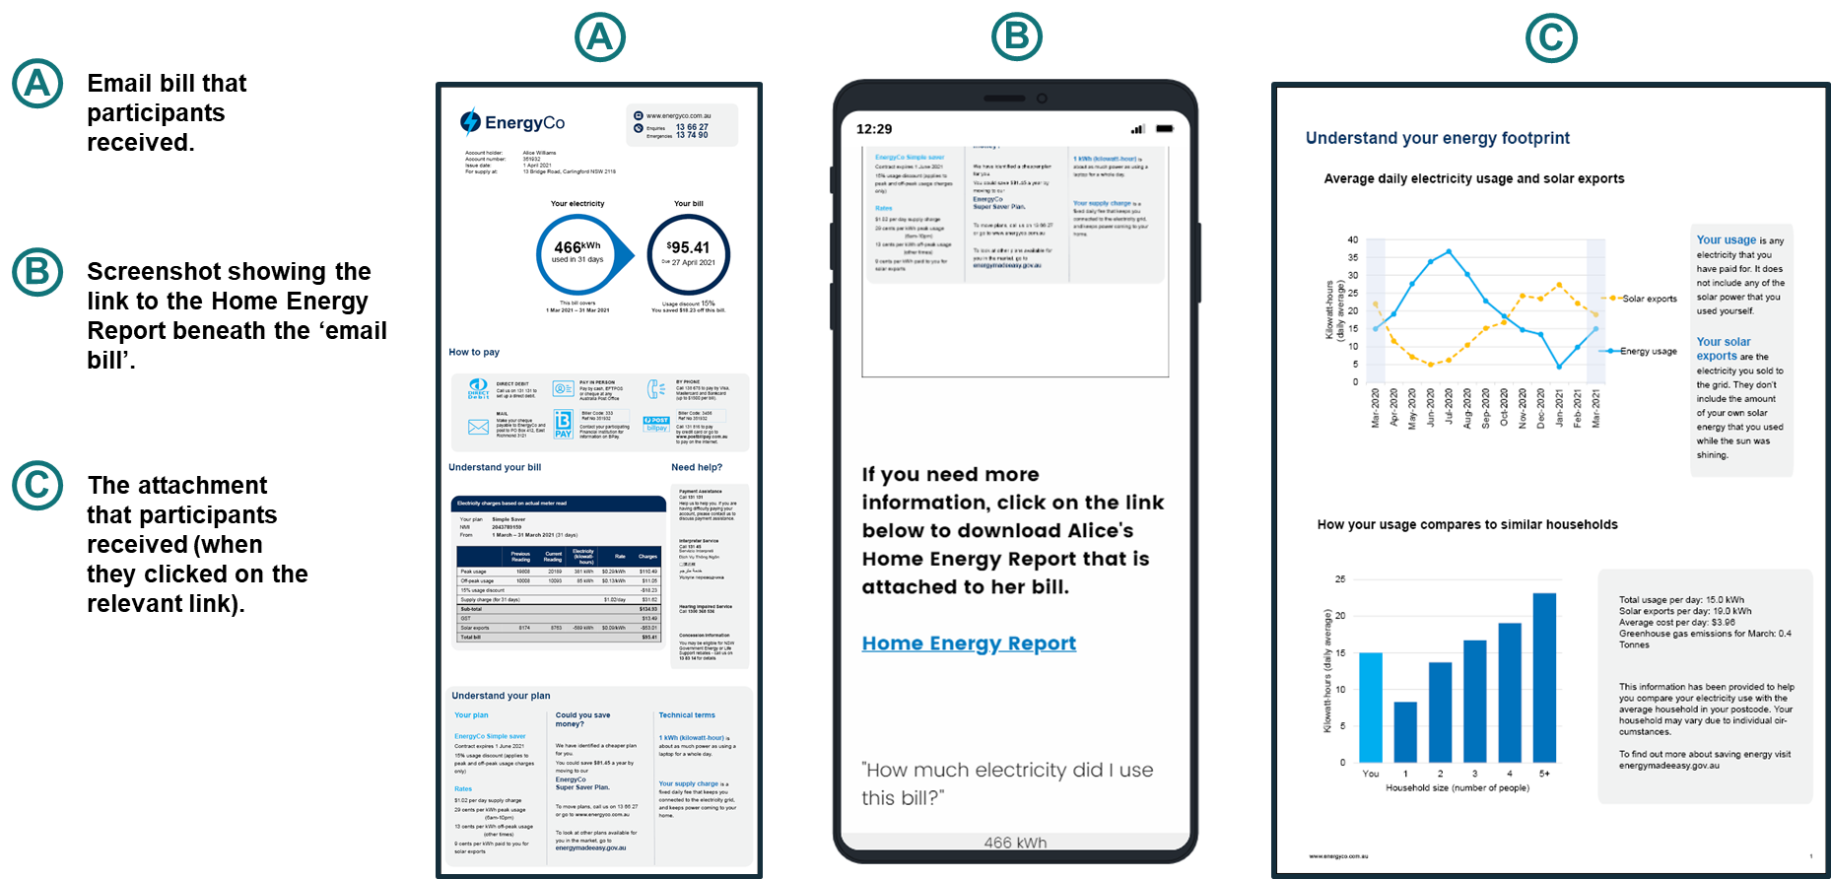
Bill 3: Email-style bill (with link to further information)

Slide 31
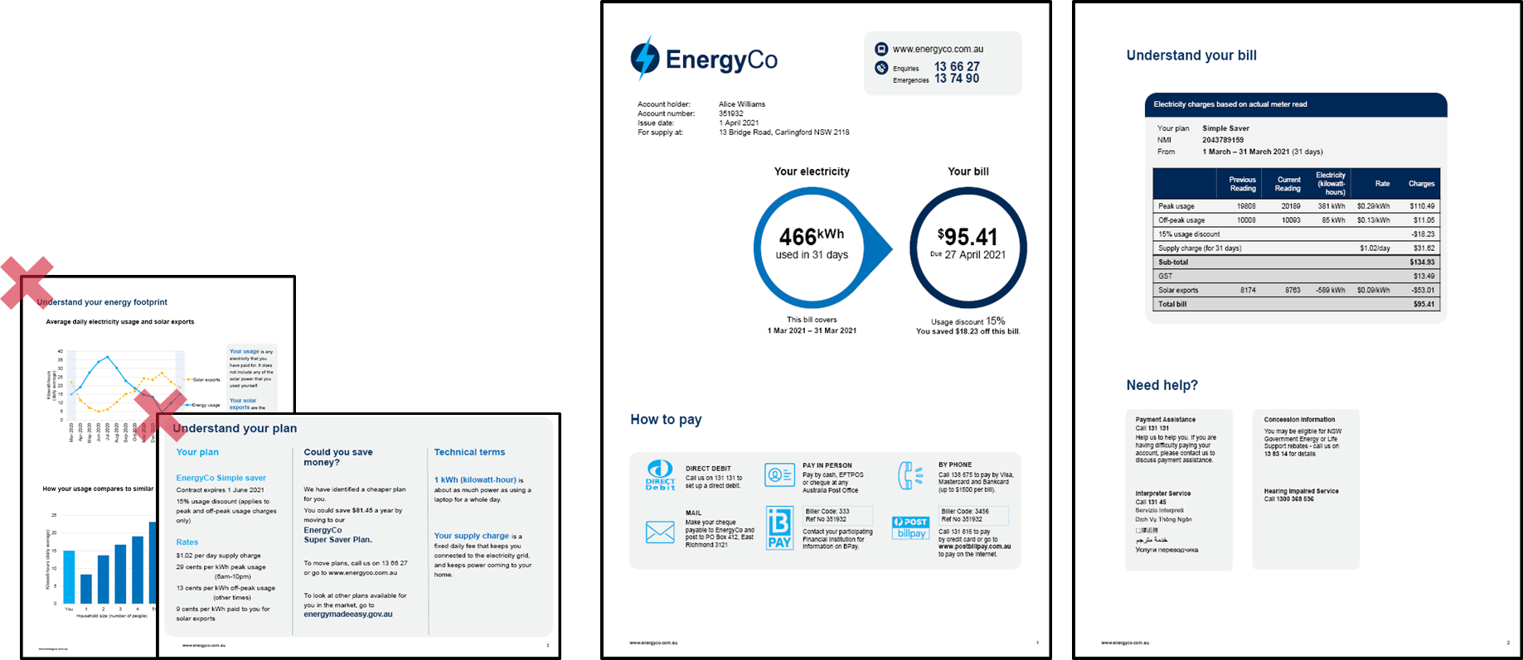
Bill 4: Basic bill (2 pages with limited content)
What’s in and what’s out?
The basic bill retained essential information:
How much, when and how to pay
The detailed charges table
‘Need help?’ contact details
The basic bill did not have:
The plan summary
Past energy usage, benchmarks or solar exports
The ‘best offer’
Definitions of technical terms

Slide 32
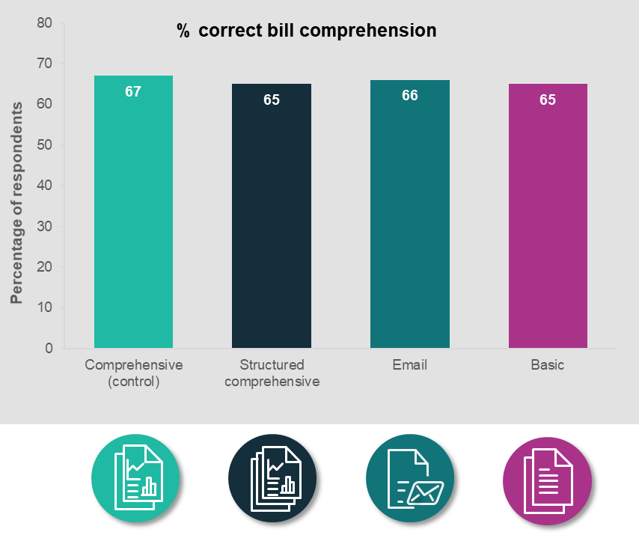
In a well-designed bill, the overall length and layout isn’t a big barrier
Respondents were able to refer to their bill to answer 9 questions that tested:
comprehension of payment information (amount, date, payment methods),
ability to correctly identify important details (NMI, contact numbers),
understanding of how their bill was calculated.
For all 4 bill designs, respondents were about equally likely to find the correct answers. This was true regardless of whether the bill design was:
re-structured to add more white space,
shortened by removing additional content,
arranged in a commonly used format in the market, with a link to more information.
The scope of this research did not include testing genuine bills used by energy retailers. We reviewed many bills in developing the trial design however testing a handful of genuine bills would have had limited value given that retailers have created many different versions. Furthermore, without some standardisation of presentation, if different bills had performed differently, it would not have been possible to determine what bill attribute caused it to perform better than others.
Note: while comprehension scores of 65-67% may seem low, some questions were deliberately designed to be challenging. In addition, it is possible that, despite our efforts to remove ‘non-genuine’ respondents, there remain some respondents who did not seriously attempt to answer the question. See Technical Appendix (Section 5) for further discussion.

Slide 33
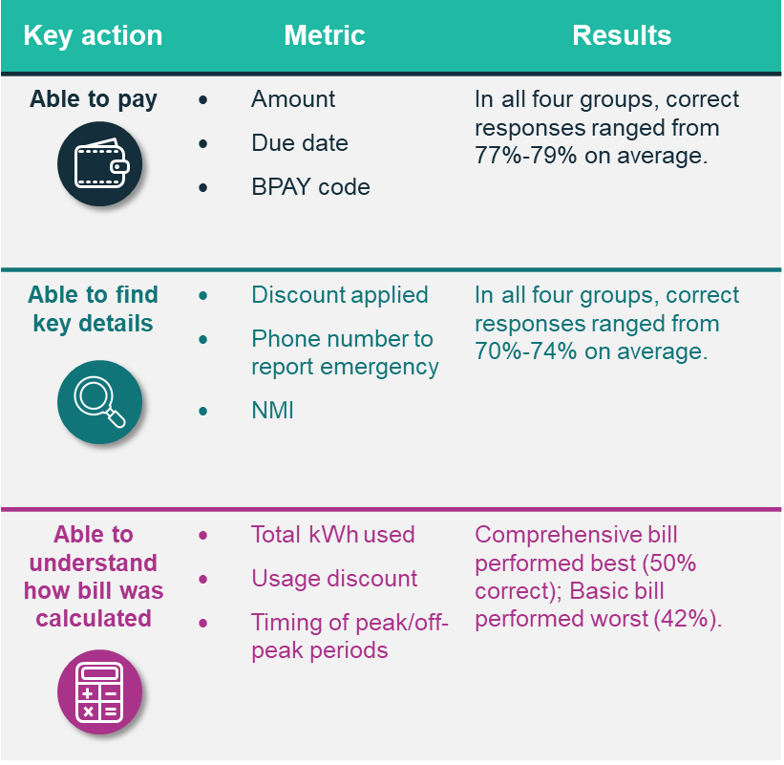
Why didn’t the shorter bill perform better?
Our literature review concluded that several factors contribute to cognitive overload when reading energy bills: consumers’ low energy literacy, complex and inconsistent language, large amounts of information, and confusing layouts.
And yet the shorter ‘basic bill’ performed no better than the others – and perhaps worse on questions related to understanding how the bill was calculated (see table).
So why didn’t the shorter bill perform better?
Shorter is not always simpler. Some additional explanatory information can make a bill easier to understand.
All layouts drew attention to key information, such as by putting the amount and due date in a bold circle. Even on the longer bills, this information was still easy enough to find in our prototypes.
These results suggest that a bill that incorporates sound design principles can vary (within a reasonable range) in terms of content and length without compromising comprehension and causing information overload.
Findings from the focus groups revealed a strong preference for the comprehensive bill. Participants noted that the comprehensive bill has all the necessary information clearly displayed on the first page, whilst more information was provided on subsequent pages if this was needed.
Note: the ‘able to pay’ questions were all fairly simple so it was surprising that the accuracy rate was only 77-79%. It is possible that, despite our efforts to remove ‘non-genuine’ respondents, there remained some respondents who did not seriously attempt to answer the question. See Technical Appendix (Section 5) for further discussion.

Slide 34
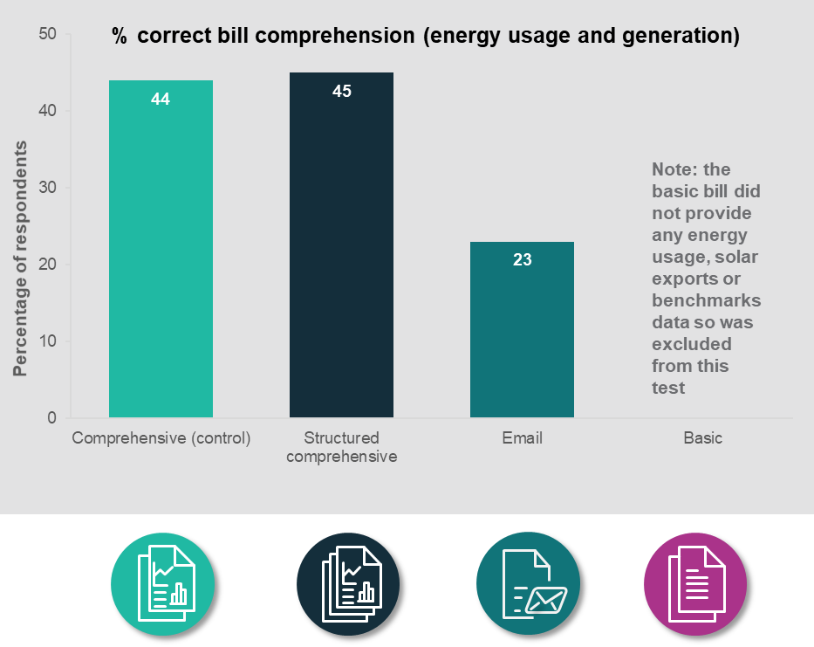
Small friction costs, like clicking a link, are a big deterrent
All bill designs other than the ‘basic bill’ contained information on: past energy usage, energy benchmarks, and solar exports. This information was presented in the following formats:
The Comprehensive Bill (#1) had these charts embedded on page 2 among other information (a common way to present this information).
The Structured Comprehensive Bill (#2) had larger charts on page 3 with the heading Understanding Your Energy Footprint.
The Email-Style Bill (#3) had a link in the bill prompting respondents to ‘Click on the link to download the Home Energy Report’.
For these three bills, we asked respondents additional comprehension questions about their energy usage and energy generation (solar exports).
We found no differences in comprehension about energy usage or solar exports between the two comprehensive bills. However, the Email-Style Bill with the clickable link performed substantially worse on this measure (21-22 percentage points lower than comprehensive bills, which contained identical information). This is because only 15% of respondents in the Email Bill group clicked on the link to download the Home Energy Report.

Slide 35

We used qualitative research throughout this project
Why we collected qualitative insights
Qualitative research provides in-depth insights into values, experiences and feelings that shape the behaviours of individuals. Qualitative research is helpful as it places an emphasis on explaining why people think and behave in certain ways and to better capture attitudes that may not be easily collected in quantitative methodologies.
How we gathered qualitative insights
Insights from qualitative research were captured in two main ways in this project:
focus groups (as discussed in Section A)
free-text responses in the survey, that were then coded and analysed.
Limitations on qualitative insights
Whilst qualitative research is helpful in understanding more about a problem, it has limitations. Such research often involves small sample sizes, meaning the research insights may not generalise. While free-text responses in surveys have a larger sample size, they are not able to ask follow up questions as we would in a focus group or interview. Finally, there may be a self-selection bias–whereby those that provide qualitative responses are not representative of the population as a whole.
These limitations should be considered when interpreting results from qualitative research.

Slide 36


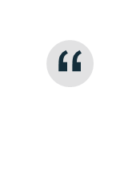
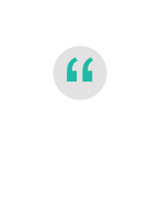
What people liked and disliked about the bills
Comprehensive bill
People liked how informative and helpful it was
Respondents liked that this bill was clear, comprehensive and informative. People appreciated the standardised layout, which made it easy to find things. People responded positively to the additional content, such as the best offer, benchmarks, plan summary, solar and usage charts.
        “All the information required was on the bill and the urgent stuff like paying the bill was easy to find”
        “Information well described in written and graphical forms”
        “It was like ours so I had an idea of where to look”
        “The big circles on the front make it almost idiot proof”
People disliked the clutter and the small font size
Many people disliked the small font size (Arial 10 point on the more detailed text). They also suggested the layout was fragmented and unstructured.
“The information was randomly placed and did not logically follow through”
“A bit overwhelming/crowded/just a lot of info all at once”
“I couldn’t enlarge and my eyesight can’t read tiny writing easily”
Structured comprehensive bill
People liked the additional content
As with the comprehensive bill, people responded positively to additional content.
“Seeing in a break down to know what was used. How the company came up with the figure”
“Comparative energy usage from local households and cheaper plan offer”
People liked that it was easy to navigate
People liked the layout, and commented positively that it was clear, uncluttered and easy to navigate.
“The necessary information was clear and easy to understand and interpret. The solar exports vs energy used was informative. Advice to save money by changing to a cheaper plan was a nice gesture”
“Skilful graphing. In-depth info”
Some people thought it would be a waste of paper if printed out
However, some people disliked the layout, commenting that it was difficult to navigate on a mobile phone and would be a waste of paper if printed out.
“Too much information going on”
“The graphs were not easy for me to understand”

Slide 37


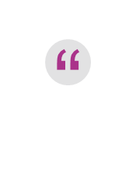
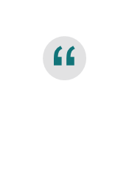
What people liked and disliked about the bills (ii)
Email bill
People really noticed the best offer information
Best offer information was quite salient on the email style bill, and many people responded positively to that information. It was also described as easy to understand, clear and uncluttered.
“Told you everything even how to save by switching plans”
“I like that the energy company could find her a better deal once her contract expires (June 2021) and let her know approx. how much she could save
“All the info was accessible on one page”
People didn’t like having to click a link to download the energy report
Others reported that they couldn’t find information. Many people noticed that the energy benchmarks and usage charts were ‘missing’ and pointed this out as a ‘dislike’.
“[I disliked] having to look at a separate home energy report. My supplier puts this on the bills so I don’t have to go searching elsewhere”
“Did not give enough comparison info (usage last month/year other households/no. of people)”
Basic bill
People liked how uncluttered it was
People commented positively that it was easy to understand. They also liked the layout and simplicity.
“First power bill I have ever understood so clear and easy to understand”
“Just about everything was easy to find and it was self-explanatory”
“The white space”
People found it a bit lacking in details
However, the brevity that some people loved was rated as too brief by others. Some people commented specifically on the lack of comparisons of usage over time or to other households.
“A bit too short and lacking in some details”
“The lack of historical usage data or the comparison of my usage compared to other households in the region”
“Prefer to see charts rather than numbers it makes it easier to read”

Slide 38
Consumers said: Bills should be simpler
We asked survey respondents: “Please describe what you would like to see in a future energy bill. For example, if you could change one thing about your energy bill, what would it be?” We reviewed their responses to identify the themes that emerged.
People wanted bills to be easy to understand and not too wordy
People wanted less jargon and clearer explanations
People wanted to know why they were being charged a ‘supply charge’
People wanted standardised bills
Many comments contained suggestions for bill simplification. Although there were some preferences for a shorter bill or even just a text message containing the amount due, other suggestions made clear that simplicity is about much more than length. Responses included requests for bills that are simpler to understand and suggestions for layout and presentation (see next slide).
What makes a bill simple was not quite as readily defined – some people want a minimum of content without 'superfluous rubbish', others want it to be 'detailed and easy to understand'. One recurring suggestion for simplification is language. In general, this includes a request for plain English, a minimum of technical jargon and clear explanations.
A recurring complaint, which is a good example of a comprehension gap, is the supply charge, which was frequently referred to as a scam or a rip-off. Customers do not necessarily equate the supply charge with the costs of maintaining poles and wires, or organising meter readers.
Some respondents drew attention to the benefits of standardisation, noting that they have either learnt over time how to understand and find things on their bill, or that they liked the bill in the example because it was laid out similarly to their own bill.
“Energy bill is generally too wordy which deters people to even start reading”
“I want my payment bill to be detailed and easy to understand”
“Put it in layman terms not all this tech stuff”
“No foreign language - elec talk”
“Explain supply charges. They are arbitrary and a rip-off. Supplying the material to make money is the responsibility of the owner not users. We pay enough.”
“Remove supply charge. It discriminates against and penalizes low and careful users”
“Lay it out simply and make them all the same - stop pretending you are doing that now”
“Universal energy bills”

Slide 39





Consumers said: Bills would benefit from better layout and presentation
“I like the use of colour. Nice graphics. Very clear”
“Larger writing with easier columns to understand”
“I'd like if my bill was colour coded and the writing was a bit bigger”
“Make it more visual with diagrams and more infographics and larger text for important values”
“I would like to be able to clearly see when my bill is due”
“Spread out a bit more, less jargon”
“Put usage/cost/due date on the same page as the payment methods”
“Perhaps green and red to indicate debt (money owed) or credit”
Use colour strategically
Many respondents also suggested the strategic use of colour to indicate credits and debits, or to separate usage and exports.
Reduce clutter
Respondents suggested making bills more spread out and less cluttered. Both focus groups cohorts noted the importance of including “white space”.
Make font size bigger
One of the biggest issues raised with the bill presentation was the font size, especially for older people and people with vision impairment to read the tiny text. This was also mentioned as an area of importance in the focus groups with people from a CALD background and elderly people.
Make critical information stand out
Some respondents had ideas about how to make the presentation clearer, mainly by making critical information really stand out. For example, they reinforced the importance of putting the most important information on the first page and in larger print.

Slide 40
Contents
A. | Context and research design
B. | Survey overview
C. | Bill content
D. | Bill simplification: length and layout
E. | Bill comprehension: how the bill is calculated
F. | Bill comprehension: switching and market engagement
G. | Bill comprehension: energy usage and solar exports
H. | Limitations

Slide 41
How the bill is calculated: Overview and key findings
Overview
Literature and qualitative research
What we found
Consumers want to understand how their bill is calculated but some struggle to do so.
This section draws together evidence from the literature, stakeholders and qualitative research on the difficulties consumers face and how these might be addressed.
We developed and tested several variations to the bill content that were intended to help survey respondents understand how the bill was calculated:
A plan summary
A box with plain English definitions
Different designs of the detailed charges table
This section also presents the results of those experiments.
Two groups have particular difficulty understanding bills and how they are calculated:
Consumers who are experiencing hardship, and
Consumers culturally or linguistically diverse backgrounds (CALD).
Specific areas of difficulty – for these cohorts and generally – include:
The use of discounts and how they apply
Time of Use plans (e.g. plans that vary rates for peak and off-peak periods)
Technical terms
Bill meter readings
Seasonal rate changes
We investigated three ways to try to improve consumers’ understanding of how their bills are calculated.
Plan summary
Energy plans are often complex. We tested a plan summary that explained key features like discounts, and the rates and timing of peak and off-peak periods. The plan summary improved survey respondents’ comprehension, and specifically their understanding peak and off-peak periods.
A box with plain English definitions
We tested a box with plain English definitions of technical terms like ‘supply charge’, ‘kilowatt-hour’ and ‘solar exports’. However, to our surprise, this box had no observable benefit on bill comprehension.
Detailed charges table
We tested several variations in the format of the detailed charges tables but none performed better than an ‘invoice-style’ table that is typical of those currently used in the market.

Slide 42
What the literature and stakeholders say about how the bill is calculated
Consumers facing hardship have difficulty understanding their bills
Consumers facing financial hardship had particular difficulty understanding their bills (Queensland Council of Social Services, 2020). These difficulties are due to bills’ overall complexity, inconsistent and changing formats, information density, illogical organisation, and gaps in the bill content. This is consistent with our survey findings described in Section B.
Time of Use details can create confusion
Consumers can fail to interpret time-of-use (TOU) information correctly and make mistakes mapping consumption to costs. A study from BEWorks (2014 pp52-54) shows that consumers have better comprehension and recall of TOU information when traditional terms ‘On-Peak, Mid-Peak, Off-Peak’ are renamed to, for example, ‘Most expensive, Average, Least Expensive’. The interventions also increased consumers’ intentions to move consumption to non-peak times of the day. However, they noted that the widespread use of the ‘Peak’ terms had allowed consumers to familiarise themselves with the language and learn the meaning over time.
Consumers struggle to understand technical terms
Consumers struggle with technical terms, as noted in Section D (bill simplification). For example, ‘kilowatt-hour’ (kWh) lacks meaning for consumers because of its lack of tangibility to actual usage activities (Ofgem, 2009 pp15-16). Information – such as how much you can do with 1 kWh of electricity – improves the accessibility of kWh information by providing concrete examples of real-world usage (BEWorks, 2016 pp15-16).
Note: For more detail, refer to Section 3 of the Literature Review.

Slide 43
Consumers said: It should be easier to understand how the bill is calculated
“
“Don't stuff around with discounts just give a straight forward price”
“The peak and off-peak hours clearly stated as I have no idea what they are”
“Date that your current energy agreement lapses and time to negotiate a new one”
“Have more information from the government about rates and usage”
“Explicit confirmation whether they use actual meter readings or estimates/projections”
“Have the read date in a very obvious spot every quarter I need to look hard to see where it is”
Many CALD participants in focus groups reported a lack of confidence in understanding how their bill was calculated.
Among the specific comprehension challenges reported by CALD consumers in reading their existing bills, the most common are:
technical terms (e.g. NMI, kilowatt-hour)
detailed charges calculation
calculation and interpretation of graphs.
Consumers asked for more transparency of energy plans and meter readings
There were a range of comments that indicated that consumers wanted better information about how their plan works and how their bill is calculated.
Many respondents also indicated that they also like to check whether the bill is based on an estimated meter read.

Slide 44
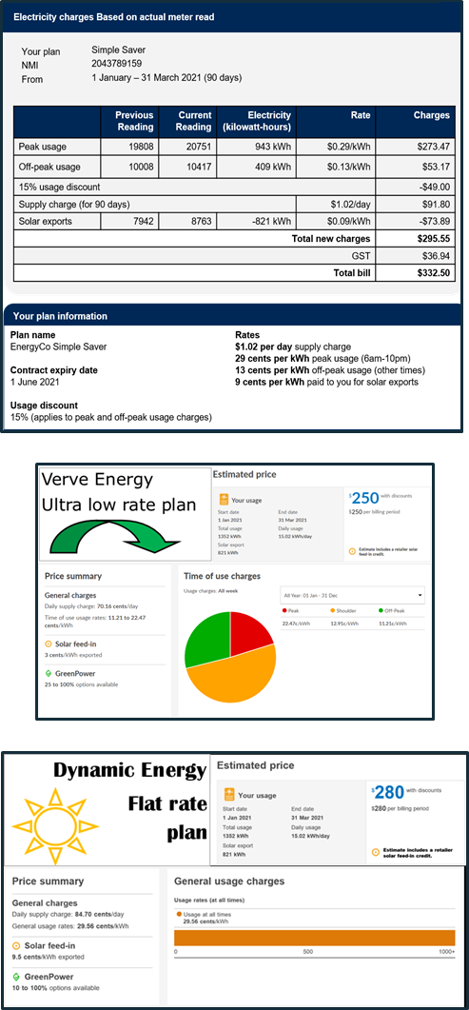


Plan summaries made it easier to understand your plan (but not to choose the best deal)
Energy plans have many different characteristics—such as peak and off-peak hours, rates, supply charges, and discounts. Understanding these characteristics is important for understanding how the bill was calculated, and how consumers might optimise their energy usage. For example, the breakdown of charges usually states the peak and off-peak usage, but without knowing which times of day are peak or off-peak, it is difficult to know how to reduce your bill in the future.
In the Australian energy market, few retailers include plan details on the bill. Some include the plan name but others do not even include this.
We designed and tested a brief summary of plan characteristics that set out: the plan name, contract expiry date, details of the usage discount, and details of the rates (including the times and rates for peak and off-peak charges).
We found that a plan summary helped consumers to better understand how their bill was calculated. Specifically, a higher proportion of respondents who saw the plan summary (62%) correctly understood the time of peak and off-peak periods (specifically, that midnight was off-peak and 8pm was peak) compared to those who did not (53%).
We did not find evidence that a plan summary helped respondents choose a better deal. We asked respondents to compare three plans: their own bill (either with or without a plan summary) plus two alternatives drawn from the Energy Made Easy website, both of which were lower cost. However, respondents who saw a plan summary were no more likely to choose a better deal. We suspect this is because Energy Made Easy already simplifies plan comparison by prominently displaying what the bill would have cost under each plan. In this sense, respondents are not disadvantaged when comparing to other plans through Energy Made Easy.
We added in a summary
We showed
two alternatives

Slide 45
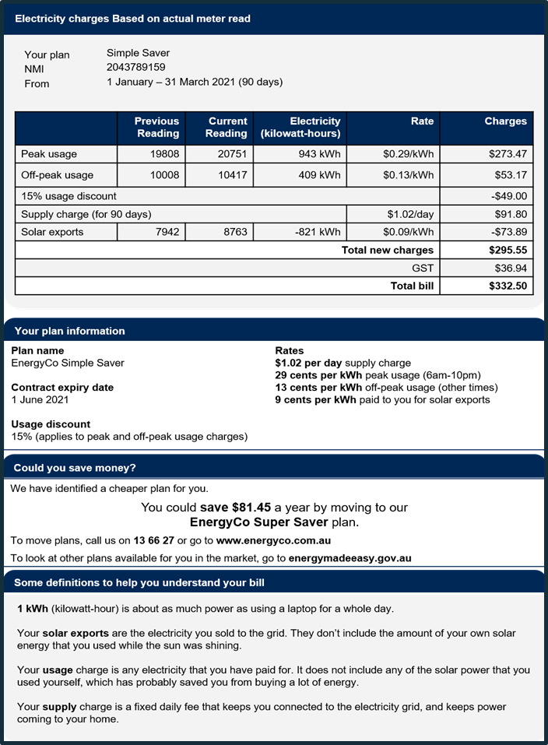

Including a definitions box did not improve comprehension
We used plain English wherever possible in the energy bill.
While we used simple language wherever possible, some technical terms were hard to replace so we tested the impact of adding a box with plain English definitions for:
‘Kilowatt-hours’
‘Solar exports’
‘Supply Charge’ and
‘Usage charge’ (or ‘energy usage’).
We explicitly tested definitions twice, adding them to plan summaries and to home energy charts to see if they boosted comprehension.
We found no positive impact of including a definitions box on comprehension.
This result was a surprise as we asked a series of comprehension questions that should have been easier to answer with clear definitions. If anything, our results suggested the group who received definitions may have performed worse on these questions. We are unsure why this might be.
We sought to select the appropriate technical terms and provide clear definitions but it is possible that different definitions or different comprehension questions may have yielded a different response.
It should be noted, however, that definitions were viewed as valued information by participants in the CALD focus groups.

Slide 46
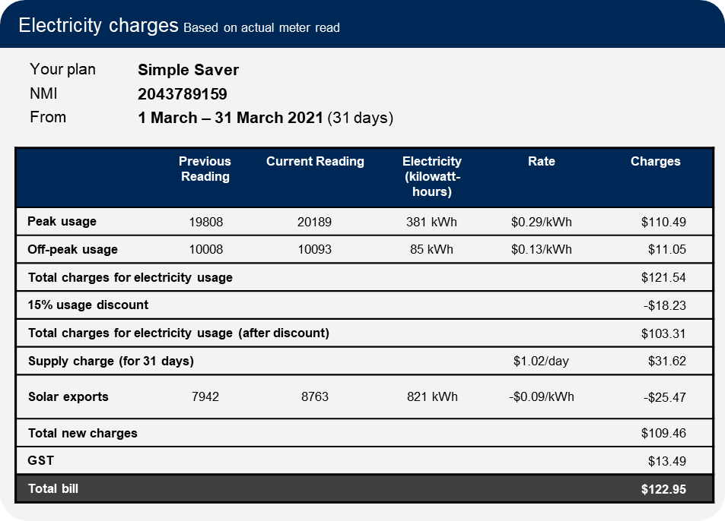
Existing charges table performed at least as well as our re-designed tables
The detailed charges table is an important bill feature.
Charges tables typically include the number of units of energy consumed (e.g. days or kilowatt hours), price per unit, and the total amount for the bill. This is usually found on page 2 of a bill.
In our review of existing bills, detailed charges tables were relatively similar across different retailers. However, a Canadian study tested in the design and formatting of the charges table. In an online survey experiment, they found that their alternative designs outperformed versions used in the market (BEworks 2014 pp59-64; BEworks 2016 pp10-11).
We tested several designs, two of which were inspired by the BEworks design, against a version that looks similar to many designs currently in the market.
We found that the alternative detailed charges tables failed to outperform the familiar ‘invoice‑style’ table. Consumers did not rate the new versions easier to understand, nor were they able to answer the comprehension questions more accurately. In fact, the familiar table performed as well as – or possibly better than – the others in terms of comprehension.
In part, this was because respondents who saw the invoice-style table already had a high level of comprehension. Three-quarters of these respondents were able to verify the amount of the supply charge, and to rate the detailed charge breakdown as easy to understand.
One challenge is to create a design that is flexible enough to be adapted for any of the different pricing models currently available in the market.

Slide 47
Contents
A. | Context and research design
B. | Survey overview
C. | Bill content
D. | Bill simplification: length and layout
E. | Bill comprehension: how the bill is calculated
F. | Bill comprehension: switching and market engagement
G. | Bill comprehension: energy usage and solar exports
H. | Limitations

Slide 48
Switching and market engagement: Overview and key findings
Literature and qualitative research
What we found
Overview
How can we make it easier for consumers to compare their retail contract with other energy offers and ultimately switch to a better product?
This is a longstanding issue, in the energy market as well as many other service markets such as banking, superannuation, and professional services. For any of these markets, greater consumer engagement and switching is likely to require a combination of policy interventions, information and comparison services. In the energy market, bills aren’t ‘the answer’ but they have an important role to play.
Nearly 1 in 4 survey respondents had considered switching plans in the past year and hadn’t done so, while only 1 in 10 had actually switched. This indicates both an appetite for switching as well as barriers to doing so.
There are many costs involved in and barriers to switching products. For example:
The time and effort involved in searching for and comparing alternative products
The fees and transaction costs associated with actually switching
Some consumer have a bias towards the status quo
Consumers may fear being worse off if they switch.
Consumers may think all retailers are the same and there is no point to switching.
When combined with other tools and interventions, bills may have an important role to increase market engagement. For example, bills may:
make it easier to compare plans through the use of standardised language or inclusion of a plan summary
reduce transaction costs by providing a link or QR code to a comparison site
counter status-quo bias through provocative information and ‘calls to action’
We tested two bill elements that may help counter inertia and status-quo bias:
A ‘best offer’, encouraging respondents to switch to a cheaper plan from the same retailer
A comparison of the current plan to the government reference price.
Best offer
Respondents who saw a ‘best offer’ on their bill were 2-3 times more likely to suggest switching plans as a way to reduce energy costs.
Reference price
Respondents with plans equal to the reference price were much more likely to say they would shop around than those with plans below the reference price.
It is possible that consumers who have plans below the reference price will incorrectly interpret this as a sign they are on a good plan, inducing complacency. However, we did not test this directly so this remains a question for further research.

Slide 49
What the literature says about switching and market engagement
There is significant literature on barriers to switching
There are many costs involved in switching products. First, searching for and comparing alternative products takes time and effort, especially when there are many suppliers in the market and the product is complex in nature. Second, there are the fees and transaction costs involved in the actual process of disconnection/re-connection.
In addition, there are psychological and behavioural barriers to switching. Some consumers have a bias towards the status quo (their current retailer). This may be related to fears of being worse off if they switch. Finally, consumers may think all retailers are the same and there is no point to switching.
Bills have an important role to support switching
Energy bills are just one input to the process of comparing plans and deciding to switch. Other potential influences include product comparison sites, retailers’ advertisements, or conversations with friends or family.
Nonetheless, energy bills have an important role to play.
Bills can reduce transaction costs for switching by providing a link or QR code to a comparison site.
In addition, bills can make it easier to compare plans through the use of standardised language or a plan summary (Fletcher, 2016; Marzilli and Starc, 2016; Sitzia et al., 2015; see also the discussion of plan summaries in Section E.).
Finally, bill content may be able to counter status-quo bias.
Bills can counter status-quo bias through provocative information and ‘calls to action’
In Victoria, bills already include information about better offers available from the same retailer. This can be combined with a ‘call to action’ (e.g. ‘to save money, call us on …’). Provocative information plus a call to action may spur consumers to search for a better plan . Calls to action work best when presenting lower rates or more savings available. They are also more effective when consumers are given only one alternative option, rather than many. However, the effects of generic encouragements to switch are less clear, with studies in the UK and EU producing conflicting results (FCA, 2016; EU, 2018).
Status quo bias
Individuals will disproportionately stick with the status quo and maintain their current or previous decision (Samuelson and Zeckhauser, 1988).
Note: For more detail, refer to Section 5 of the Literature Review.

Slide 50
Consumers said:
It should be easier to engage with the market
People wanted their retailer to tell them about cheaper plans
“All pricing information easy to find on bill and if there is a cheaper plan I could be on”
“Compare to other deals because they never offer to help. I got ripped off for 25 years because I didn't know what I could do”
“I'd like to see the time remaining before the next price changes are determined so I know when to shop around”
People wanted it to be easier to compare their plan with other plans
“The ability to compare my energy prices with other energy providers not just users with my energy provider”
“Simple bill comparing price to other providers and showing all the comparisons of rates so can change my plan and save money if there is a better one out there”
“To have a comparative rate for same household from the best alternative provider”
People were keen to see the reference price included on their bills
“I like the thought of seeing how much I am below or above the government input as was shown in the second image. This would help me know if I was getting charged correctly or ripped off.”
“I would love to know what the reference price is and how it compares to my price. Also any seniors’ prices the provider has.”
Around a quarter of survey respondents said they had considered changing plans in the past year, so it is unsurprising that there were many comments around the topic of switching.
In the length-and-layout trial (Section D), respondents noticed and commented on the ‘best offer’ and the reference price information in the bills.

Slide 51
Testing switching behaviours and market engagement
We tested the impact of two bill features on switching behaviours and market engagement, but with differences in methodology
Methodological differences
We used different measures to evaluate the impact the best retailer offer and the reference price.
For the best retailer offer, respondents were asked an open question seeking suggestions on ways to reduce energy costs or save money on their electricity, and they could write in any free-text response.
For the reference price, respondents were asked whether the information about the reference price would lead them to: shop around for a better deal, stay on their current deal, or feel unsure.
Consequently, it is not possible to make a direct comparison between the two sets of results.
However, the differences between groups within a trial (e.g. the difference between ‘best offer’ and ‘no best offer’, or between ‘equal to reference price’ and ‘below reference price’) remain reliable estimates the impact of those features.
The AEMC final determination specifies that billing information should enable small customers to “compare their customer retail contract with other energy offers available to them”.
We used different methods to test how providing ‘best retailer offer’ and ‘reference price’ information on a bill could impact consumers’ intentions to engage in switching behaviours.
Best retailer offer
For the ‘best retailer offer’, we tested if adding information about cheaper plans available from their current retailer prompted participants to think about comparing or switching plans.
Reference price
For the ‘reference price’, we tested if adding information comparing an existing plan to the market reference price would increase participants' intention to shop around.

Slide 52
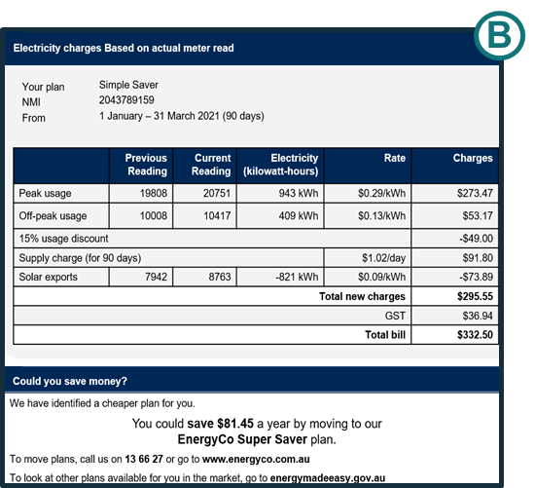
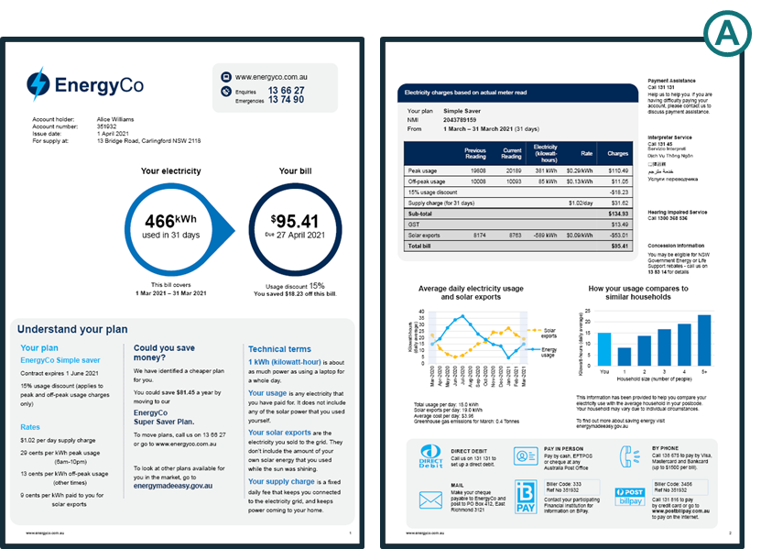

We added a ‘best retailer offer’
We added information telling consumers about cheaper plans available from their current retailer.
The ‘best retailer offer’ was included in a box entitled ‘Could you save money?’ along with a statement of how much money could be saved, and an encouragement to compare with other plans in the market by visiting the Energy Made Easy web site.
We wanted to know whether seeing this information would make people more likely to consider switching plans.
We tested the impact of the ‘best retailer offer’ in two different ways:
A control group of participants saw the detailed charges table and plan summary, while another group saw these along with ‘best offer’ box (Group B)
A control group saw a bill prototype with no best offer (the basic bill), while three other groups saw various bills all containing the best offer message but placed in varying locations (Group A)
Respondents were asked an open question seeking suggestions on ways to save money on their electricity (Group B) or reduce energy costs (Group A) and could write in any free-text response.

Slide 53
The best retailer offer increased people’s intention to switch plans
“
Free text responses: ways to reduce energy costs
“Try to use energy-saving lights”
“Use blanket instead of heater. Watch TV in the dark”
“Use power more when sun shining”
“Do the washing during off-peak times”
“Perhaps go to a comparison site and see if she is using the cheapest plan”
“Change plans to the one recommended on her bill”
The presence of a ‘best offer’ message on the bill substantially increased the proportion of respondents suggesting the bill recipient should compare their plan or switch to a better one. This was true in both trials.
Respondents were asked for suggestions to save money or reduce energy costs. We coded responses as ‘comparing or switching plans’ if they suggested:
Calling the energy company to ask for a better plan or discounts, or
Compare the plan with others in the market.
The best offer message was most effective (the effect was tripled) when it was more prominent on the bill (Group B). But just having it somewhere on the bill was enough to cause a substantial effect (Group A).
What other money-saving suggestions did people provide? This was an optional question so around half the respondents did not provide an answer. Of the remainder, most (other than those listed above) were:
Suggestions to cut down energy use (the majority)
Suggestions to use more solar or off-peak energy, and use less at peak times
74% of respondents said they would value best offer information on their bill.
Suggestions to compare or switch plans
% who suggested comparing or switching plans
(Group A: n=6,372. Group B: n= 7,827)

Slide 54
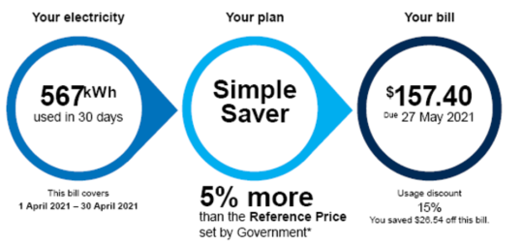
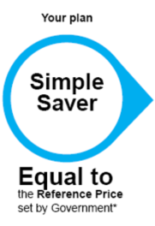
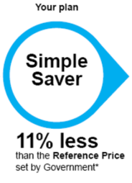
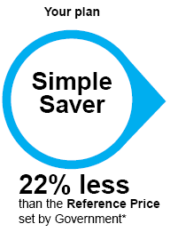
We added a comparison to the government ‘reference price’
The Reference Price and the Default Market Offer are Government initiatives intended to lower energy prices and improve participation in the market. They operate to set a cap on standing offers and to mandate a consistent benchmark price for comparisons.
While not meant as a proxy for the average market price, the aim of the reference price is to make it easy for consumers to compare different electricity plans and prices. In particular, when retailers advertise their electricity plans, they are required to show how it compares to the reference price. We explained to participants what the reference price was without explicitly telling them it generally represents the highest price on offer in the market.
We added a comparison to the reference price to the first page of the bill, depicting plans that were below, equal to or above the reference price. We expect that adding the reference price to the bill would make it easier for consumers to quickly compare their current plan with advertised plans however we were unable to test this.
Instead we tested how consumers’ stated intention to shop around changed depending on how their plan compared to the reference price (above, equal to or below). This is a different method to that used to test ‘best offer’ as we asked people explicitly whether they would shop around for a better deal. This means the proportions saying they would switch should not be compared between ‘best offer’ and ‘reference price’.
* Text displayed at the bottom the bill: “The electricity rates you are paying in your current plan are [equal to/11% less than/22% less than/5% more than] the reference price set by Government. You can use this percentage to quickly compare to the rates of other plans advertised by retailers. The reference price is based on the average electricity usage in your area.”

Slide 55
Including the reference price may prompt some consumers to shop around
But the reference price could induce complacency for consumers whose plans are below the reference price
We tested the impact of including information that the energy plans was equal to or below the reference price.
For plans equal to the reference price, 40% of respondents said they would ‘shop around for a better deal’. But this proportion decreased for those with a plan below the reference price. The extent of the gap between plan and reference price made little difference in the examples we tested.
In practice the reference price generally represents the highest price in the market. It is possible that consumers who have plans below the reference price will incorrectly interpret the reference price comparison as a sign they are on a good plan, inducing complacency. However, we did not test this directly so this remains a question for further research.
78% of respondents agreed (at least ‘slightly’) that they would value having reference price information on their bill. This finding was backed up in the focus groups where both CALD and 65+ cohorts finding the inclusion of a reference price as useful. However, the 65+ noted it is not deemed to be as useful as personal, historical usage data.
% who would shop around for a better deal
Note: we also tested the impact of information showing an energy plan that was above the reference price, and found an even higher inclination to shop around. However, to our knowledge, there are very few market offers currently available in the market that are higher than the reference price so we have focused on the results for the other 3 groups.
Survey question: “If I saw on my bill that the plan was [equal to/11% less than/22% less than/5% more than] the reference price, I would …”
Caveats: 1) We asked respondents about their intentions to shop around however we know that people do not always follow through on these intentions. 2) These proportions are not directly comparable to those given in ‘best offer’ testing due to differences in the outcome measures used.

Slide 56
Contents
A. | Context and research design
B. | Survey overview
C. | Bill content
D. | Bill simplification: length and layout
E. | Bill comprehension: how the bill is calculated
F. | Bill comprehension: switching and market engagement
G. | Bill comprehension: energy usage and solar exports
H. | Limitations

Slide 57
Benchmarks, past use, solar exports: Overview and key findings
What we investigated
How can we make it easier for consumers to understand their energy consumption and production, to assist with using energy efficiently?
We investigated 3 types of content designed to make it easier for consumers to understand their patterns of energy use and production:
Benchmarks (or peer comparisons) provide a comparison with the amount of energy used by other households in the community, making it easier for people to work out how their usage compares with similarly sized households.
Historical usage charts show electricity use over the past year (usually 13 months or 5 quarters).
Solar export charts are not yet common on Australian bills. They depict how much energy has been transferred to the grid, and allow a comparison between the household’s energy usage and generation.
Benchmarks
A recent literature review by CSIRO concluded that: “Presenting electricity consumption benchmarks on household bills is likely to benefit some, but not all, customers.”
It made recommendations to improve benchmark design and delivery:
Benchmarks should be visible and prominent
Associate benchmarks with a credible source
Display information that will be most meaningful
Benchmark should be as relevant to household as possible
Add positive reinforcement for low usage households
Consider whether to use the average or, e.g., the top 20% as the benchmark
Add practical energy-saving tips
Consider standardisation of information across retailers
We conducted two trials involving benchmarks. The first presented a bill element including a benchmark. It found that benchmarks: improved energy usage comprehension, and increased the likelihood that high-energy consumers would suggest energy reductions as a way to save money.
In the second trial, where the benchmark was included on a full bill, we did not find evidence that the benchmark increased energy saving suggestions.
Past usage
Historical usage charts showing seasonal changes are core content for energy bills.
Retailers and consumers were generally supportive of historical usage charts. And there is some evidence that usage feedback on bills have a small impact on encouraging energy efficiency. In addition, focus group participants noted that personalised usage data can be important.
We did not find that any one of our designs for presenting past usage was superior to the others.
Solar export charts
Information on solar exports may help consumers make the most of their solar by shifting usage times to save money and reduce pressure on the grid. Indeed, 89% of solar consumers agreed they would value solar export information on their bill.
We were, however, unable to draw a clear conclusion about the impact of solar exports on intentions to use solar more efficiently. And we did not find evidence that the chart design mattered.

Slide 58
Consumers said: It should be easier to understand your energy usage
People wanted personalised and practical tips to save energy
People wanted more granular information about their energy consumption
People wanted to know how much solar their system was generating
Consumers would like to know where their energy is coming from
People wanted benchmarks to be more clearly explained
Requests for personalised tips to save energy included advice on: smart meters, solar, and which appliances use the most power.
Respondents were interested in getting more granular usage data to enable them to use less energy.
A lot of people wanted better solar data, or information about getting solar.
Many respondents wanted to know about the ‘green credentials’ of their energy company.
A number of comments indicated people want the benchmark comparison, but would like to be able to better understand how it is calculated.
“How to get a smart meter”
“Information on devices that would help reduce electricity costs”
“How to save and not use so much power - with no solar panels and only renting with low income. People in this position really struggle and just want to get ahead like everyone else”
“Tips on how to reduce electricity use in general. Maybe a new tip each billing period”
“Clear details on spikes in usage”
“Easy comparison to current, last bill and same time last year”
“Provide a lowest, medium and highest hour comparison to allow for personal analysis”
“Seeing how much solar energy you used directly for your house vs exported”
“Details about green energy solutions (solar and batteries) and how much they could save me”
“Information about when our solar energy is being exported i.e. at what time and how much”
“Information about the company I'm dealing with. Their green credentials”
“I'd like to know exactly how much of the green energy I actually use. That information isn't quite as transparent as I'd like”
“How they calculate the comparison of my usage to others. Currently we seem to use a lot of power but I suspect we are not comparing other properties with a pool etc”
“Comparison to other households & occupant sizes. Previous usages to track on where she's going”

Slide 59
What the literature and stakeholders say about benchmarks
Energy bill benchmarks provide average usage figures for households with the same number of people in the same postcode. They are designed to help consumers compare their individual usage with the 'benchmark' usage. Electricity consumption benchmarks for residential customers are mandatory for residential customer bills, and the first benchmarks appeared on bills in 2012.
Benchmarks are likely to benefit consumers but the design and delivery matters
A recent, thorough review of the literature on electricity bill benchmarks concluded that: “Presenting electricity consumption benchmarks on household bills is likely to benefit some, but not all, customers. Some segments of the population may respond in different ways to the benchmarks, with evidence suggesting that there may be a subset of households (e.g. below-average energy consumers) who do not benefit from the current design and delivery of this information.” (Frederiks, 2021 pv)
The literature review notes that numerous factors may moderate the effects of benchmark data on consumers, so the benchmark design matters. The review addresses these moderating factors in a series of recommendations for the design and delivery of benchmarks (Frederiks, 2021 Section 4.1).
Visibility and placement of information: benchmarks should be clearly visible and prominently displayed.
Credibility of information: consider having the benchmarks associated with a reputable official source (e.g. government agency) to enhance consumer trust.
Meaningfulness of information: Consider what type of information is most meaningful. For example, displaying the benchmarks in terms of money spent may make the information more relevant.
Relevance of information: The reference/comparison group should be as similar to the consumer as practically possible and relevant to their own identity.
Add positive reinforcement for low usage households: To reduce the risk of a ‘boomerang’ effect among low energy users, combine the benchmark data (a descriptive norm) with an injunctive norm that offers positive reinforcement for desirable behaviour (e.g. a smiley face or words of encouragement).
Consider the reference group: Instead of comparing a household’s energy consumption to the ‘average’ consumption of the reference group, consider comparing it to a higher-performing group (e.g. the most efficient 20% of households).
Add practical energy-saving tips: Consider including simple, easy, and practical advice alongside the benchmarks to inform consumers about what steps can be taken to save energy.
Consider standardisation of information across retailers: Australian energy retailers currently present benchmark data on customer bills in different ways. There may be value in a single, standardised format for displaying energy consumption benchmarks.
Stakeholder views
Energy retailers suggested that consumers generally do not like the benchmark charts because they have “caused unnecessary consumer distrust, complaints and costs” (AGL, 2020). Ergon Energy (2020) describes similar customer complaints about the benchmarking graph and claims that “each customer is unique and there are too many variables in a household to correctly depict such information on a comparison graph”. Consumer groups also suggested that consumers do not like peer comparison charts (e.g. EWON, EWOV, EWOQ and EWOSA, 2020, p.5)
Note: For more detail, refer to Section 4 of the Literature Review.

Slide 60
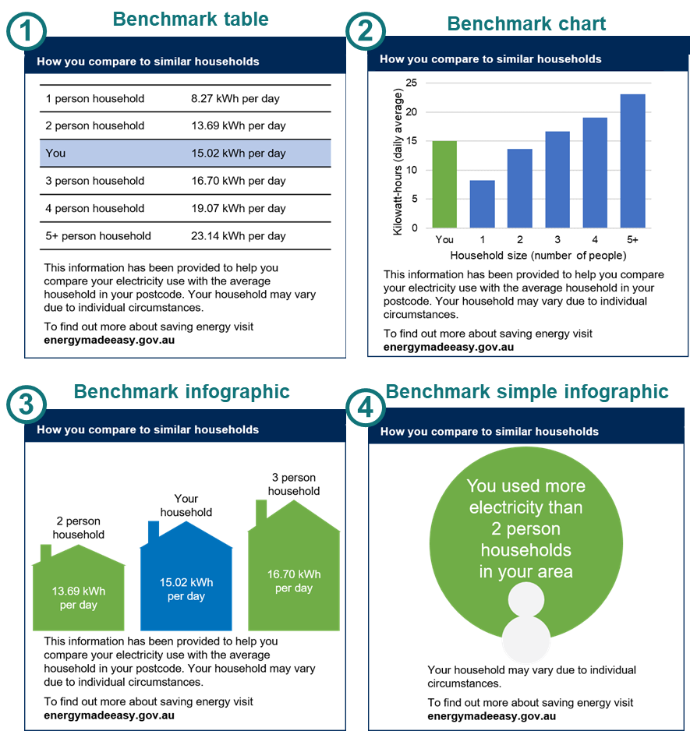
Benchmarks tell you how you compare to similar households
We tested benchmarks in both samples (Group A and Group B).
Group B trial
For Group B, we designed 4 different ways to present the benchmarks: a table, a chart, a detailed infographic, and a simple infographic. There were a total of 5 groups in the trial:
The control group simply saw a chart with their historical energy usage and solar exports, but no benchmark.
The other 4 groups saw the same usage and solar chart along with one of the benchmark designs.
Respondents were told that this information was part of a bill for someone who ‘lives alone in an apartment’ and we then asked them two questions.
Comprehension: We tested comprehension by asking whether benchmarks helped consumers realise the energy usage was ‘higher than other people’.
Intentions: Improved understanding may not, however, lead to a change in intentions so we asked a second, open-ended question: ‘What would you do to save some money on electricity?’. We coded all those who mentioned saving energy as indicating an ‘energy saving intention’.
Group A trial
In this trial, we only used one benchmark design (the chart), which was included in the 3 ‘comprehensive’ bills. By contrast, the ‘basic bill’ had no benchmark and so acted as the control group. Respondents were told the bill was for someone who lives alone and who would ‘like to know how she can reduce her energy costs’. As for the Group B trial, we coded the suggestions depending on whether they showed an ‘energy saving intention’.
Notes:
Consistent with literature.

Slide 61
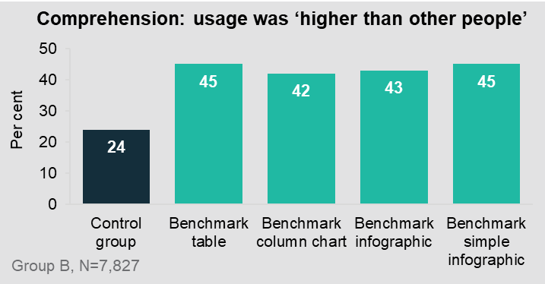
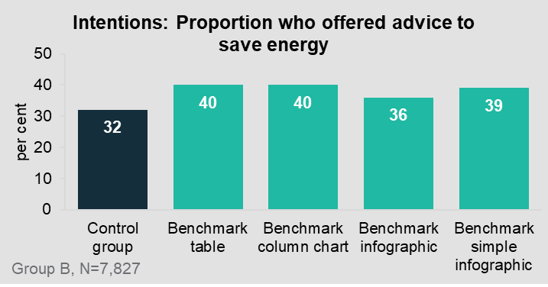
Benchmarks helped consumers comprehension and intentions (but all 4 benchmark designs performed equally well)
The control group saw a historical usage chart but did not see a benchmark (so they had no guide about how their usage compared with others). Of these, only 24% correctly answered that their consumption was above average. This question had four options so this is comparable to a pure guess. In effect, the control group allowed us to assess whether comprehension improved for those who saw the benchmark.
Consumers who saw a benchmark were more likely to see that energy usage was ‘higher than other people’ (comprehension) and to suggest energy reductions as a way to save money (intentions). They were also more likely to attribute an bill’s cost to high usage, rather than an expensive plan or a mistake. The proportion who offered advice to reduce energy increased from 32% (for the control group) to 39% (for the 4 benchmark groups combined). This suggests that a benchmark showing higher-than-average usage caused respondents to think about reducing energy usage.
Focus group participants stated that they found benchmarks were useful. However, the 65+ cohort felt benchmarks were less useful than historical usage data. Comparison to other households can either cause guilt (for those that use more than comparable households) or be disregarded (every house is different). Being able to compare current usage with the historical personal usage was felt to be a vital element of the energy bill to understand seasonal highs and lows (Hall and Partners, 2021).
We did not find evidence that one benchmark design outperformed the rest. While there was mild variation between the four benchmark designs, this was not enough to conclude that one design was clearly superior to the others.

Slide 62
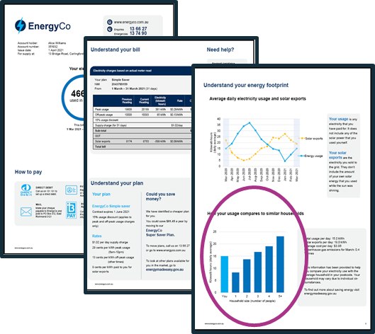
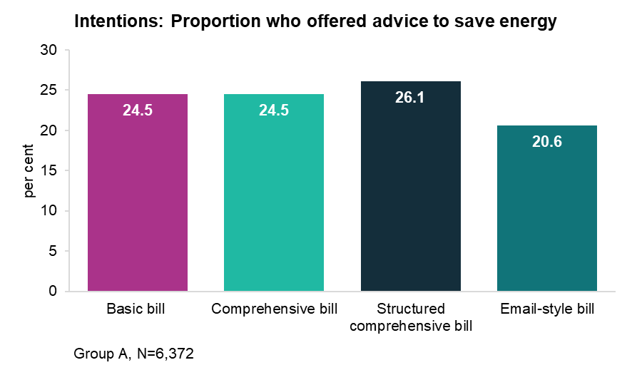
When benchmarks were included on a full bill, they had less impact on intentions
In the Group B trial, respondents only saw part of the bill – a chart depicting their usage and solar exports, and the benchmark. This meant the benchmark was prominent and largely free from distractions. By contrast, in the Group A trial, respondents saw a full bill, of which the benchmark was just one element (see Section D).
In this trial, we did not find evidence that benchmarks increased the likelihood of energy saving suggestions. While there was some variation between the 4 groups, these differences were not statistically significant. (See Technical Appendix (Section 9) for details).
How can the two sets of results be reconciled?
One possibility is that benchmarks are effective when respondents focus their attention on them (Group B result) but lose their effectiveness when seen in the context of a full bill (Group A result).
Alternatively, when respondents in Group A saw a full bill and were asked for suggestions to reduce energy costs, there were many potential answers. Respondents may have felt one answer was sufficient and not looked for further suggestions. If so, our outcome measure may not have been sufficiently sensitive to detect the impact of benchmarks.
(Respondents who saw the email-style bill were somewhat less likely to suggest reducing energy usage (21% versus 25% for the basic bill). We think this is an anomaly rather than evidence of a deficiency in the email-style bill. See Technical Appendix (Section 9) for further discussion.

Slide 63
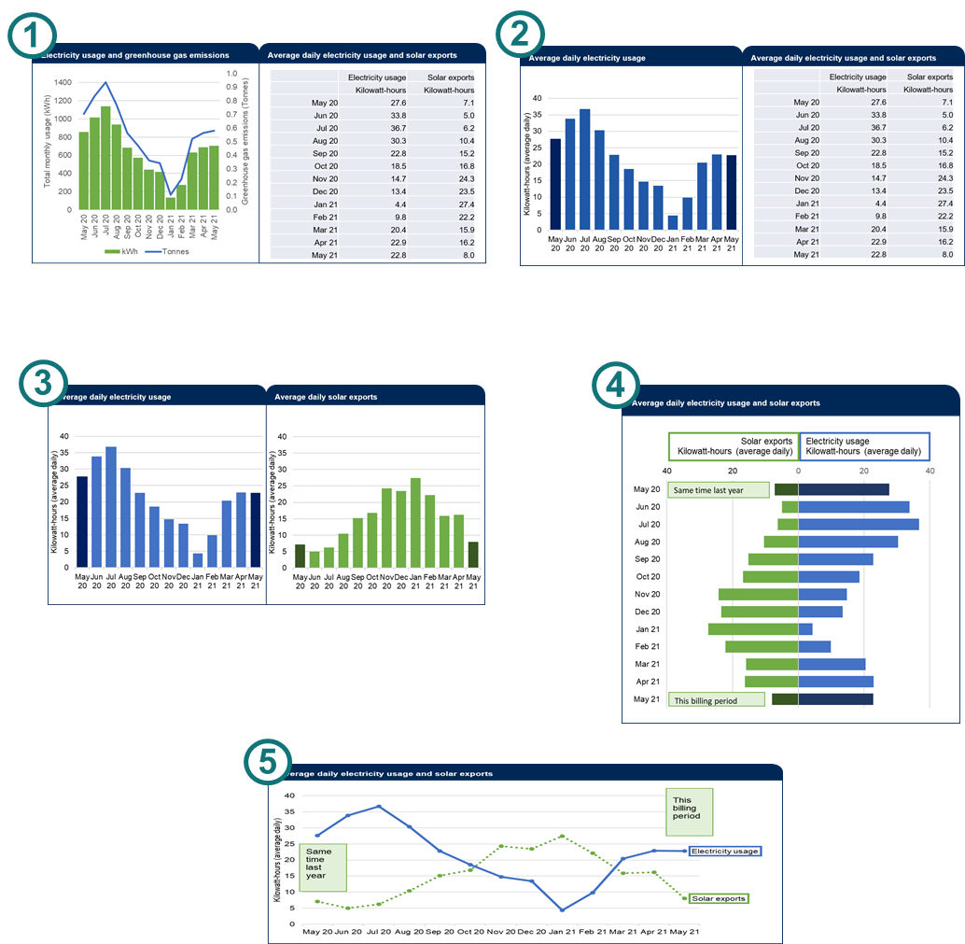
Past energy usage
Charts showing electricity use over the past year (usually 13 months or 5 quarters) are a familiar element of electricity bills. The seasonality of energy use means that usage charts help consumers to understand why their bills go up and down from one billing period to the next, and to track if it has gone up or down, relative to the same time last year.
There is some evidence that usage feedback on bills have a small impact on encouraging energy efficiency (Arvola et al., 1993). Retailers and consumers were generally supportive of historical usage charts in the context of consultations conducted by the Australian Energy Market Commission (AEMC) in 2020.
Participants in the 65+ focus group noted that if a bill is greater than expected, referring to personalised comparative data is important. Referring to what the bill was for the same time last year is a simple way for these consumers to check.
We tested different designs for the past usage: in a table, or in a bar or line chart.* We also varied how the information was combined with solar exports (see next slide). We measured comprehension with 4 multiple-choice questions looking at: month-on-month comparisons, seasons of peak usage, expected patterns, and comparisons to the same time last year.
Most designs performed about the same, although the combined bar chart (number 4) appeared to perform worse than the others.
* We did not include a pure control group because, in the absence of a past usage chart, respondents would not have been able to answer any of the comprehension questions.

Slide 64
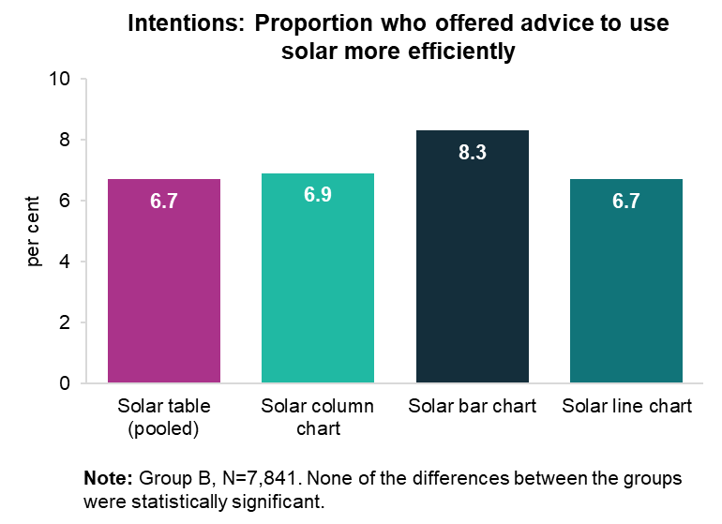
Solar exports: 89% of people with solar panels want information about solar exports on their bill
Potential benefits of putting solar exports on bills
Even though 21% of Australian households have solar panels, bills typically contain very little information about solar exports. Often bills just show the total number of kilowatt-hours exported to the grid for that billing period (not including self-consumption). This potentially results in an underestimation of their total energy usage and the value of their solar panel system.
Lack of effective solar data on bills prevents consumers from making the most of their solar by shifting usage times to save money and reduce pressure on the grid in peak demand times.
Consumers with solar panels do not receive information on their bills about their self-consumption.
89% of solar consumers at least ‘slightly agreed’ that they would value solar export information on their bill (and 73% strongly or moderately agreed).
We tested different formats of solar export information in a table, a bar chart, or a line chart (see previous slide).* We also varied whether the information was combined with past energy usage, or sat adjacent to it.
We did not find evidence that the manner of presentation made a difference to comprehension or intentions.
We tested the variations in solar export information in two ways.
Comprehension: Respondents were asked 4 comprehension questions. Their scores were roughly the same regardless of how the solar exports were presented. However, respondents who actually have solar panels in their home were better at answering these questions, scoring about 7 percentage points better than non-solar customers.
Intentions: We asked respondents how to save money. Since the solar charts indicated that the solar panels were exporting more energy to the grid than the household was actually using, the charts indicated there was potential to use solar more efficiently.
Although a somewhat higher proportion of respondents suggested using solar more efficiently in the ‘bar chart’ group, this difference was not statistically significant so should be interpreted with caution.
* In this trial, we did not include a pure control group because, in the absence of information on solar exports, respondents would (at best) only have been able to answer one of the four questions, and even then it would have been complicated.

Slide 65
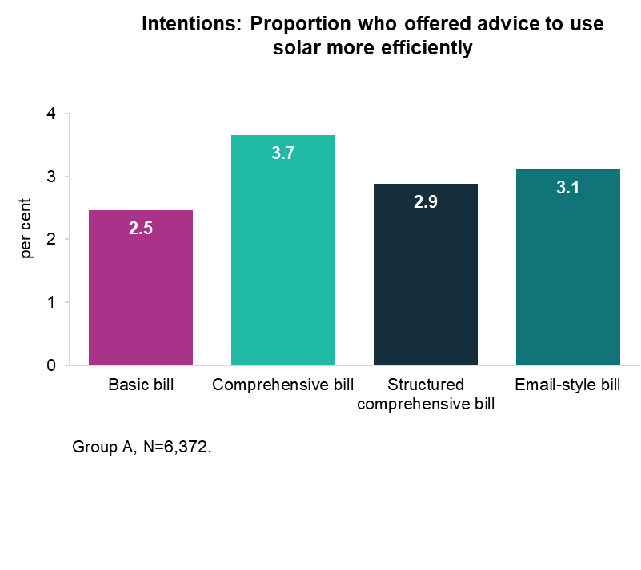
The impact on intentions to use solar efficiently was unclear
We tested the impact of including (or not including) a solar export chart on a full bill, in the Group A trial on bill length and layout (see Section D). In that trial, the 3 ‘comprehensive’ bills all included a solar exports chart, while the basic bill did not.
We asked respondents viewing these prototype bills for suggestions on how to reduce energy costs. Since the charts indicated there was potential to use solar more efficiently, we looked for suggestions that related to efficient solar use, as a way of measuring intentions.*
We were unable to draw a clear conclusion about the impact of solar exports on intentions to use solar more efficiently.
Respondents who saw the comprehensive bill were more likely (3.7%) to recommend using solar more efficiently than those who saw the basic bill (2.5%). While this result was statistically significant, it raises the question of why the structured comprehensive bill did not have a similar impact. Because the proportions who suggested efficient solar use were so small, it was difficult to draw a clear conclusion.
* Suggestions for efficient solar use included: shift their energy usage to daytime (when the sun is shining), invest in battery storage, get solar hot water, or do maintenance on their solar panels. We coded these as suggestions to ‘use solar more efficiently’. For details of how these responses were coded, see the Technical Appendix (Section 4).

Slide 66
Contents
A. | Context and research design
B. | Survey overview
C. | Bill content
D. | Bill simplification: length and layout
E. | Bill comprehension: how the bill is calculated
F. | Bill comprehension: switching and market engagement
G. | Bill comprehension: energy usage and solar exports
H. | Limitations

Slide 67
There are limitations to our research
We did our best to design our survey and the survey experiments to generate answers to the questions in our research plan. Nonetheless, like any research, our studies have limitations that should be considered when assessing our results. These have been highlighted where relevant in the results above.
Survey experiments
We ran experiments (RCTs) within a survey: different respondents saw different versions of the energy bill, and then compared their answers to questions about their comprehension or intentions.
The survey environment is different from the real-world setting where people are likely to be juggling other activities and distractions when they receive their bill.
Consequently, the findings from survey experiments will only generalise imperfectly into the real world.
Intentions vs Actions
We used a range of outcome measures but most assessed comprehension or intentions. Unfortunately, we know the comprehension and intentions alone do not necessarily lead to action - this is known as the 'intention-action gap'.
Nonetheless, intentions are a necessary precursor to action so we typically assume that an increase in intentions will lead to some (smaller) increase in action.
Reliability of self-reports
At several points in our surveys, we asked people what they want to see on an energy bill. While these 'self-reports' are often a useful guide, sometimes they may be misleading. For example, when people are in a reflective state (as with a survey experiment) they often prefer more information and detail. In a busy, real-world setting, greater levels of detail sometimes lead to inaction.
Online survey panel
We collected our sample through an online survey panel, where panellists regularly participate in surveys in return for small incentive payments. This gives rise to two issues.
First, some respondents will not have provided genuine responses. This is discussed in more detail in the following slide.
Second, although the sample is large and diverse, it is not truly representative of the Australian population. In particular, it only includes people who are online and willing to regularly participate on online surveys.
Qualitative research
Qualitative insights were drawn from focus groups and free-text survey responses.
Qualitative research has limitations as it usually cannot be generalised due to small sample sizes. While free-text survey responses have larger sample sizes, they are not able to ask follow-up questions. Finally, there may be a self-selection bias – whereby those that provide qualitative responses are not representative of the population as a whole.
These limitations should be considered when interpreting results from qualitative research.

Slide 68
Limitations: survey data quality
Survey data cleaning and sample size
The survey results described in this report are based on the questionnaire presented to the ‘Group A’ sample. Before analysing the results from the survey presented to the Group A sample, we cleaned the data set to remove ‘speeders’ (i.e. respondents whose survey duration was implausibly short) and ‘incompletes’ (i.e. respondents who didn’t complete the survey and trials). Speeders were defined as the bottom quintile in terms of survey duration (i.e. the 20% fastest).
This left a sample size of 4,818 for the cleaned dataset. Some respondents chose not to answer a specific question (this was usually less than 55 respondents) so the sample size for any specific question may be slightly smaller than the total.
The demographic characteristics for this cleaned dataset were very similar to those for the full dataset. There were, however, material differences in other responses, indicating that removing the speeders was important for improving the data quality.
It is possible that there were still a small number of non-genuine responses remaining in the cleaned dataset. In particular, there may have been some issues with response quality for more complex questions (e.g. a matrix of questions about how respondents use their bills). This should be borne in mind when interpreting the survey results from such questions.
Analysis of randomised controlled trials (RCTs)
We ran additional sensitivity checks to see whether keeping speeders and incomplete responses in our dataset materially changed the RCT results.
We found that although keeping these responses does give us lower means in the analysis (i.e. a lower proportion of correct answers overall), these were distributed evenly across treatment arms. Therefore, it has materially altered the differences between these treatment arms, nor whether these differences were statistically significant. See Technical Appendix (Section 4) for further details.
The approach to data cleaning in our pre-analysis plan did not explicitly address speeders but we stated we would follow standard practice and conduct an ‘intent-to-treat’ analysis. This implied that, for the RCTs, we would keep all respondents. The pre-analysis did address the issue of incomplete responses (referred to as ‘attrition’ in the plan), as follows:
“Attrition related to treatment status is plausible in this trial. Some interventions presented will be harder to comprehend than others. If difficulty understanding a given intervention results in attrition (i.e., if people leave the survey because it is too difficult) then this could lead to bias in our estimates.
We will include a ‘don’t know’ option for participants to use when they are not confident in the answer. We will include anybody who was randomised into a trial in the analysis and record any unanswered questions as zero.
We will assess attrition, questions skips and ‘don’t know’ responses to see if there is suggestive evidence that these are related to assignment. We will take the results of this robustness check into account when interpreting and reporting our findings.”

Slide 69
Changes between the Interim Report and Final Report
This Final Report builds on the Interim Report that was released in September. The results in the Interim Report have not changed however they are supplemented by:
Survey results presented in Section B and at various other points in the report.
Additional results in relation to benchmarks and solar exports (Section G)
Free-text responses, on what respondents would like in a future energy bill, and what respondents liked or disliked about the bill prototypes. This is included at various points in the report, and notably at the end of
Section D.
Focus group findings, which are referenced at various points in the report.
In addition, each section summarises the key findings from our review of the literature and the stakeholder submissions to the Australian Energy Market Commission (AEMC) in 2020. The one substantive change to the literature review relates to benchmarks, where we now draw on a recent, thorough review specifically on the use of benchmarks in electricity bills (Frederiks, 2021).
Finally, we have attempted to synthesise the research and insights from all these sources in a new ‘Overview and Key Findings’ slide at the start of each section.

Slide 70
Technical appendix: overview
The technical appendix provides the supporting details for the results and analysis presented in this report.
In addition, supporting data files contain cross-tabulations of the survey results, and the full statistical analysis for each randomised controlled trial (RCT). The technical appendix is structured as follows:
Data quality and sample characteristics – A discussion of how we addressed data quality issues, and a summary of the demographic characteristics of our two samples.
Survey design and questions – Description of the survey design, including the full set of survey questions
Overview of the experimental design and analysis for the 6 RCTs
Details of the experimental design and analysis for the 6 RCTs:
      Length and layout (RCT A1) – tested for cognitive overload in full energy bills. This trial investigated whether the length and layout of the bill impacts comprehension. We used bills of varying lengths and layouts to determine if providing additional information causes information overload.
      Reference price (RCT A2) – tested the inclusion of the ‘reference price’ on the bill.
      Detailed charges table (RCT A3) – tested alternative presentations of the detailed charges table.
      Plan summary, best offer & definitions (RCT B1) – tested the impact of including a plan summary, a ‘best offer’ prompt to switch plans, and/or a definitions box.
      Benchmarks (RCT B2) – tested the design of benchmark peer comparisons
      Energy usage, solar exports and definitions (RCT B3) – tested the impact of the design of charts depicting historical energy usage and solar exports; also tested the impact of a definitions box
The technical appendix and data files are available at: https://behaviouraleconomics.pmc.gov.au/projects/improving-energy-bills

Slide 71
References
Accurassi (2020) Submission to AEMC consultation paper.
Arvola A, Uutela A, and Anttila U (1993) Billing feedback as a means to encourage household electricity conservation: A field experiment in Helsinki, European council for an energy efficient economy conference proceedings.
AEMC (Australian Energy Market Commission) (2021) National Energy Retail Amendment (Bill contents and billing requirements) Rule 2021 No. 2, AEMC_Final_rule.
AER (Australian Energy Regulator) (2021) Better Bills Guideline Behavioural and Consumer Research: Targeted focus group findings (Culturally and linguistically diverse consumers).
AGL (2020) Submission to AEMC consultation paper.
BETA (2018) Electricity Information to Fit the Bill: Redesigning Bills to Support Consumer Engagement. The Behavioural Economics Team of the Australian Government.
BETA (2020) Improving Government Forms Better Practice Guide. The Behavioural Economics Team of the Australian Government.
BEworks (2014) Analyzing and Nudging Energy Conservation and Demand Shifting Through Time of Use Compliance, Prepared for the Ontario Energy Board.
BEworks (2016) Introduction to Behavioural Economics for CDM, Applications and Best Practices for Bill Design. Toronto
Energy Australia (2020) Submission to AEMC consultation paper.
Ergon Energy (2020) Submission to AEMC consultation paper.
EU (European Commission) (2018) Pre-contractual information and billing in the energy market – improved clarity and comparability. September 2018
EWON, EWOV, EWOQ and EWOSA (2020) AEMC Consultation Paper – Billing contents and billing requirements. Joint submission by the Energy and Water Ombudsmen of: New South Wales (EWON), South Australia (EWOSA), Queensland (EWOQ) and Victoria (EWOV).
Financial Conduct Authority (2016) Attention, Search and Switching: Evidence on Mandated Disclosure from the Savings Market. Occasional paper 19.
Fletcher A (2016) The Role of Demand-Side Remedies in Driving Effective Competition – A Review for Which. Centre for Competition Policy University of East Anglia
Hall & Partners (2021) Australian Energy Regulator Better Bills Guidelines research: final report.
Jones M, Mothersbaugh D and Beatty S (2002) Why customers stay: measuring the underlying dimensions of services switching costs and managing their differential strategic outcomes. Journal of business research, 55(6), pp.441-450.
Karjalainen, S (2011) Consumer preferences for feedback on household electricity consumption. Energy and buildings. 43, 458-467.
Marzilli K, and Starc A (2016) How product standardization affects choice: Evidence from the Massachusetts Health Insurance Exchange. Journal of Health Economics 50, 71-85.
Ofgem (2009) Ofgem Consumer First Panel – Research Findings from the Second Events – Billing Information and Price Metrics
Ofgem (2011) Energy Demand Research Project: Final Analysis
Powerpal (2020) Submission to AEMC consultation paper.
Queensland Council of Social Services (2020) Submission to AEMC consultation paper.
Samuelson W and Zeckhauser R (1988) Status quo bias in decision making. J Risk Uncertainty 1, 7–59.
Schultz W, Nolan J, Cialdini R, Goldstein N and Griskevicius V (2007) The Constructive, Destructive, and Reconstructive Power of Social Norms. Psychological Science 18, 429–434
Sitzia S, Zheng J and Zizzo, DJ (2015) Inattentive consumers in markets for services. Theory and Decision 79, 307-332

Slide 72
BETA and behavioural insights
Why is it useful for public policy?
What is behavioural insights?
About BETA
The Behavioural Economics Team of the Australian Government, or BETA, is the Australian Government’s central unit applying behavioural insights to improve public policy, programs and processes.
BETA’s mission is to advance the wellbeing of Australians through the application and rigorous evaluation of behavioural insights to public policy and administration.
Economics has traditionally assumed people always make decisions in their best interests. Behavioural insights challenges this view by providing a more realistic model of human behaviour. It recognises we are systematically biased (for example, we tend to satisfy our present self rather than planning for the future) and can make decisions that conflict with our own interests.
Behavioural insights apply behavioural concepts to the real world by drawing on empirically-tested results. These new tools can inform the design of government interventions to improve the welfare of citizens.
Rather than expect citizens to be optimal decision makers, drawing on behavioural insights ensures policy makers will design policies that go with the grain of human behaviour.

Slide 73

Research team
Laura Bennetts Kneebone was the principal investigator for this project. Other (current and former) staff who contributed were: Michael Bleasdale, Michael Ridgway, Alex McKenzie, Nicholas Hilderson, Jacqui Brewer, Scott Copley, Martin Brumption and Harry Greenwell.
The trial was pre-registered on the BETA website and the American Economic Association registry:
https://behaviouraleconomics.pmc.gov.au/projects/improving-energy-bills
https://www.socialscienceregistry.org/trials/7974
https://www.socialscienceregistry.org/trials/7970
Acknowledgements
Thank you to the Australian Energy Regulator (AER) and Consumers, Policy and Markets Division for their support and valuable contribution in making this project happen. In particular, special thanks to Simone Tyson, Tony Weir, Lois Shedd, Bronwen Jennings, Keira Germech and Arek Gulbenkoglu for their work on this project.

Slide 74

Commonwealth of Australia 2021
ISBN 978-1-925364-85-9 Improving energy bills: final report
Copyright Notice
With the exception of the Commonwealth Coat of Arms, this work is licensed under a Creative Commons Attribution 4.0 International license (CC BY 4.0) (https://creativecommons.org/licenses/by/4.0/)
…
Third party copyright
Wherever a third party holds copyright in this material, the copyright remains with that party. Their permission may be required to use the material. Please contact them directly.
Attribution
This publication should be attributed as follows:
© Commonwealth of Australia, Department of the Prime Minister and Cabinet, Improving energy bills: final report .
Use of the Coat of Arms
The terms under which the Coat of Arms can be used are detailed on the following website: https://pmc.gov.au/cca
Other uses
Enquiries regarding this license and any other use of this document are welcome at:
  Managing Director
  Behavioural Economics Team of the Australian Government
  Department of the Prime Minister and Cabinet
  1 National Circuit
  Barton ACT 2600
  Email: beta@pmc.gov.au
The views expressed in this paper are those of the authors and do not necessarily reflect those of the Department of the Prime Minister and Cabinet or the Australian Government.
Media enquiries media@pmc.gov.au
Find out more: pmc.gov.au/beta

