Slide 1
Improving energy bills: interim report
A report prepared for the Australian Energy Regulator
September 2021

Slide 2
BETA and behavioural insights
Why is it useful for public policy?
What is behavioural insights?
About BETA
The Behavioural Economics Team of the Australian Government, or BETA, is the Australian Government’s central unit applying behavioural insights to improve public policy, programs and processes.
BETA’s mission is to advance the wellbeing of Australians through the application and rigorous evaluation of behavioural insights to public policy and administration.
Economics has traditionally assumed people always make decisions in their best interests. Behavioural insights challenges this view by providing a more realistic model of human behaviour. It recognises we are systematically biased (for example, we tend to satisfy our present self rather than planning for the future) and can make decisions that conflict with our own interests.
Behavioural insights apply behavioural concepts to the real world by drawing on empirically-tested results. These new tools can inform the design of government interventions to improve the welfare of citizens.
Rather than expect citizens to be optimal decision makers, drawing on behavioural insights ensures policy makers will design policies that go with the grain of human behaviour.

Slide 3
Executive Summary
Context and research design
BETA partnered with the Australian Energy Regulator (AER) to apply behavioural insights to the design of energy bills. We conducted a literature review to identify key research questions, which we examined through two online samples involving over 14,000 Australians, including six randomised controlled trials.
Bill content: What is the priority content for inclusion on the bill?
The main purpose of energy bills is to enable customers to make a payment.
Many survey respondents said they also use bills to: find information about how much energy they use, understand how their bill was calculated, and find information about their energy plan.
Bill simplification: Length, layout, and definitions
Consumers find bills complex and confusing. We explored two aspects of simplification: variations in bill length or layout.
Compared to a short bill, we did not find evidence that a well-designed longer bill reduced comprehension. Reducing the amount of content may not be that important for addressing information overload. This is just one element of simplification.
We also designed a bill where some information was removed but available via a link to view a ‘Home Energy Report’. This friction made respondents much less likely to find the information, even when asked to look for it.
Including a box with plain English definitions for technical terms had no positive impact on comprehension.
Bill comprehension: Understanding how the bill was calculated
We tested different formats for the detailed charges table showing the breakdown of costs. None of the alternative designs performed better than the current ‘invoice-style’ table.
Simple plan summaries helped consumers to better understand their plan (but did not improve the likelihood they would choose a better deal).
Bill comprehension: Switching and market engagement
In two separate trials, adding a ‘best retailer offer’ to bill prototypes increased respondent’s intention to switch plans. This was based on responses to an open question seeking suggestions for how to save money.
We also tested the impact of comparing plans on bills to a reference price. Respondents were more likely to say they would shop around for a better plan if they saw that their plan was equal to the reference price, and less likely to shop around if they saw that it was below the reference price.
Bill comprehension: Energy usage and solar exports
A benchmark helped consumers understand how household consumption compared to similar households but the format didn’t make a difference.
Energy usage charts worked equally well, irrespective of their format.
We tested various formats for a new chart showing solar exports. No format clearly outperformed the others however 87% of respondents who have solar panels said they would value having this information on their bill.
Limitations and next steps
Like any research, ours has limitations. We’ve highlighted these in the report.
This is an Interim Report prepared to inform the AER’s consultations on the Billing Guideline. BETA will publish our full report later in the year.

Slide 4
Contents
A. | Context and research design
B. | Bill content
C. | Bill simplification: length, layout and definitions
D. | Bill comprehension: how the bill is calculated
E. | Bill comprehension: switching and market engagement
F. | Bill comprehension: energy use and solar exports
G. | Limitations and next steps
H. | Appendix: bill designs

Slide 5
We undertook a review of existing literature
The literature review identified several well-supported findings:
BETA began this project by undertaking a literature review on three bill content areas:
Energy bills include complex content that can make them difficult to understand and cause confusion for consumers.
1
Complex bill content and structures are confusing for consumers in the energy market. Retailers and consumer groups contest what causes this confusion, but there are matters where evidence in the literature is clear on the changes that can improve energy bills. Replacing text with graphs, using conversational language, reducing the amount of information, and providing important information on the first page are proven ways to improve bill comprehension. Further research should test whether standard presentation of key plan characteristics and plain language definitions of technical terms improve understanding.
Providing consumers with feedback on their energy usage is an effective way to engage and educate them on their energy efficiency. However, issues with the format and delivery of usage feedback in Australia means that many consumers have problems understanding this information. Existing research does not clarify the ideal format and mode of delivery for this and the information could be improved to help consumers whilst reducing costs for businesses.
Making bills easier to compare is a crucial step in encouraging switching, but more active promotion of switching services in bills themselves also motivates inert consumers. Standardisation of key terms between retailers will help consumers make better decisions when comparing plans. However, switching providers is often difficult. Encouraging ‘within provider’ switching (i.e. to a cheaper plan offered by one’s current retailer) may be an easier and more effective method for helping consumers. So-called ‘Best offer’ notices and other calls to action on bills need further investigation to identify how they can be used to aid consumer switching.
Bill simplification, based on evidenced-based behavioural principles, can reduce the cognitive load that bills place on consumers, making them easier to understand and effectively use.
2
3
Drawing on the available literature, stakeholder submissions and broader evidence from behavioural science, we identified four key principles for the design of energy bills:
Language: Use simple, conversational language
Presentation: Make the bill visually attractive
Salience: Make the key information salient
Structure: Order the information carefully and logically.
Caveat: The literature review sought to cover most of the key research relevant to identifying gaps in relation to energy bill contents and billing requirements but it was not a full systematic review and so does not claim to be comprehensive.

Slide 6
We identified gaps in the literature
The gaps in the literature that we identified included:
These gaps shaped our three research questions:
Simple definitions of technical terms, e.g, kilowatt-hours, tariffs, should be tested to improve comprehension of bills.
The presentation of calls to action (for switching behaviour) should be tested to improve understanding of consumers while minimising distrust.
A standardised summary of plan characteristics placed on the front page should be tested for its potential to improve comprehension of a plan.
Different displays of total usage in historical usage graphs should be tested to improve comprehension of bills.
The impact of taking non-essential information off bills and/or delivering it through alternative means (such as a link from the bill to a website) should be tested to determine whether it would improve comprehension.
The efficacy and format of peer comparison (benchmarking) energy usage graphs should be tested to improve comprehension for consumers and reduce costs for businesses receiving complaints.
Communication of solar power in bills should be tested to help consumers more accurately evaluate the value of their solar system and optimise their consumption.
Bill content: What is the priority content for inclusion on the bill?
This covers how consumers engage with their energy bills (what elements they read, and what they use their bills for) and the impact of some new types of bill content.
Bill simplification: How do we reduce information overload in bills?
This covers bill length and layout, as well as inclusion of plain English definitions of technical terms.
Bill comprehension: How do we maximise comprehension of bill content?
Comprehension covers a number of features:
How the bill is calculated
Switching and market engagement
Energy use and solar exports

Slide 7
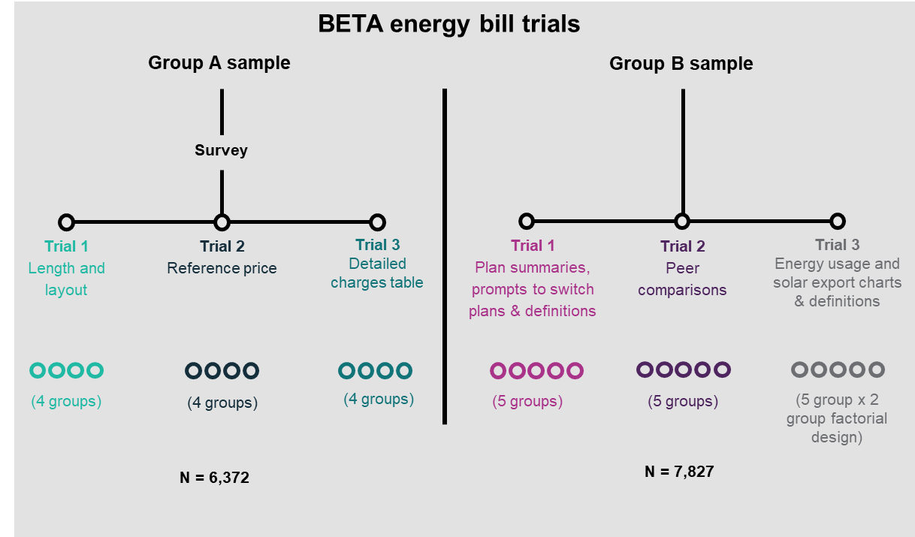
We conducted research with over 14,000 Australian consumers
We collected 2 online sample populations targeting energy consumers living in the regions covered by the National Energy Customer Framework (QLD, NSW, SA, TAS and the ACT). We oversampled respondents from SA, TAS and the ACT. The sample characteristics are illustrated on the next slide.
There were 6 randomised controlled trials (RCTs) embedded in the 2 samples. For each RCT, respondents were shown one bill design, followed by a series of questions designed to measure their comprehension (based on up to 9 questions) or intentions.
Respondents were randomly assigned to see different bill designs independently for each trial.
The first sample population of 6,372 respondents (Group A) included a survey and 3 trials. In each trial, we tested 4 bills or bill elements (hence each bill was shown to more than 1,500 respondents). The ordering of the 3 RCTs was the same for all respondents but the ordering of the survey and the 3 RCTs was randomised.
The second sample of 7,827 respondents (Group B) included 3 more trials, with 5 bills or bill elements in each trial (again showing the bill to more than 1,500 respondents). The ordering of each RCT was randomised.
Caveat: like any research, ours has limitations. We’ve highlighted these as relevant in the report. Please also see Section G: Limitations and next steps.

Slide 8
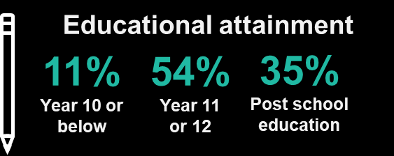
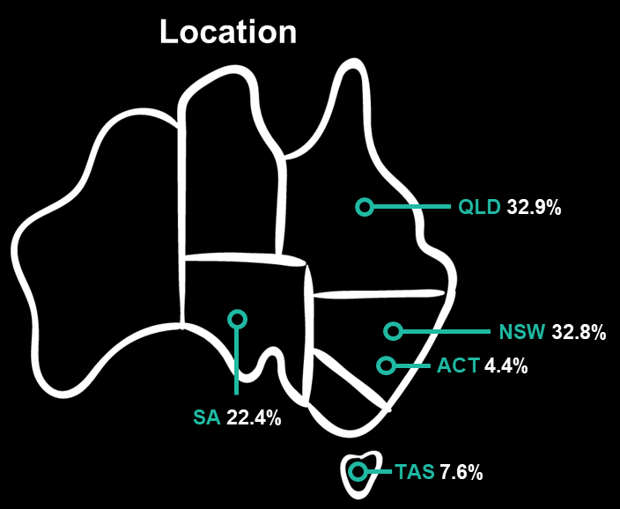
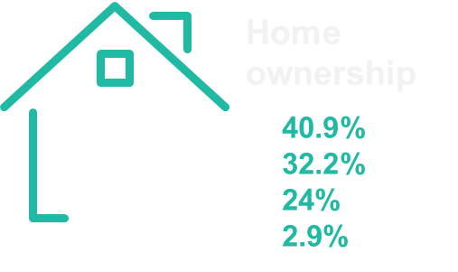
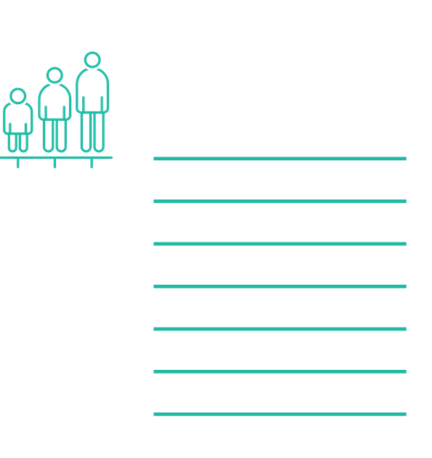
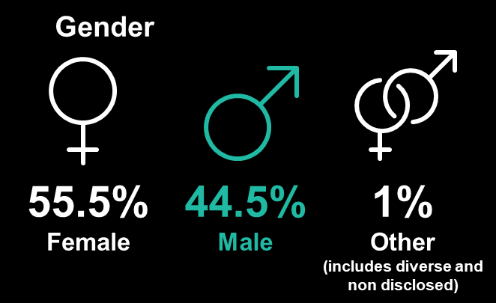
The survey reflected groups in varied circumstances in different parts of Australia*
* Group A, n=6,372; Group B showed similar diversity.

Slide 9
Contents
A. | Context and research design
B. | Bill content
C. | Bill simplification: length, layout and definitions
D. | Bill comprehension: how the bill is calculated
E. | Bill comprehension: switching and market engagement
F. | Bill comprehension: energy use and solar exports
G. | Limitations and next steps
H. | Appendix: bill designs

Slide 10
Consumers use bills to pay their bills, and for various related purposes
Top 4 uses of bills
Finding out much to pay
Finding out how much energy they have used
Checking how their bill was calculated
Finding information about their energy plan
Respondents receive their bills through various channels: an email, a letter, in an app, and/or on a retailer website.
Most consumers use the bill to find out how much to pay (although this may be optional for direct debit consumers). Consequently, the most-read bill elements are the ones relevant to paying the bill: the amount owing, and the due date.
Bills are used for a variety of related purposes. Other popular uses consumers selected include:
finding out how much energy they have used,
checking how their bill was calculated, and
finding information about their energy plan.
A substantial minority identified other ways they use the bill, including for complaints, seeking financial help, or to find interpreter services.
Further details on these survey findings will be presented in the final report, which will be published later this year.
10

Slide 11
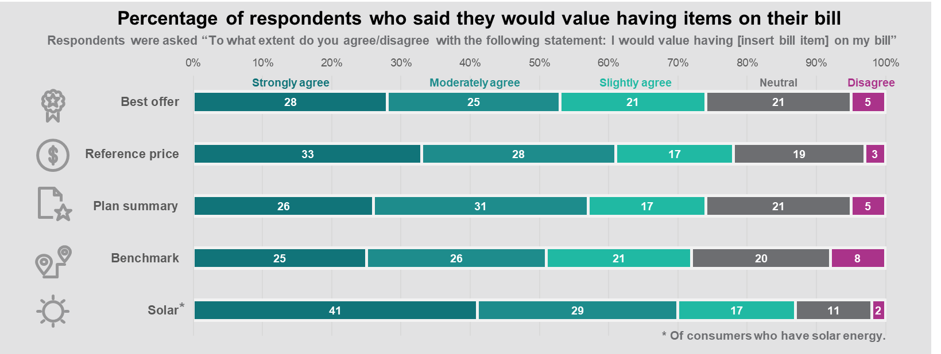
We asked consumers whether they would value new or existing elements of their bills
We tested several types of new and existing bill content designed to meet the Australian Energy Market Commission’s (AEMC) billing objectives. After giving respondents an opportunity to engage with the bill content (through a randomised controlled trial), we asked a follow-up question to find out whether they agreed that they would value this information on their own energy bill. The graphics below show that a large majority of respondents strongly, moderately or slightly agreed that they would value this information.
Caveats: 1) stated preferences do not always match actual preferences. 2) The percentage for each group may be affected by responses from ‘non-genuine’ participants.

Slide 12
Contents
A. | Context and research design
B. | Bill content
C. | Bill simplification: length, layout and definitions
D. | Bill comprehension: how the bill is calculated
E. | Bill comprehension: switching and market engagement
F. | Bill comprehension: energy use and solar exports
G. | Limitations and next steps
H. | Appendix: bill designs

Slide 13
How we developed well-designed prototype bills
Key design principles applied to energy bills
We drew on previous research and key behavioural insights principles to design prototype bills.
Language
Use conversational language and plain English, aiming for a year 7-8 reading level. Remove jargon or technical terms where possible.
We used a prototype ‘simple bill’ that had we developed during previous research on energy billing (BETA, 2018) as the starting point for testing the impact of length and layout.
Our previous research included:
a review of the literature,
focus groups in which participants compared three existing electricity bills, answered semi-structured questions, and designed their ideal bill,
user testing, including eye tracking of a range of designs and checking comprehension, and
testing a subset of the designs through a framed field experiment.
We also applied BETA’s ‘WISER framework’ for improving government forms to the updated bill designs (BETA, 2020) .
Presentation
Make the bill visually attractive. Use a combination of text, diagrams and tables.
Salience
Include key information on the front page. Only include one graphic for the ‘amount due’. Use boxes and bold sparingly to highlight key information.
Structure
Group the bill contents into common themes (e.g. how to pay, understand your bill, understand your plan). Order information carefully and draw out key facts.

Slide 14
We tested the length and layout of well-designed bills
We designed four bills which varied in length, layout and the number of additional elements on the bill.
The ‘simple bill’ from our previous research (BETA, 2018), was the starting point for all 4 bills developed for this trial. To design a ‘comprehensive bill’, we reviewed many bills in the market, and drew on key ideas from our literature review and from stakeholder submissions. The ‘basic bill’ was stripped back to minimum essential information.
In all the bills tested, we set out to make the information as clear and as easy to understand as possible, based on principles established in the existing literature. Thus, we tested well-designed prototypes, not genuine bills. Each bill element was kept constant across designs so we could isolate the impact of specific changes to bill length or layout. In subsequent trials, we tested the impact of including individual elements (such as a plan summary) or we tested variations in the design of that element (such as the past usage chart).
Respondents were randomly assigned to view one prototype bill – described below – and were able to refer to it to answer a series of comprehension questions.
1
2
3
4
Comprehensive bill (2 pages)
Similar to many existing bills over two, densely packed pages.
Structured comprehensive bill
(3 pages)
Same content but with headings, more white space, and a “home energy report” on the third page (this drew together all the information about energy consumption, solar exports and benchmarks).
Email-style bill
Main bill contains same content as first two pages of Bill 2 in long email format. The additional information in the “home energy report” is available via a clickable link.
Basic bill (2 pages)
Only contains information necessary to enable payment, a table showing how the bill was calculated and key contact details (omits plan summary, definitions, best offer and home energy report).

Slide 15
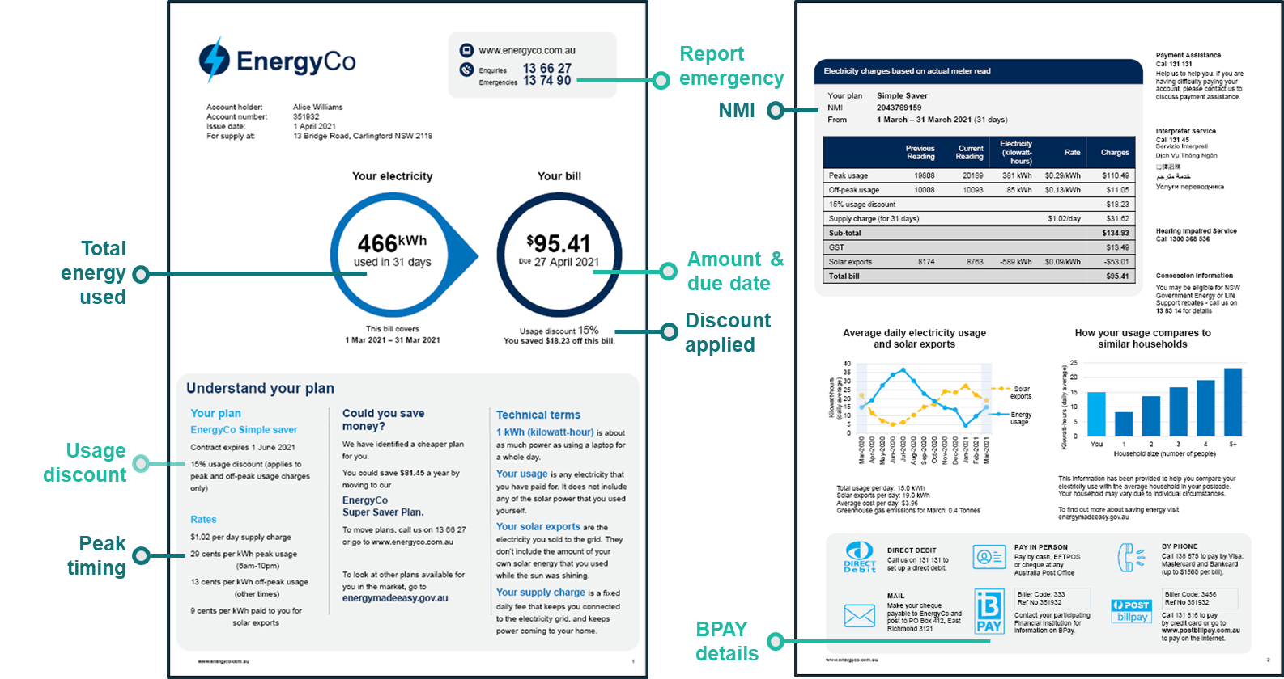
Bill 1: Comprehensive bill (control group)

Slide 16
Bill 2: Structured comprehensive bill (3 pages)

Slide 17
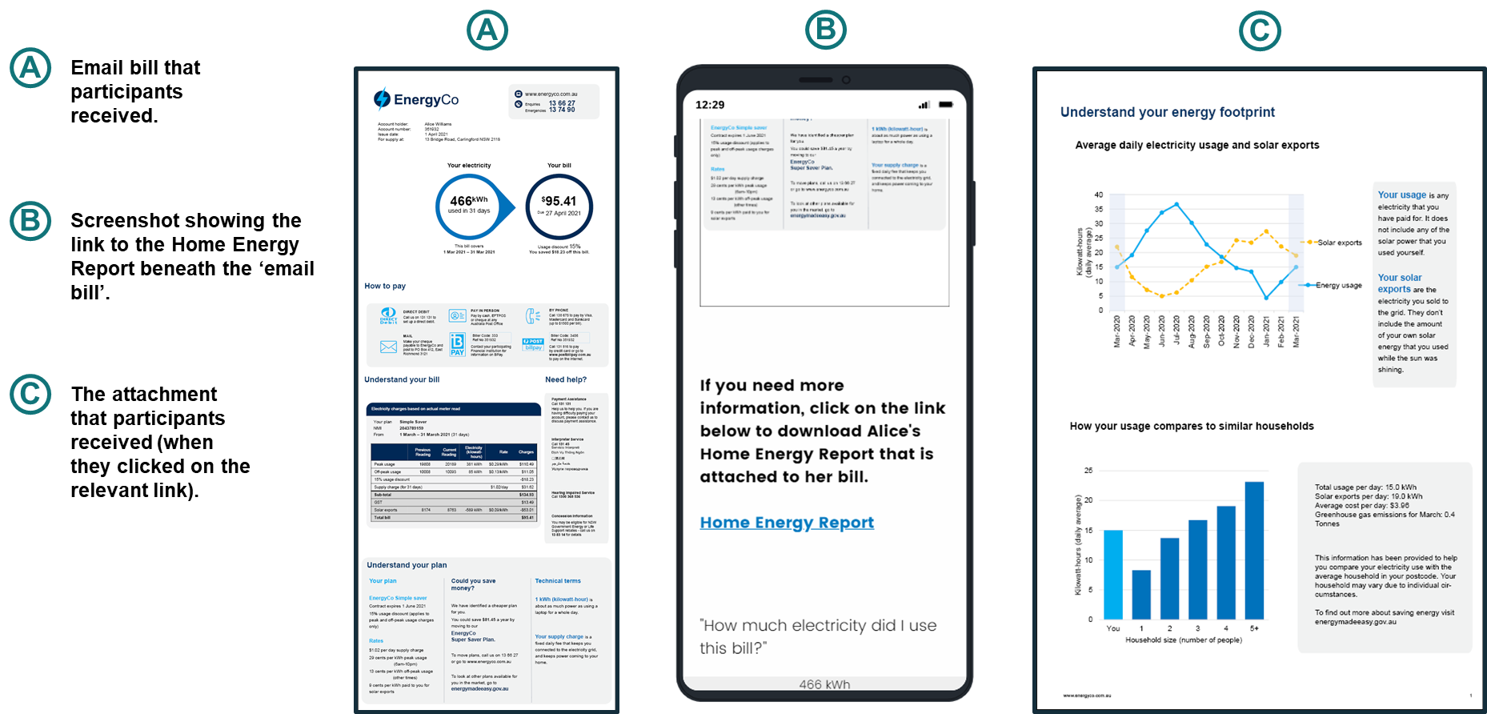
Bill 3: Email-style bill (with link to further information)

Slide 18
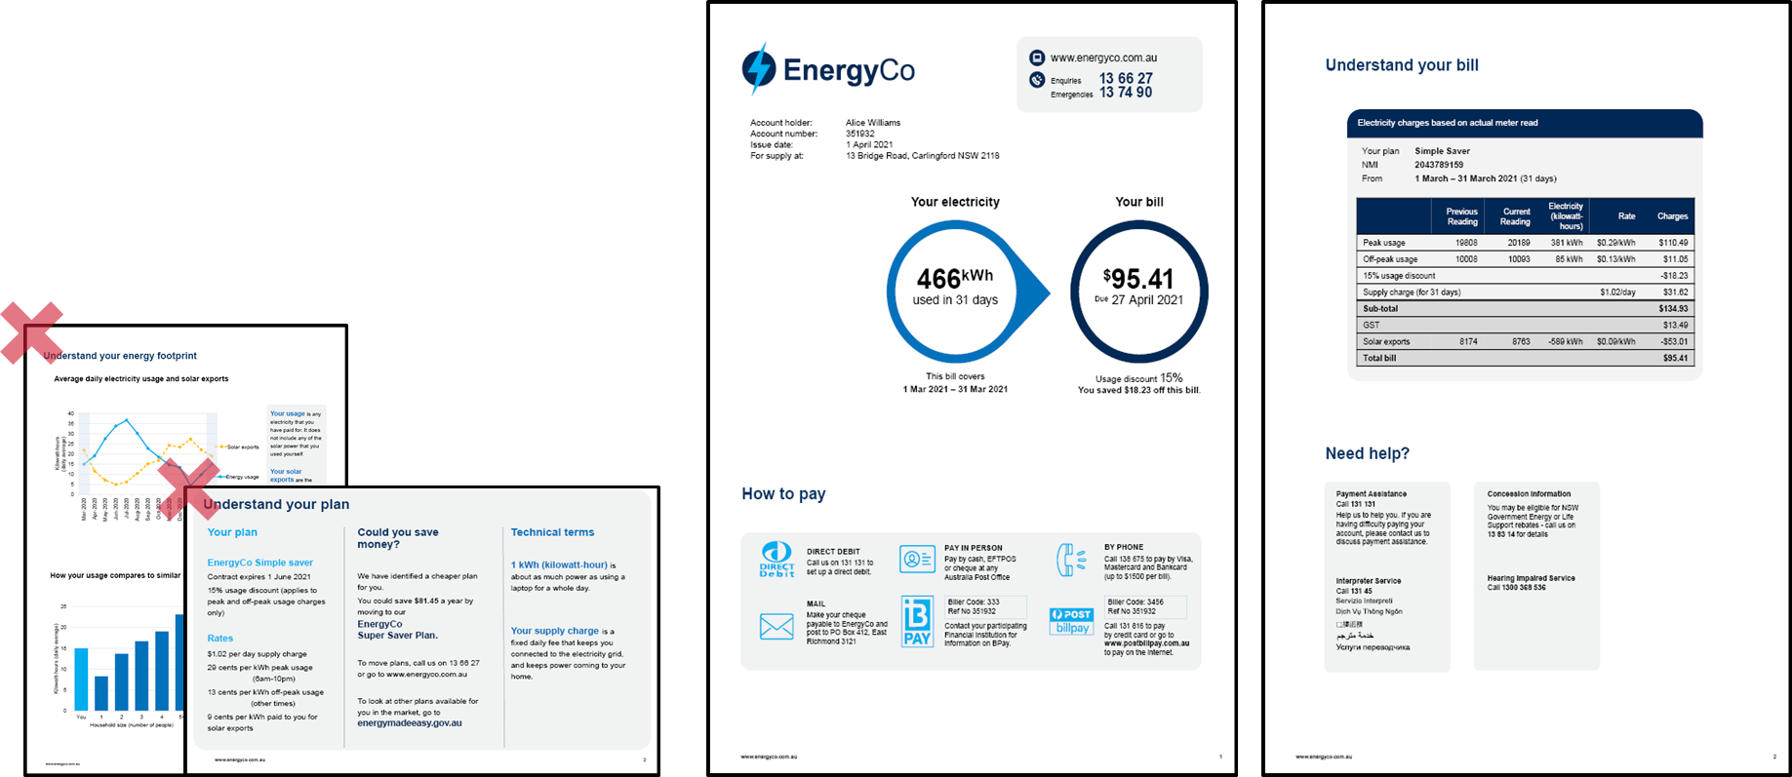
Bill 4: Basic bill (2 pages with limited content)
What’s in and what’s out?
The basic bill retained essential information:
How much, when and how to pay
The detailed charges table
‘Need help?’ contact details
The basic bill did not have:
The plan summary
Past energy usage, benchmarks or solar exports
The ‘best offer’
Definitions of technical terms

Slide 19
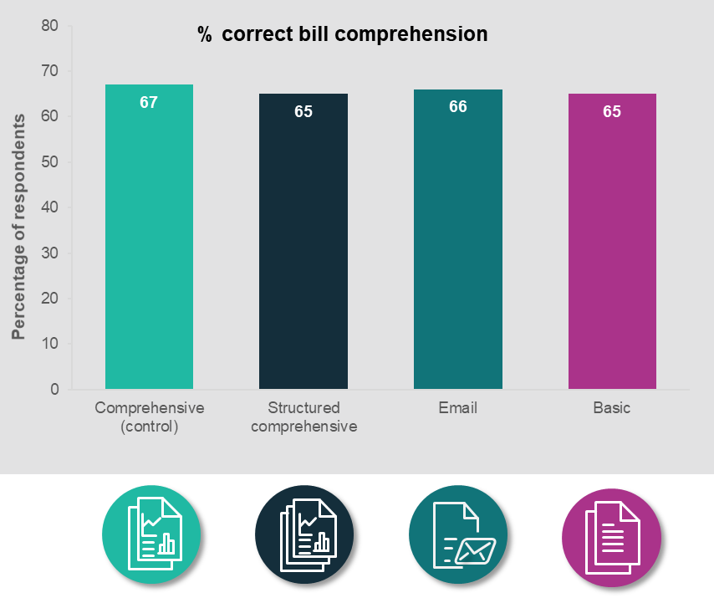
In a well-designed bill, the overall length and layout isn’t a big barrier
Respondents were able to refer to their bill to answer 9 questions that tested:
comprehension of payment information (amount, date, payment methods),
ability to correctly identify important details (NMI, contact numbers),
understanding of how their bill was calculated.
For all 4 bill designs, respondents were about equally likely to find the correct answers. This was true regardless of whether the bill design was:
re-structured to add more white space,
shortened by removing additional content,
arranged in a commonly used format in the market, with a link to more information.
The scope of this research did not include testing genuine bills used by energy retailers. We reviewed many bills in developing the trial design however testing a handful of genuine bills would have had limited value given that retailers have created many different versions. Furthermore, without some standardisation of presentation, if different bills had performed differently, it would not have been possible to determine what bill attribute caused it to perform better than others.
Note: We will include the results of a range of secondary outcomes in our final report, to be published later in the year.
Caveats: 1) We designed our survey experiment to attempt to mimic a real-life situation. Nonetheless, respondents’ comprehension in an online survey setting may be different from energy consumers’ comprehension in real life. 2) The percentage for each group may be affected by responses from ‘non-genuine’ participants however, the differences between these groups are robust to any such responses.

Slide 20
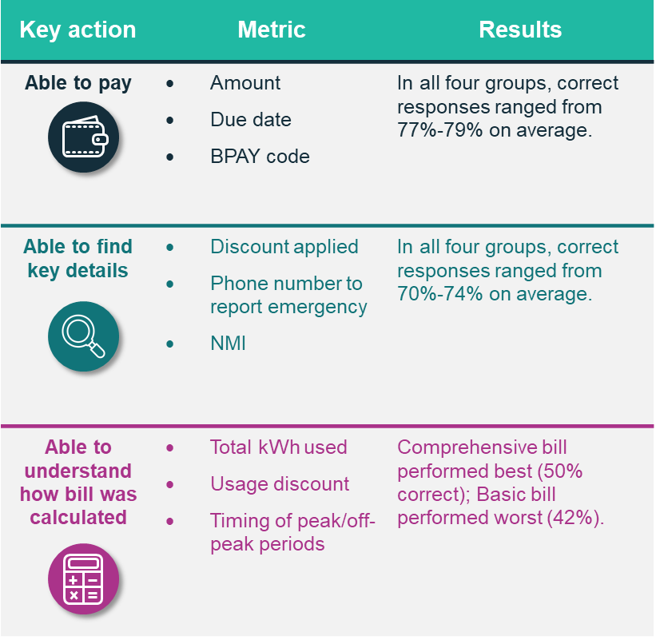
Why didn’t the shorter bill perform better?
Our literature review concluded that several factors contribute to cognitive overload when reading energy bills: consumers’ low energy literacy, complex and inconsistent language, large amounts of information, and confusing layouts.
And yet the shorter ‘basic bill’ performed no better than the others – and perhaps worse on questions related to understanding how the bill was calculated (see table).
So why didn’t the shorter bill perform better?
Shorter is not always simpler. Some additional explanatory information can make a bill easier to understand.
All layouts drew attention to key information, such as by putting the amount and due date in a bold circle. Even on the longer bills, this information was still easy enough to find in our prototypes.
These results suggest that a bill that incorporates sound design principles can vary (within a reasonable range) in terms of content and length without compromising comprehension and causing information overload.

Slide 21
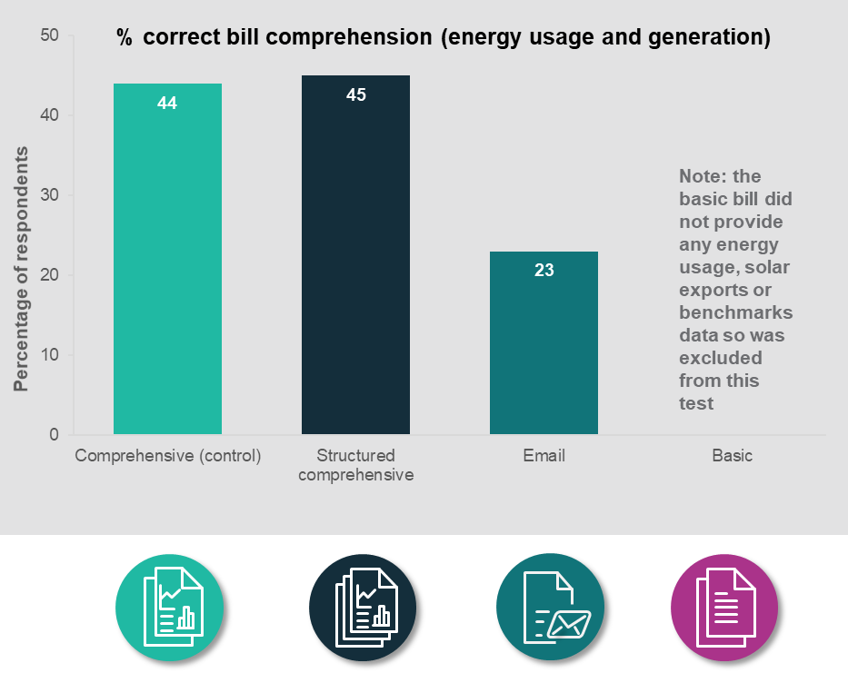
Small friction costs, like clicking a link, are a big deterrent
All bill designs other than the ‘basic bill’ contained information on: past energy usage, energy benchmarks, and solar exports. This information was presented in the following formats:
The Comprehensive Bill (#1) had these charts embedded on page 2 among other information (a common way to present this information).
The Structured Comprehensive Bill (#2) had larger charts on page 3 with the heading Understanding Your Energy Footprint.
The Email-Style Bill (#3) had a link in the bill prompting respondents to ‘Click on the link to download the Home Energy Report’.
For these three bills, we asked respondents additional comprehension questions about their energy usage and energy generation (solar exports).
We found no differences in comprehension about energy usage or solar exports between the two comprehensive bills. However, the Email-Style Bill with the clickable link performed substantially worse on this measure (21-22 percentage points lower than comprehensive bills, which contained identical information). This is because only 15% of respondents in the Email Bill group clicked on the link to download the Home Energy Report.
Caveats: 1) We designed our survey experiment to attempt to mimic a real-life situation. Nonetheless, respondents’ willingness to click on a link in an online survey setting may be different from that of energy consumers in real life. 2) The percentage for each group may be affected by responses from ‘non-genuine’ participants however the differences between these groups are robust to any such responses.

Slide 22
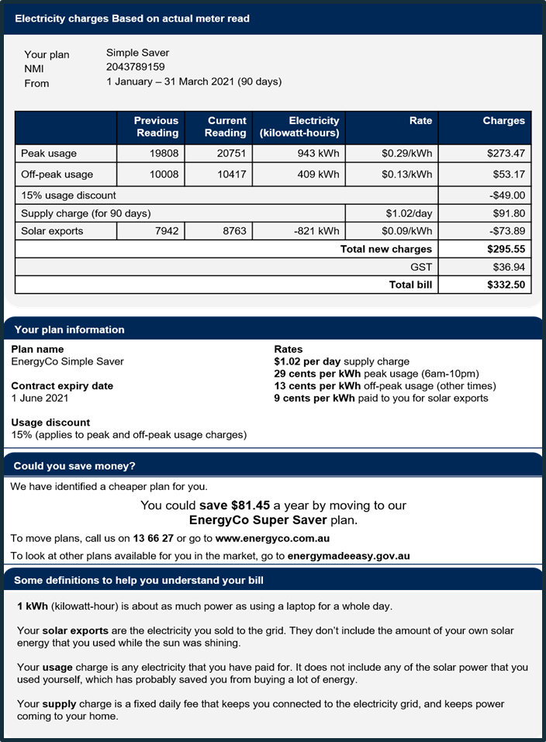
Including a definitions box did not improve comprehension
We used plain English wherever possible in the energy bill.
However, some technical terms were hard to replace so we tested the impact of adding a box with plain English definitions for:
‘Kilowatt-hours’
‘Solar exports’
‘Supply Charge’ and
‘Usage charge’ (or ‘energy usage’).
We explicitly tested definitions twice, adding them to plan summaries and to home energy charts to see if they boosted comprehension.
We found no positive impact of including a definitions box on comprehension.
This result was a surprise as we asked a series of comprehension questions that should have been easier to answer with clear definitions. If anything, our results suggested the group who received definitions may have performed worse on these questions. We are unsure why this might be.
We sought to select the appropriate technical terms and provide clear definitions but we are open to the possibility that different definitions may have yielded a different response.

Slide 23
Contents
A. | Context and research design
B. | Bill content
C. | Bill simplification: length, layout and definitions
D. | Bill comprehension: how the bill is calculated
E. | Bill comprehension: switching and market engagement
F. | Bill comprehension: energy use and solar exports
G. | Limitations and next steps
H. | Appendix: bill designs

Slide 24
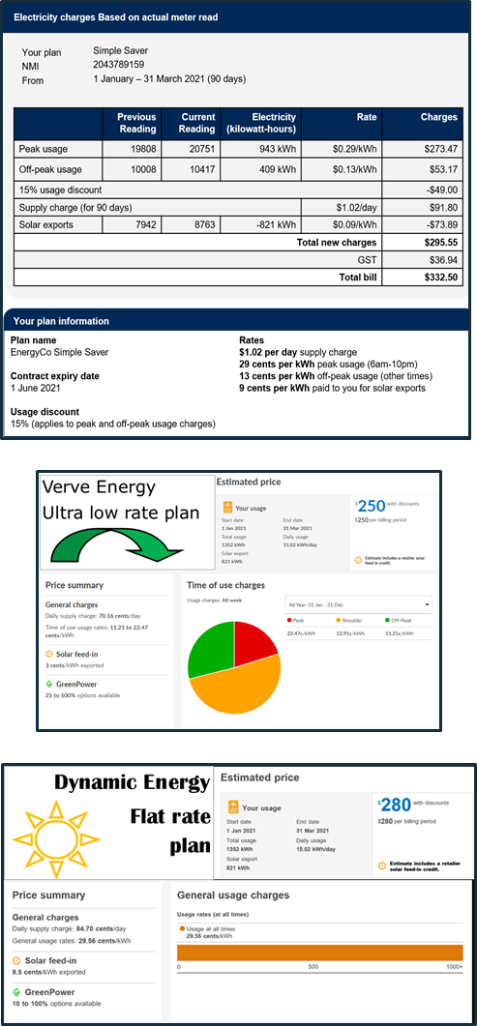
Plan summaries made it easier to understand your plan (but not to choose the best deal)
Energy plans have many different characteristics—such as peak and off-peak hours, rates, supply charges, and discounts. Understanding these characteristics is important for understanding how the bill was calculated, and how consumers might optimise their energy usage. For example, the breakdown of charges usually states the peak and off-peak usage, but without knowing which times of day are peak or off-peak, it is difficult to know how to reduce your bill in the future.
In the Australian energy market, few retailers include plan details on the bill. Some include the plan name but others do not even include this.
We designed a brief summary of plan characteristics that set out: the plan name, contract expiry date, details of the usage discount, and details of the rates (including the times and rates for peak and off-peak charges).
We found that a plan summary helped consumers to better understand how their bill was calculated. Specifically, a higher proportion of respondents who saw the plan summary (62%) correctly understood the time of peak and off-peak periods (specifically, that midnight was off-peak and 8pm was peak) compared to those who did not (53%).
We did not find evidence that a plan summary helped respondents choose a better deal. We asked respondents to compare three plans: their own bill (either with or without a plan summary) plus two alternatives drawn from the Energy Made Easy website, both of which were lower cost. However, respondents who saw a plan summary were no more likely to choose a better deal. We suspect this is because Energy Made Easy already simplifies plan comparison by prominently displaying what the bill would have cost under each plan. In this sense, respondents are not disadvantaged when comparing to other plans through Energy Made Easy.
We added in a summary
We showed two alternatives

Slide 25
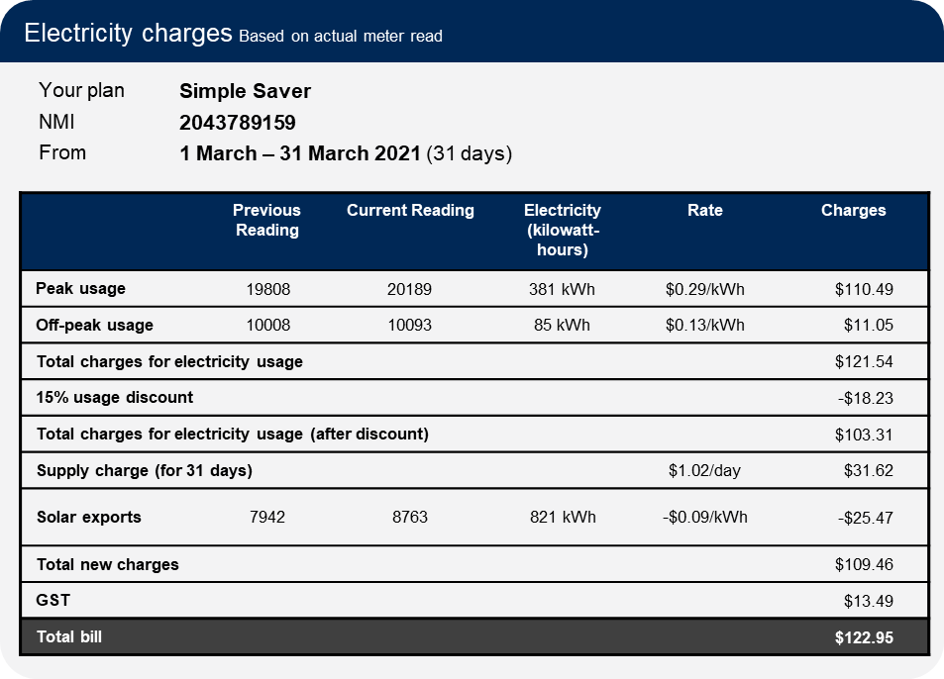
Existing charges table performed as well as our re-designs
The detailed charges table is an important bill feature.
Charges tables typically include the number of units of energy consumed (e.g. days or kilowatt hours), price per unit, and the total amount for the bill. This is usually found on page 2 of a bill.
In our review of existing bills, detailed charges tables were relatively similar across different retailers. A previous study found that their “reengineered bills outperformed currently in-market utility bills on numerous key metrics of clarity and fluency” in research for the Ontario Energy board (BEworks 2016).
We tested several designs, two of which were inspired by the BEworks design, against a version that looks similar to many designs currently in the market.
We found that the alternative detailed charges tables failed to materially outperform the familiar ‘invoice‑style’ table. Consumers did not rate the new versions easier to understand, nor were they able to answer the comprehension questions more accurately.
In part, this was because respondents who saw the invoice-style table already had a high level of comprehension. Three-quarters of these respondents were able to verify the amount of the supply charge and to rate the detailed charge breakdown as easy to understand.
One challenge is to create a design that is flexible enough to be adapted for any of the different pricing models currently available in the market.

Slide 26
Contents
A. | Context and research design
B. | Bill content
C. | Bill simplification: length, layout and definitions
D. | Bill comprehension: how the bill is calculated
E. | Bill comprehension: switching and market engagement
F. | Bill comprehension: energy use and solar exports
G. | Limitations and next steps
H. | Appendix: bill designs

Slide 27
Testing switching behaviours and market engagement
We tested the impact of two features on switching behaviours and market engagement, but with differences in methodology
Methodological differences
We used different measures to evaluate the impact the best retailer offer and the reference price.
The AEMC final determination specifies that billing information should enable small customers to “compare their customer retail contract with other energy offers available to them”.
We used different methods to test how providing ‘best retailer offer’ and ‘reference price’ information on a bill could impact consumers’ intentions to engage in switching behaviours.
For the best retailer offer, respondents were asked an open question seeking suggestions on ways to reduce energy costs or save money on their electricity, and they could write in any free-text response.
For the reference price, respondents were asked whether the information about the reference price would lead them to: shop around for a better deal, stay on their current deal, or feel unsure.
Best retailer offer
For the ‘best retailer offer’, we tested if adding information about cheaper plans available from their current retailer prompted participants to think about comparing or switching plans.
Reference price
For the ‘reference price’, we tested if adding information comparing an existing plan to the market reference price would increase participants' intention to shop around.
Consequently, it is not possible to make a direct comparison between the two sets of results.
However, the differences between groups within a trial (e.g. the difference between ‘best offer’ and ‘no best offer’, or between ‘equal to reference price’ and ‘below reference price’) remain reliable estimates the impact of those features.

Slide 28
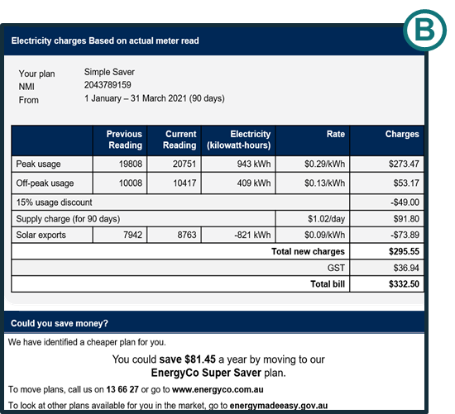
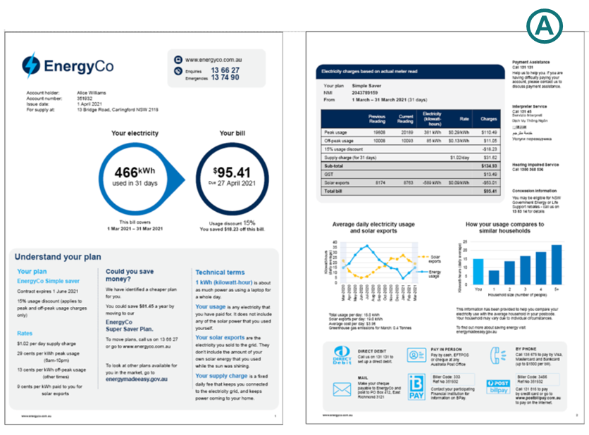
We added a ‘best retailer offer’
We added information telling consumers about cheaper plans available from their current retailer.
The ‘best retailer offer’ was included in a box entitled ‘Could you save money?’ along with a statement of how much money could be saved, and an encouragement to compare with other plans in the market by visiting the Energy Made Easy web site.
We wanted to know whether seeing this information would make people more likely to consider switching plans.
We tested the impact of the ‘best retailer offer’ in two different ways:
A control group of participants saw the detailed charges table and plan summary, while another group saw these along with ‘best offer’ box (Group B)
A control group saw a bill prototype with no best offer (the basic bill), while three other groups saw various bills all containing the best offer message but placed in varying locations (Group A)
Respondents were asked an open question seeking suggestions on ways to save money on their electricity (Group B) or reduce energy costs (Group A) and could write in any free-text response.

Slide 29
The best retailer offer increased people’s intention to switch plans
Free text responses: suggesting ways to reduce energy costs
“
“
“
Change plans to the one recommended on her bill”
Perhaps go to a comparison site and see if she is using the cheapest plan”
Do the washing during off-peak times”
The presence of a ‘best offer’ message on the bill substantially increased the proportion of respondents suggesting the bill recipient should compare their plan or switch to a better one. This was true in both trials.
Respondents were asked for suggestions to save money or reduce energy costs. We coded responses as ‘comparing or switching plans’ if they suggested:
Calling the energy company to ask for a better plan or discounts, or
Compare the plan with others in the market.
The best offer message was most effective (the effect was tripled) when it was more prominent on the bill (Group B). But just having it somewhere on the bill was enough to cause a substantial effect (Group A).
What other money-saving suggestions did people provide? This was an optional question so around half the respondents did not provide an answer. Of the remainder, most (other than those listed above) were:
Suggestions to cut down energy use (the majority)
Suggestions to use more solar or off-peak energy, and use less at peak times
74% of respondents said they would value best offer information on their bill.
“
“
“
Try to use energy-saving lights”
Use blanket instead of heater. Watch TV in the dark”
Use power more when sun shining”
% who suggested comparing or switching plans
(Group A: n=6,372. Group B: n= 7,827.)
Caveat: The percentage for each group may be affected by responses from ‘non-genuine’ participants however the differences between these groups are robust to any such responses.

Slide 30
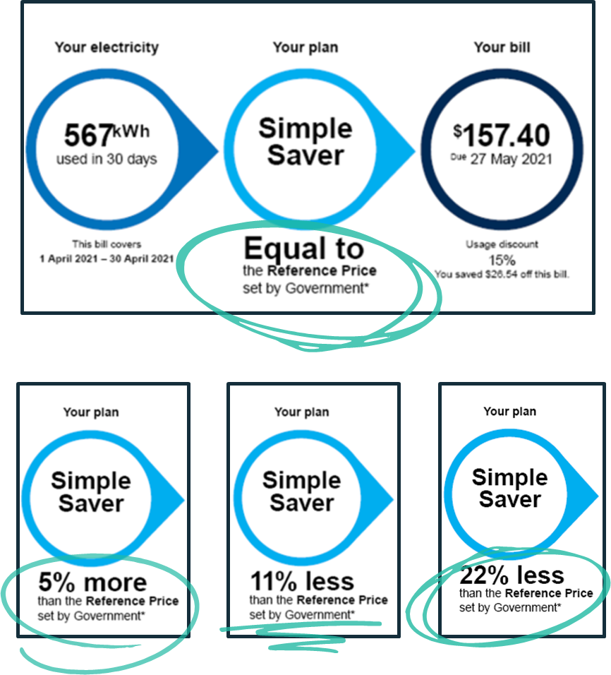
We added a comparison to the government ‘reference price’
The Reference Price and the Default Market Offer are Government initiatives intended to lower energy prices and improve participation in the market. They operate to set a cap on standing offers and to mandate a consistent benchmark price for comparisons.
While not meant as a proxy for the average market price, the aim of the reference price is to make it easy for consumers to compare different electricity plans and prices. In particular, when retailers advertise their electricity plans, they are required to show how it compares to the reference price.
We added a comparison to the reference price to the first page of the bill, depicting plans that were below, equal to or above the reference price.
We expect that adding the reference price to the bill would make it easier for consumers to quickly compare their current plan with advertised plans however we were unable to test this.
Instead we tested how consumers’ stated intention to shop around changed depending on how their plan compared to the reference price (above, equal to or below). This is a different method to that used to test ‘best offer’ as we asked people explicitly whether they would shop around for a better deal. This means the proportions saying they would switch should not be compared between ‘best offer’ and ‘reference price’.

Slide 31
Including the reference price may prompt some consumers to shop around
But the reference price could induce complacency for consumers whose plans are below the reference price
We tested the impact of including information that the energy plans was equal to or below the reference price.
For plans equal to the reference price, 40% of respondents said they would ‘shop around for a better deal’. But this proportion decreased for those with a plan below the reference price.
It is possible that consumers who have plans below the reference price will incorrectly interpret the reference price comparison as a sign they are on a good plan, inducing complacency. However, we did not test this directly so this remains a question for further research.
77% of respondents said that they would value having reference price information on their bill.
Note: we also tested the impact of information showing an energy plan that was above the reference price, and found an even higher inclination to shop around. However, in reality, almost no consumers have such plans so we have focused on the results for the other 3 groups.
% who would shop around for a better deal
Caveats: 1) We asked respondents about their intentions to shop around however we know that people do not always follow through on these intentions. 2) These proportions are not directly comparable to those given in ‘best offer’ testing due to differences in the outcome measures used. 3) The percentage for each group may be affected by responses from ‘non-genuine’ participants however the differences between these groups are robust to any such responses.

Slide 32
Contents
A. | Context and research design
B. | Bill content
C. | Bill simplification: length, layout and definitions
D. | Bill comprehension: how the bill is calculated
E. | Bill comprehension: switching and market engagement
F. | Bill comprehension: energy use and solar exports
G. | Limitations and next steps
H. | Appendix: bill designs

Slide 33
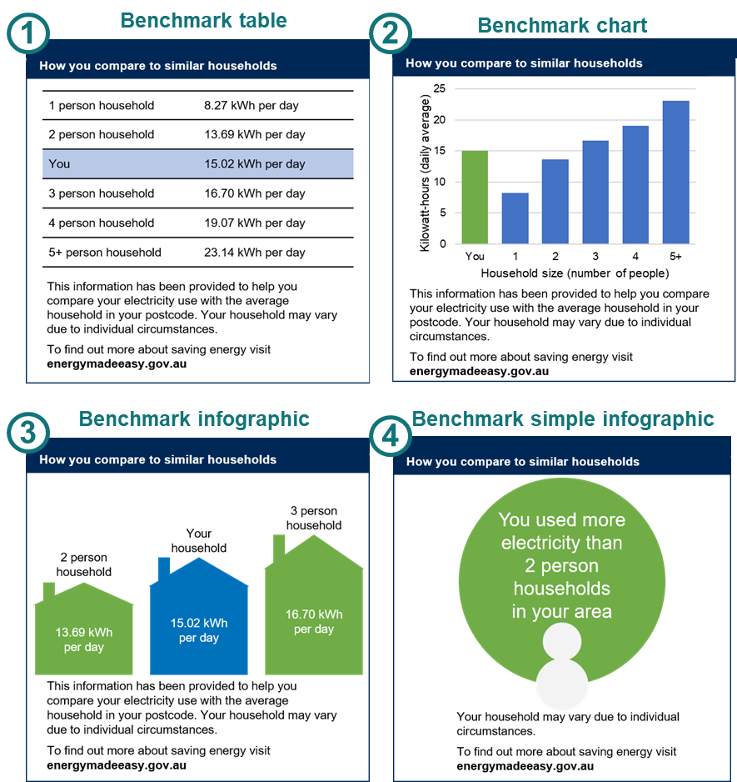
Benchmarks tell you how you compare to similar households
Energy bill benchmarks compare a consumer’s usage to the average usage by households with the same number of people in the same postcode. (Individual usage varies depending on individual circumstances.)
Electricity consumption benchmarks for residential customers are mandatory for residential customer bills, and the first benchmarks were published in 2011.
Our literature review found mixed evidence on the effectiveness of benchmarks on energy bills. Several studies have found they are effective at reducing energy consumption when delivered through an energy efficiency report. However, it is less clear that this also occurs when benchmarks are displayed on energy bills. Furthermore, it is possible that such benchmarks can produce a boomerang effect, where low consumption consumers increase their usage.
Energy retailers suggested that consumers generally do not like the benchmark charts because they have “caused unnecessary consumer distrust, complaints and costs” (AGL, 2020). Ergon Energy (2020) describes similar customer complaints about issues with the benchmarking graph and claims that “each customer is unique and there are too many variables in a household to correctly depict such information on a comparison graph”.
Consumer groups also suggested that consumers do not like peer comparison charts (e.g. EWON, EWOV, EWOQ and EWOSA, 2020, p.5)
Retailers present benchmarks in a variety of ways so we designed 4 different ways to present the benchmarks: a table, a chart, a detailed infographic, and a simple infographic.
Notes:
Consistent with literature.

Slide 34
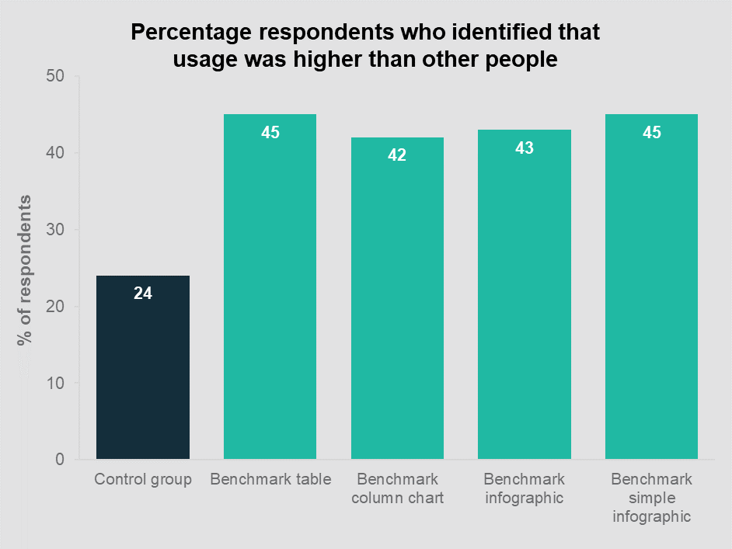
Benchmarks helped consumers compare energy usage with others (but all 4 benchmark designs performed equally well)
We tested whether benchmarks help consumers assess whether energy usage was ‘higher than other people’. Respondents saw a prototype bill for a single person household and were asked to determine whether the household’s energy usage was above, below or around average, as compared to others.
The control group saw a historical usage chart but did not see a benchmark. Of these, only 24% correctly answered that their consumption was above average. This question had four options so this reflects a pure guess. In effect, the control group allowed us to assess whether comprehension improved for those who saw the benchmark.
Consumers who saw a benchmark were more likely to determine that the energy usage was ‘higher than other people’. They were also more likely to attribute an expensive bill to high usage, rather than an expensive plan or a mistake. In addition, 72% of respondents who saw benchmark information reported that they would find this information valuable on their own bills.
BETA also tested different benchmark designs but we did not find evidence that one design outperformed the rest.
Note: We will include the results of additional outcome measures in our final report, to be published later in the year.
Caveat:The percentage for each group may be affected by responses from ‘non-genuine’ participants. (This may partially explain the apparently low accuracy rate of 42-45%.) However the differences between these groups are robust to any such responses.

Slide 35
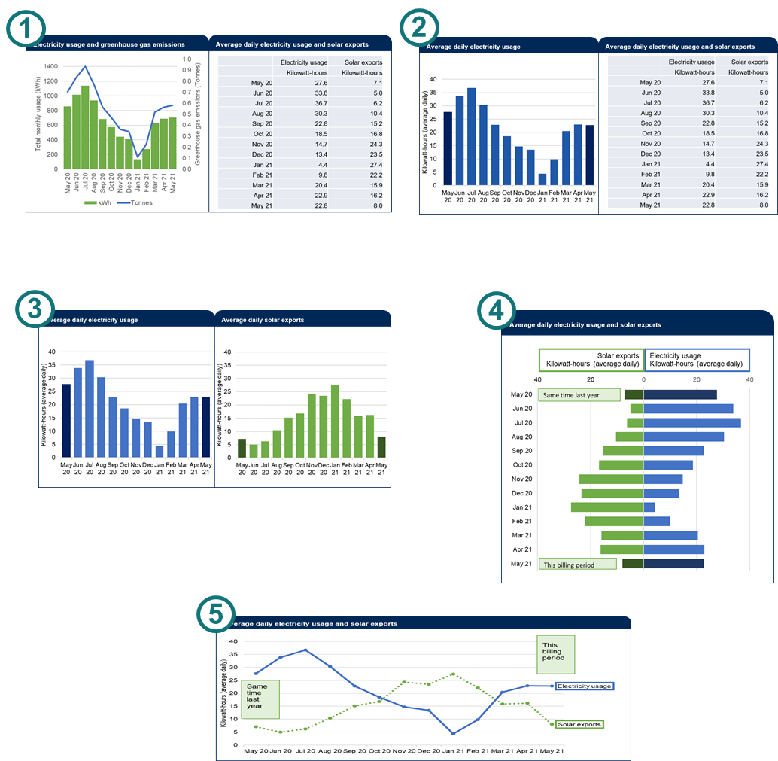
Energy usage and solar exports
We tested standalone electricity usage charts and some that were merged with solar exports.
The AEMC final determination requires bills to enable small customers to easily understand “their energy consumption and production, and related costs and revenue, to assist with using energy efficiently; comparing their retail contract with other energy offers available to them; and considering options for energy supply other than through the distribution system.”
Past energy usage (consumption): Charts showing electricity use over the past year (usually 13 months or 5 quarters) are a familiar element of electricity bills. The seasonality of energy use means that usage charts help consumers to understand why their bills go up and down from one billing period to the next, and to track if it has gone up or down, relative to the same time last year.
Solar exports (generation): Bills typically contain very little information about solar exports even though 31% of survey respondents (and a similar proportion of Australian households) have solar panels. Bills usually just show the total number of kilowatt-hours exported to the grid for that billing period (not including self-consumption). More efficient self-consumption of solar has the potential to reduce bills and pressure on the grid at peak times.

Slide 36
Past energy usage: most charts worked equally well
Solar exports: 87% of people with solar panels want information about solar exports on their bill
We tested different types of solar charts, each showing seasonal variation in a way that mirrors the 13-month energy usage chart. We depicted the solar generation information in a table, a bar chart, or a line chart. We also varied whether the information was combined with their past energy usage, or sat adjacent to it.
In this trial, we did not include a pure control group (with no information on solar generation). Had we done so, the control group would (at best) only have been able to answer one of the four questions, and even then it would have been complicated.
We did not find evidence that the manner of presentation (e.g. table or chart) made a difference to the accuracy of respondents’ answers to 4 comprehension questions. Respondents who actually have solar panels in their home were better at answering these questions, scoring about 7 percentage points better than non-solar customers.
87% of solar customers said that they would value this information on their bill.
Note: We will include the results of additional outcome measures in our final report, to be published later in the year.
BETA tested several versions of a typical 13-month energy consumption chart. Several versions were combined with solar generation data.
We tested comprehension using four multiple choice questions looking at:
month-on-month comparisons,
seasons of peak usage,
expected patterns, and
comparisons to the same time last year.
Most designs performed about the same, although the combined bar chart (number 4) appeared to perform worse than the others.

Slide 37
Contents
A. | Context and research design
B. | Bill content
C. | Bill simplification: length, layout and definitions
D. | Bill comprehension: how the bill is calculated
E. | Bill comprehension: switching and market engagement
F. | Bill comprehension: energy use and solar exports
G. | Limitations and next steps
H. | Appendix: bill designs

Slide 38
There are limitations to our research
We did our best to design our survey and the survey experiments to generate answers to the questions in our research plan. Nonetheless, like any research, our studies have limitations that should be considered when assessing our results. These have been highlighted where relevant in the results above.
Survey experiments
We ran experiments within a survey: different respondents saw different versions of the energy bill, and then compared their answers to questions about their comprehension or intentions.
The survey environment is different from the real-world setting where people are likely to be juggling other activities and distractions when they receive their bill.
Consequently, the findings from survey experiments will only generalise imperfectly into the real world.
Intentions vs Actions
We used a range of outcome measures but most assessed comprehension or intentions. Unfortunately, we know the comprehension and intentions alone do not necessarily lead to action - this is known as the 'intention-action gap'.
Nonetheless, intentions are a necessary precursor to action so we typically assume that an increase in intentions will lead to some (smaller) increase in action.
Reliability of self-reports
At several points in our surveys, we asked people what they want to see on an energy bill. While these 'self-reports' are often a useful guide, sometimes they may be misleading. For example, when people are in a reflective state (as with a survey experiment) they often prefer more information and detail. In a busy, real-world setting, greater levels of detail sometimes lead to inaction.
Online survey panel
We collected our sample through an online survey panel, where panellists regularly participate in surveys in return for small incentive payments. This gives rise to two issues.
First, some respondents will not have provided genuine responses. Although we attempted to remove clearly non-genuine responses, some will remain. We do not expect this to change the main in this report but we will conduct sensitivity analysis to assess the impact, if any, of non-genuine responses.
Second, although the sample is large and diverse, it is not truly representative of the Australian population. In particular, it only includes people who are online and willing to regularly participate on online surveys.

Slide 39
Next steps
This is an Interim Report prepared to inform the AER’s consultations on the Billing Guideline. Accompanying this report are:
A literature review that BETA prepared earlier this year, and
The pre-analysis plans we prepared prior to analysing the results of the randomised controlled trials described in this report.
These publications are all available at: https://behaviouraleconomics.pmc.gov.au/projects/improving-energy-bills
BETA will publish a full report later in the year. It will include:
Analysis of ‘intention outcomes’ based on free-text survey responses
Survey results
Subgroup analysis, and
Sensitivity analysis, including any variation due to non-genuine responses.
It will also include appendices that include: the survey questions, descriptive statistics, and the statistical analysis underpinning the results in this report.

Slide 40
References
AGL, 2020. Submission to AEMC consultation paper.
BETA, 2018. Electricity Information to Fit the Bill: Redesigning Bills to Support Consumer Engagement. The Behavioural Economics Team of the Australian Government
BETA, 2020. Improving Government Forms Better Practice Guide. The Behavioural Economics Team of the Australian Government
BEWorks, 2016. Introduction to Behavioural Economics for CDM, Applications and Best Practices for Bill Design. Toronto
Ergon Energy, 2020. Submission to AEMC consultation paper.
EWON, EWOV, EWOQ and EWOSA, 2020. AEMC Consultation Paper – Billing contents and billing requirements. Joint submission by the Energy and Water Ombudsmen of: New South Wales (EWON), South Australia (EWOSA), Queensland (EWOQ) and Victoria (EWOV).

Slide 42
Commonwealth of Australia 2021
ISBN 978-1-925364-74-3 Improving energy bills: interim report
Copyright Notice
With the exception of the Commonwealth Coat of Arms, this work is licensed under a Creative Commons Attribution 4.0 International license (CC BY 4.0) (https://creativecommons.org/licenses/by/4.0/)
…
Third party copyright
Wherever a third party holds copyright in this material, the copyright remains with that party. Their permission may be required to use the material. Please contact them directly.
Attribution
This publication should be attributed as follows:
© Commonwealth of Australia, Department of the Prime Minister and Cabinet, Improving energy bills: interim report .
Use of the Coat of Arms
The terms under which the Coat of Arms can be used are detailed on the following website: https://pmc.gov.au/cca
Other uses
Enquiries regarding this license and any other use of this document are welcome at:
Managing Director
Behavioural Economics Team of the Australian Government
Department of the Prime Minister and Cabinet
1 National Circuit
Barton ACT 2600
Email: beta@pmc.gov.au
The views expressed in this paper are those of the authors and do not necessarily reflect those of the Department of the Prime Minister and Cabinet or the Australian Government.
Media enquiries media@pmc.gov.au
Find out more: pmc.gov.au/beta

Slide 43
Appendix: Bill designs

Slide 44
Group A: Trial 1 (Length and layout)
Trial 1 investigated whether the length and layout of the bill impacts comprehension. We used bills of varying lengths and layouts to determine if providing additional information causes information overload.
Trial 1 had the following arms:
Control (C) = Comprehensive bill
Treatment 1 (T1) = Structured bill
Treatment 2 (T2) = Simple email bill with link to additional information
Treatment 3 (T3) = Basic bill with limited content.

Slide 45
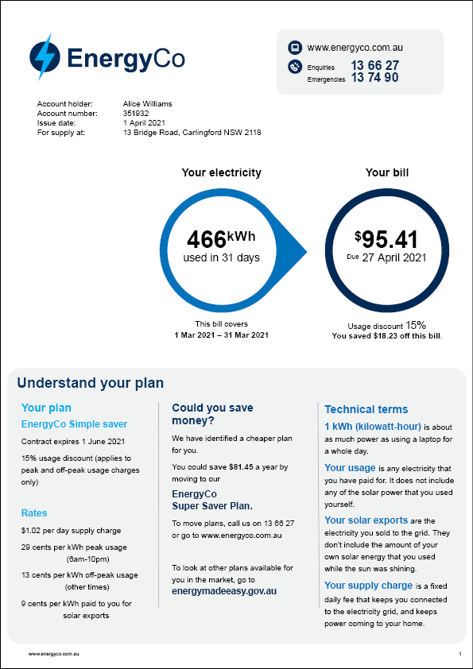
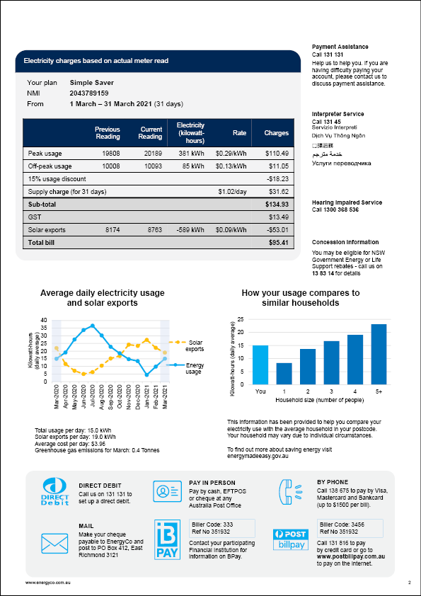
Control (C) = Comprehensive bill

Slide 46
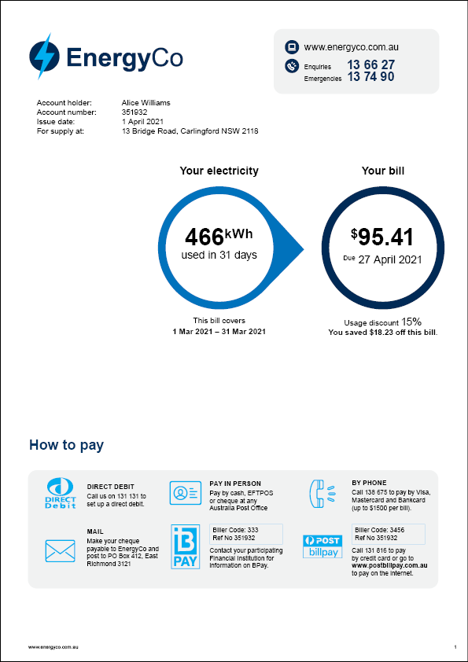
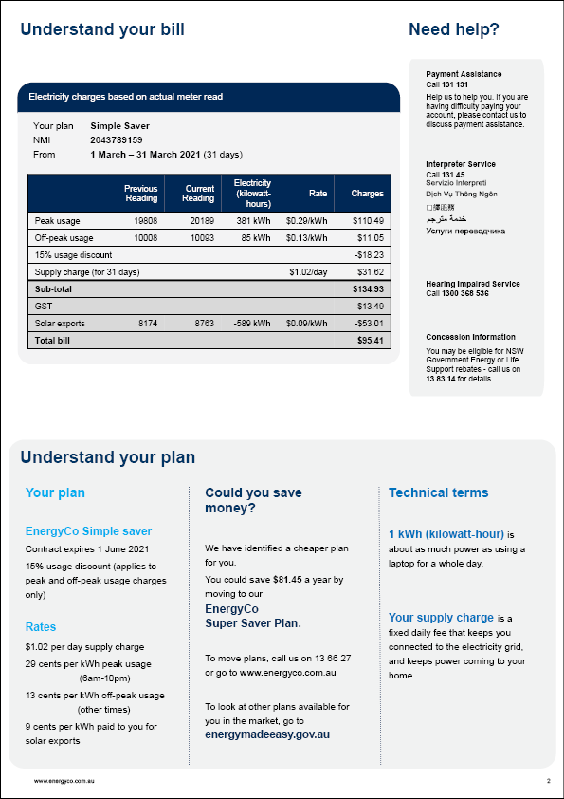
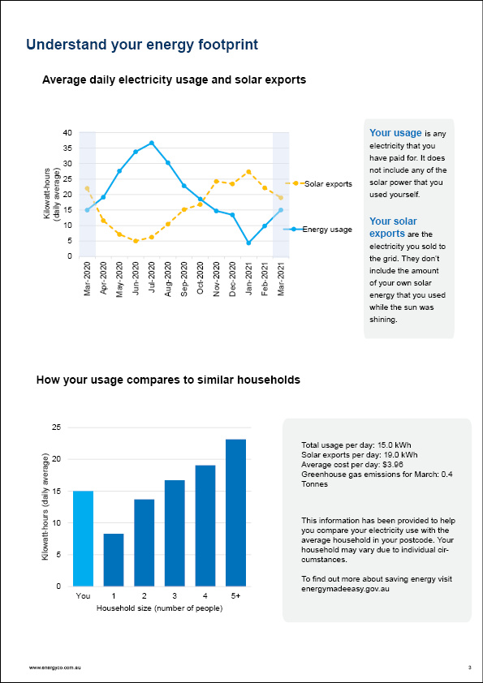
Treatment 1 (T1) = Structured comprehensive bill

Slide 47
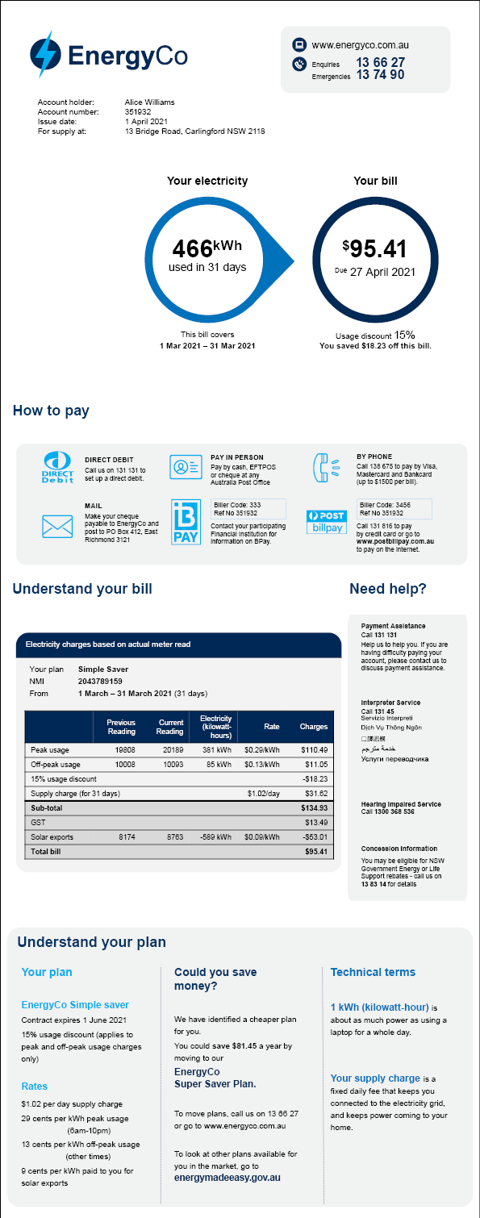
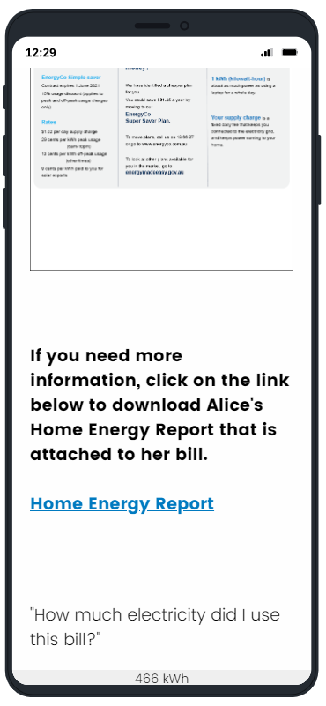
Treatment 2 (T2) = Simple email bill with link to additional information

Slide 48
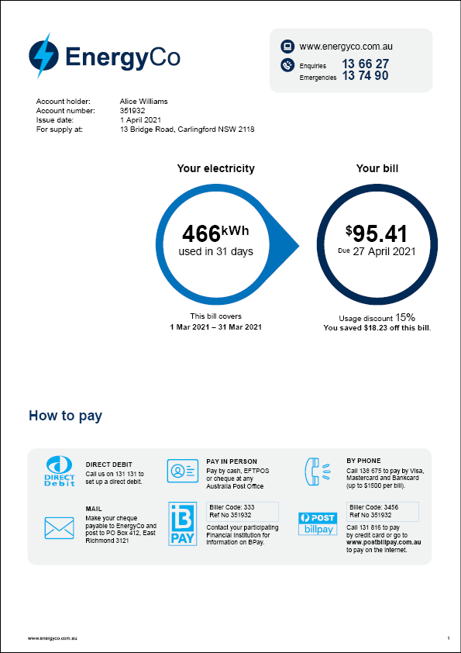
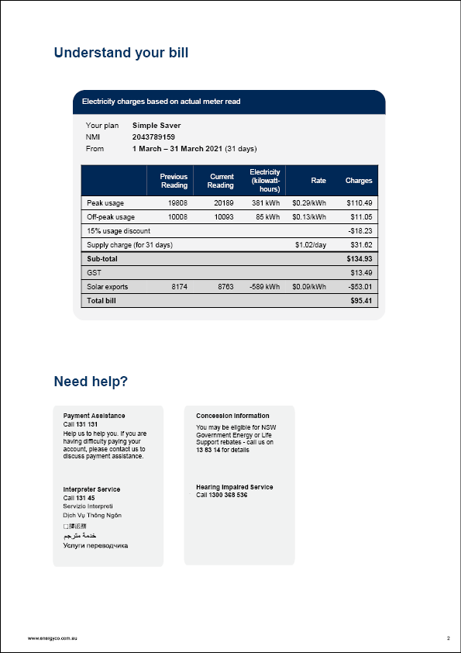
Treatment 3 (T3) = Basic bill with limited content

Slide 49
Group A: Trial 2 (Reference price)
Trial 2 tested the inclusion of the ‘reference price’ on the bill, to see whether consumers are sensitive to different reference price levels, and whether they would value the information on the bill. A four-arm trial to test reference price with the following groups:
Treatment 0 (T0) = Plan is “equal to the reference price”
Treatment 1 (T1) = Plan is “11% less than the reference price”
Treatment 2 (T2) = Plan is “22% less than the reference price”
Treatment 3 (T3) = Plan is “5% more than the reference price”

Slide 50
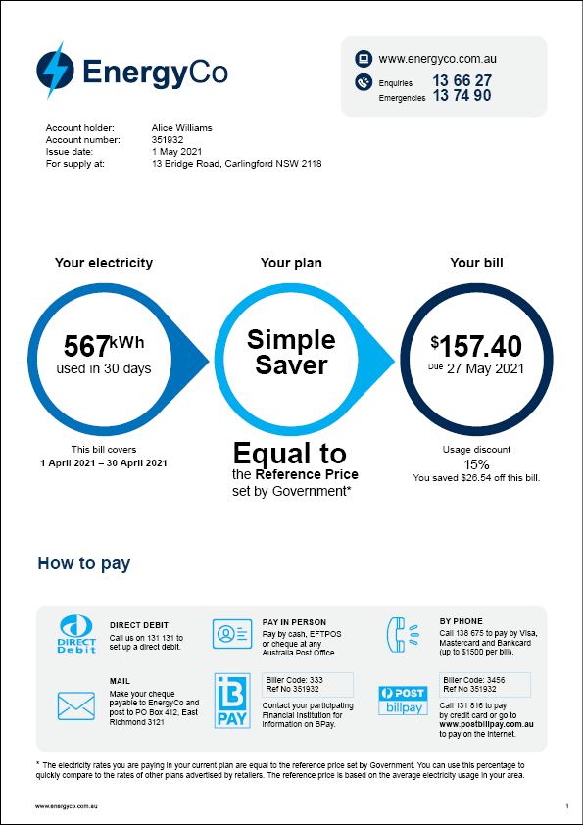
Treatment 0 (T0) = Plan is “equal to the reference price”

Slide 51
Treatment 1 (T1) = Plan is “11% less than the reference price”

Slide 52
Treatment 2 (T2) = Plan is “22% less than the reference price”

Slide 53
Treatment 3 (T3) = Plan is “5% more than the reference price”

Slide 54
Group A: Trial 3 (Detailed charges table)
Trial 3 tested alternative presentations of the detailed charges table to see which most improved comprehension and was preferred by customers as easy to understand.
Trial 3 involved the following arms:
Control (C) = Traditional table
Treatment 1 (T1) = Two tables
Treatment 1 (T2) = Coloured infographic and two tables
Treatment 1 (T3) = Black & white infographic and two tables

Slide 55
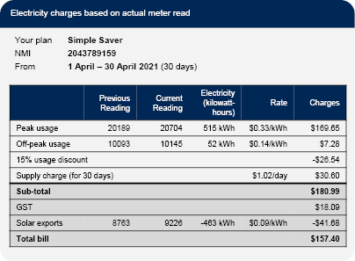
Control (C) = Traditional table

Slide 56
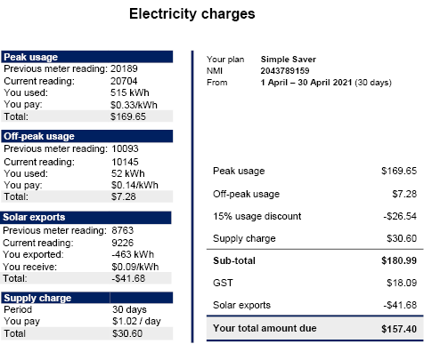
Treatment 1 (T1) = Two tables

Slide 57
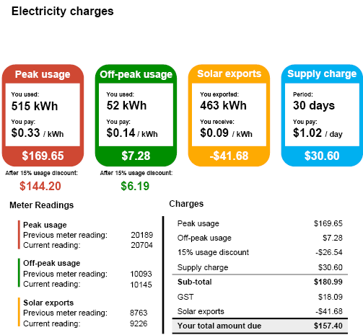
Treatment 1 (T2) = Coloured infographic and two tables

Slide 58
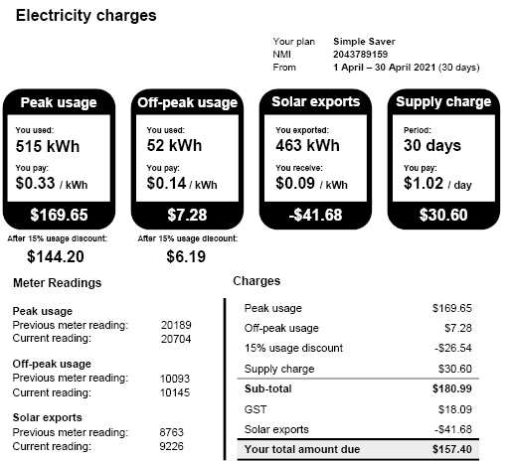
Treatment 1 (T3) = Black & white infographic and two tables

Slide 59
Group B: Trial 1 (Plan summaries, market engagement and definitions)
This was a five arm trial with the following groups:
Control (C) = Detailed charges table only
Treatment 1 (T1) = Detailed charges table + Plan summary
Treatment 2 (T2) = Detailed charges table + Could you save money?
Treatment 3 (T3) = Detailed charges table + Plan summary + Could you save money?
Treatment 4 (T4) = Detailed charges table + Plan summary + Could you save money? + Definitions

Slide 60
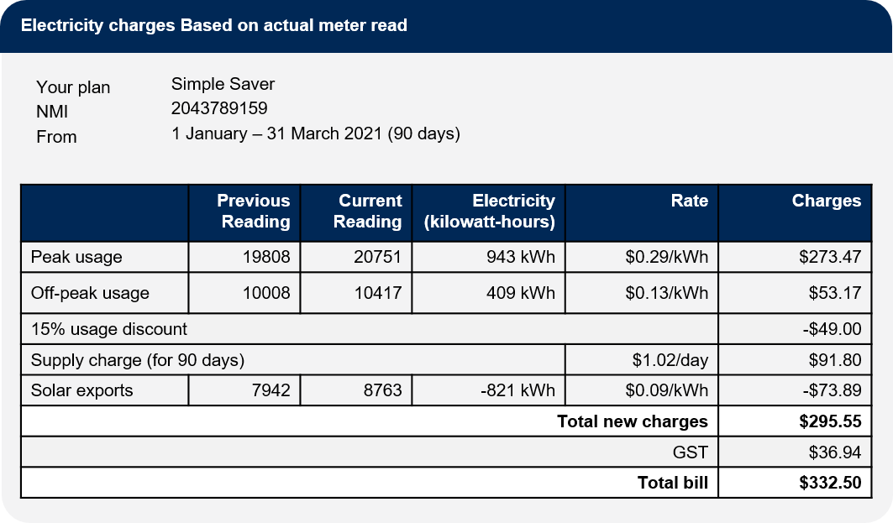
Control (C) = Detailed charges table only

Slide 61
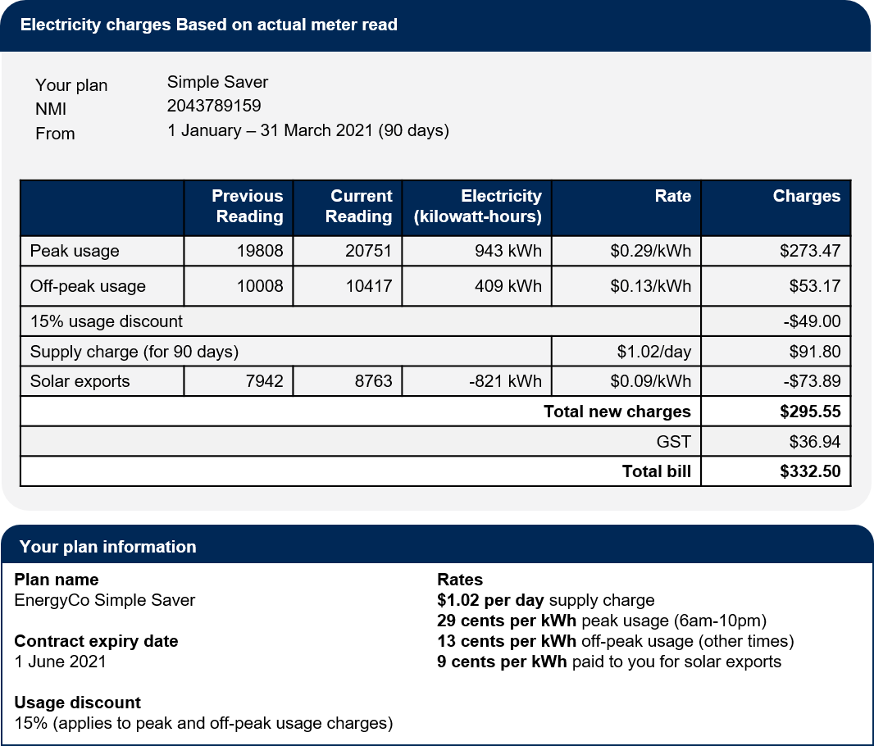
Treatment 1 (T1) = Detailed charges table + Plan summary

Slide 62
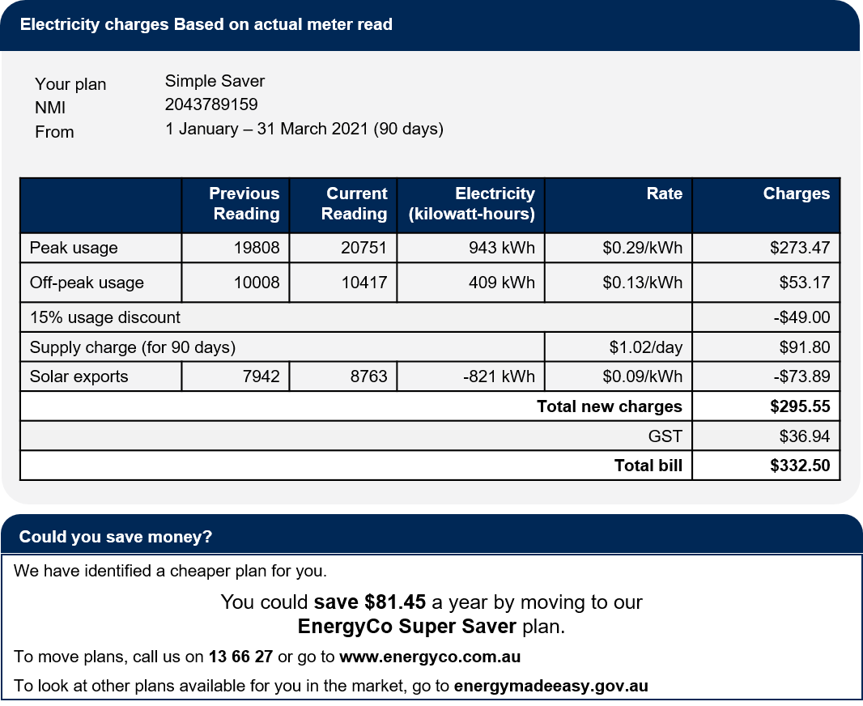
Treatment 2 (T2) = Detailed charges table + Could you save money?

Slide 63
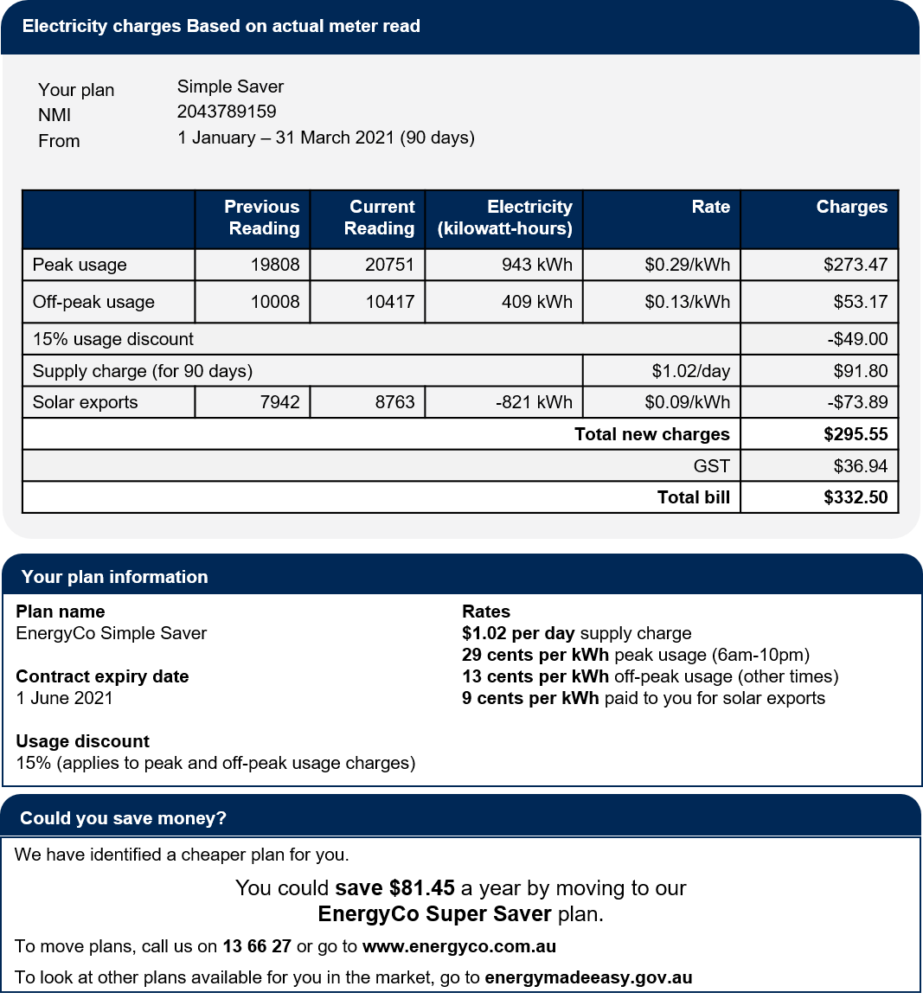
Treatment 3 (T3) = Detailed charges table + Plan summary + Could you save money?

Slide 64
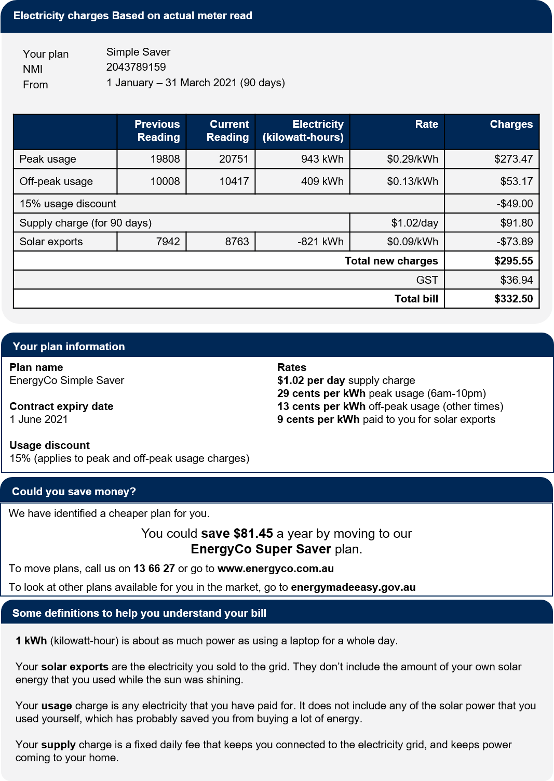
Treatment 4 (T4) = Detailed charges table + Plan summary + Could you save money? + Definitions

Slide 65
Group B: Trial 2 (Benchmarks)
This was a five arm trial with the following groups:
Control (C) = usage chart only
Treatment 1 (T1) = usage chart + benchmark table
Treatment 2 (T2) = usage chart + benchmark vertical bar graph
Treatment 3 (T3) = usage chart + benchmark infographic
Treatment 4 (T4) = usage chart + benchmark simple infographic

Slide 66
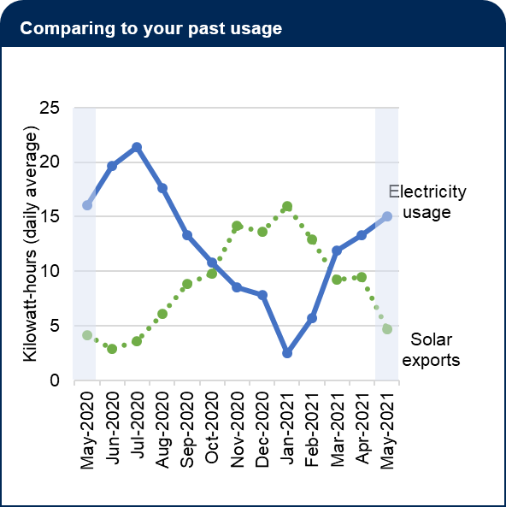
Control (C) = usage chart only

Slide 67
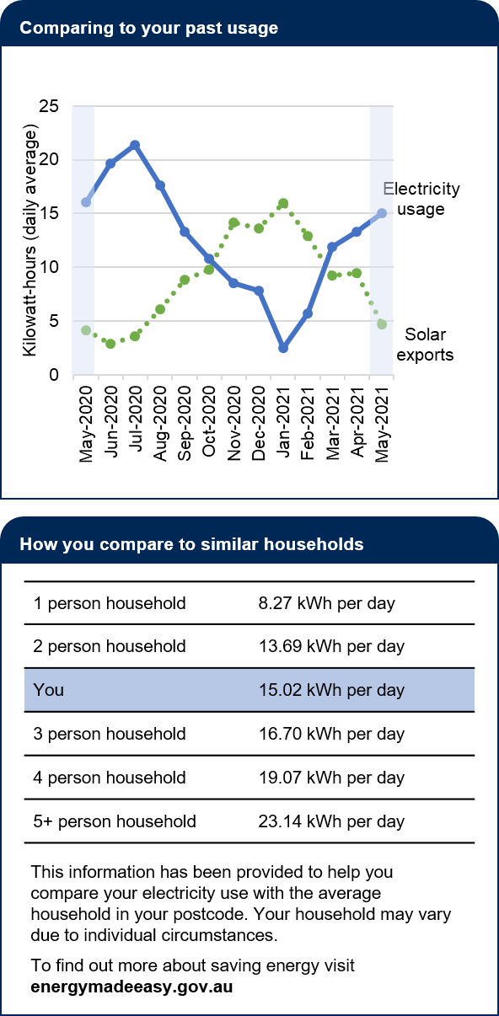
Treatment 1 (T1) = usage chart + benchmark table

Slide 68
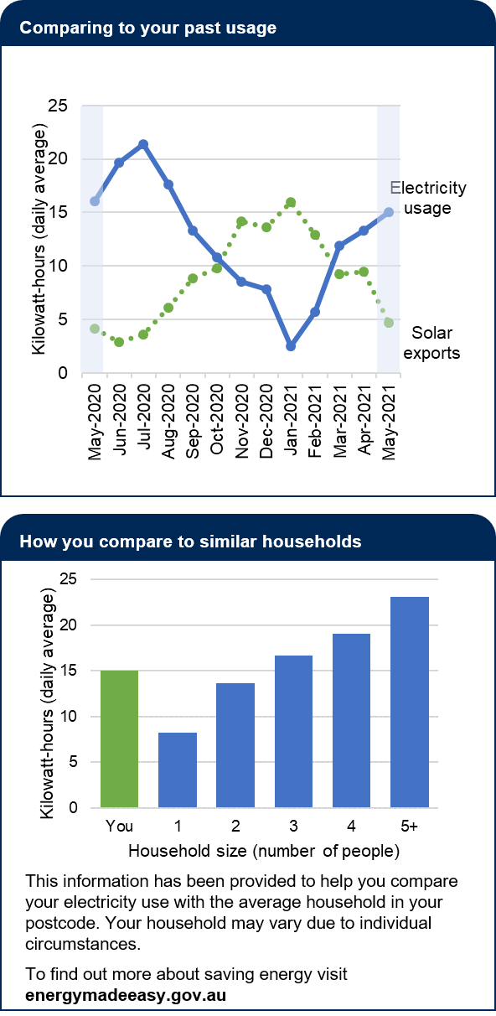
Treatment 2 (T2) = usage chart + benchmark vertical bar graph

Slide 69
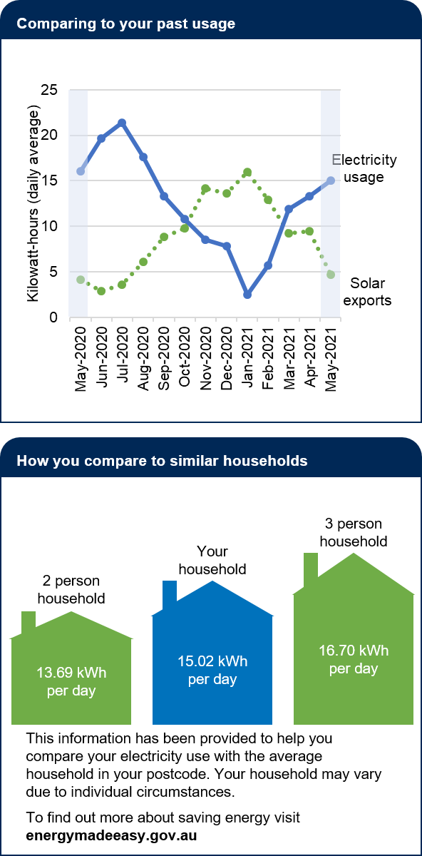
Treatment 3 (T3) = usage chart + benchmark infographic

Slide 70
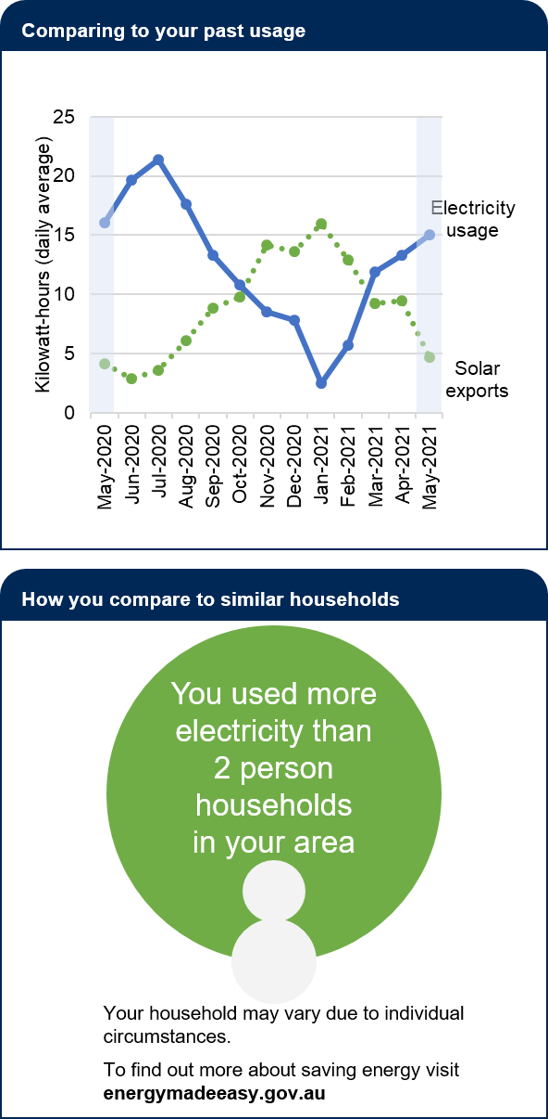
Treatment 4 (T4) = usage chart + benchmark simple infographic

Slide 71
Group B: Trial 3 (Energy consumption and generation charts and definitions)
This was a 5x2 factorial design trial. The first ‘level’ had 5 groups for the different usage and solar charts. The second ‘level’ had 2 groups for with/without definitions. This means respondents were divided into 10 groups as shown below.
 | B0 = Without definitions | B1 =With definitions
A0 = Complex consumption chart, solar generation table | A0B0 | A0B1
A1 = Simple consumption column chart, solar generation table | A1B0 | A1B1
A2 = Two column charts | A2B0 | A2B1
A3 = Combined bar chart | A3B0 | A3B1
A4 = Combined line chart | A4B0 | A4B1

Slide 72
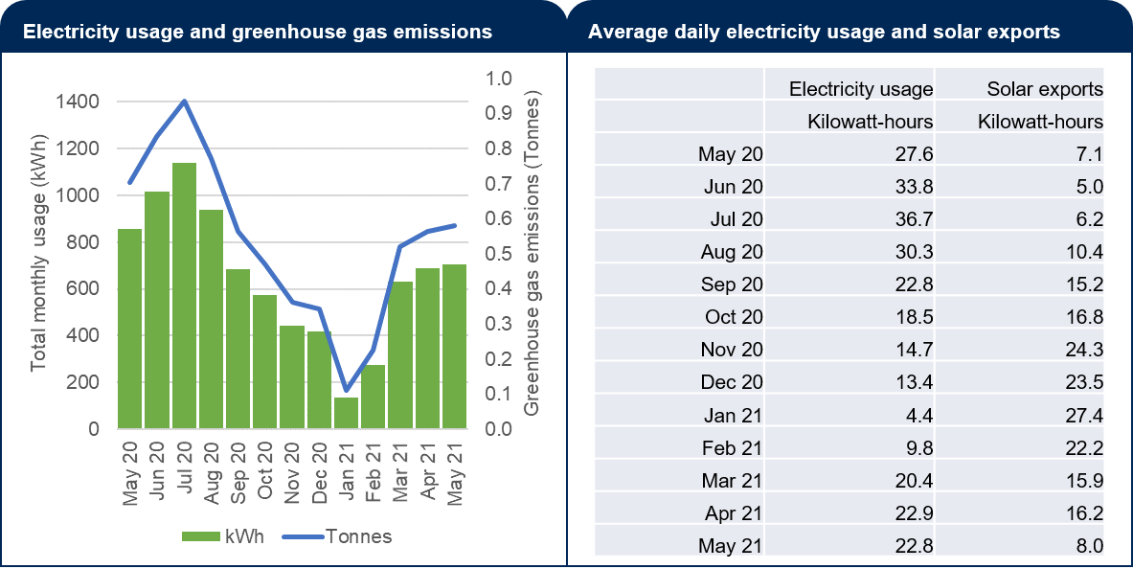
A0 = Complex consumption chart, solar generation table

Slide 73
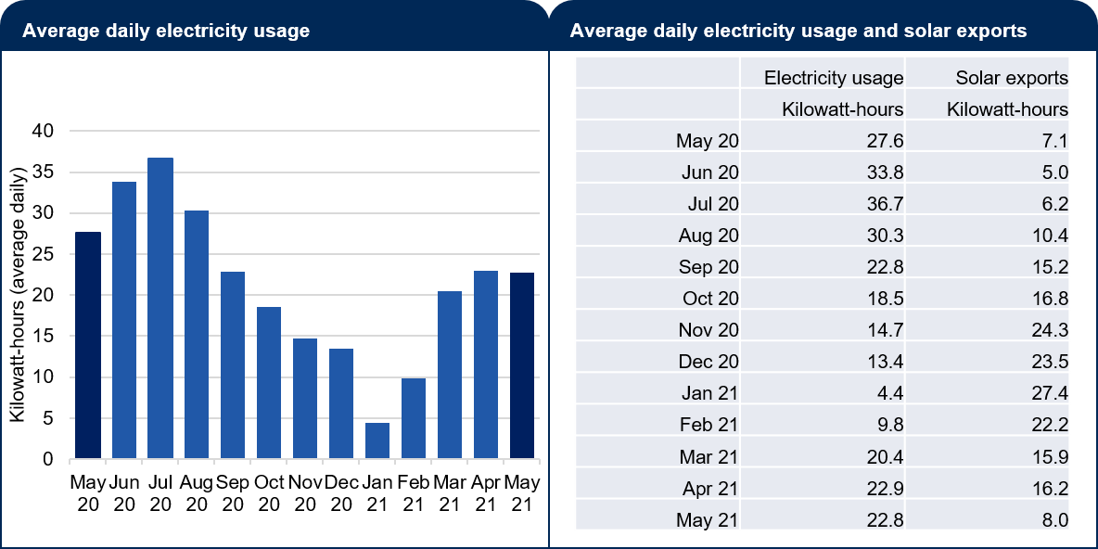
A1 = Simple consumption column chart, solar generation table

Slide 74
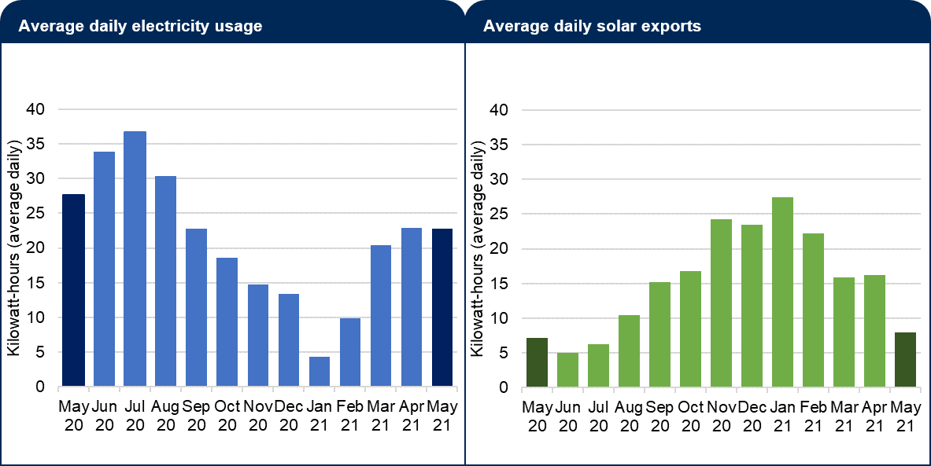
A2 = Two column charts

Slide 75
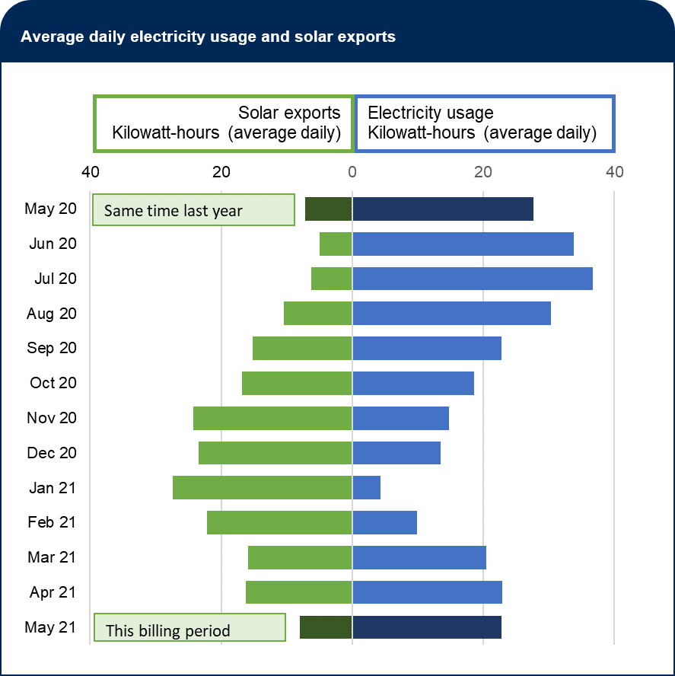
A3 = Combined bar chart

Slide 76
A4 = Combined line chart

Slide 77
B1 = With definitions (placed beneath A~)

